Slide 1
THE UNITED METHODIST CHURCH
BUDGET PROCESS

Slide 2
What Is The Budget Process?
The Budget process for a new quadrennium begins almost immediately after General Conference concludes.
A group called the Budget Advisory Team is assembled with representatives from GCFA, The Connectional Table and The General Secretaries Table, guiding the overall budget process and developing the principles upon which the budget will be formed.
The Budget Advisory Team develops principals to guide the budget
01

Slide 3
What Is The Budget Process?
GCFA’s Economic Advisory Committee (EAC), comprised of economists, clergy, and laity, projects the local church expenditures, one of two factors in the apportionment formula. (When General Conference occurs, only the first year of net expenditures for the formula are known. The other 3 years are projections established by the economic modeling of this committee.)
The Budget Advisory Team develops principals to guide the budget
Economic Advisory Committee recommends net expenditure projections
02

Slide 4
What Is The Budget Process?
The Apportionment Sustainability Taskforce (Taskforce), comprised of one clergy and one laity from each Jurisdiction, are tasked with assessing the current viability of the Base Percentage Rate (P).
The Budget Advisory Team develops principals to guide the budget
Economic Advisory Committee recommends net expenditure projections
Apportionment Sustainability Taskforce recommends a base percentage rate
03

Slide 5
What Is The Budget Process?
The EAC’s projections and the Taskforce’s recommendation on base percentage go before GCFA’s General Agency and Episcopal Matters Committee, who makes a recommendation on final numbers to the full GCFA Board.
The Budget Advisory Team develops principals to guide the budget
Economic Advisory Committee recommends net expenditure projections
Apportionment Sustainability Taskforce recommends a base percentage rate
GCFA’s General Agency and Episcopal Matters Committee makes recommendations to GCFA’s Board
04

Slide 6
What Is The Budget Process?
GCFA’s Board accepts or modifies GAEM’s recommendation. By combining the net expenditure projection and a base percentage rate, the calculation can then be figured for the total quadrennium apportionments.
The Budget Advisory Team develops principals to guide the budget
Economic Advisory Committee recommends net expenditure projections
Apportionment Sustainability Taskforce recommends a base percentage rate
GCFA’s General Agency and Episcopal Matters Committee makes recommendations to GCFA’s Board
GCFA’s Board modifies or ratifies as necessary
05

Slide 7
What Is The Budget Process?
Great! But how does money get to the agencies, Bishops, and others?
GAEM makes recommendations to the GCFA Board on allocations to the Episcopal Fund, the General Administration Fund, and any fixed charges to GCFA from other funds (to support the bookkeeping and administration of these funds), considering the principles and guidelines established by the Budget Advisory Team.
GAEM recommends funding allocations for Episcopal & General Admin Fund
GCFA’s Board modifies or ratifies

Slide 8
What Is The Budget Process?
What about the other five funds?
GCFA provides the estimated total amount available for distribution among World Service, MEF, Africa University, Black College, and Interdenominational Cooperation Fund (minus fixed charges) to The Connectional Table to make recommendations on allocations
GCFA provides estimated amount to Connectional Table

Slide 9
What Is The Budget Process?
The Connectional Table reviews program and missional priorities, special programs, and estimated amount available to program agencies.
The Connectional Table then makes recommendations on the allocation to and within these funds.
GCFA must agree to the proposed allocations.
GCFA provides estimated amount to Connectional Table
Connectional Table makes recommendations on allocations for MEF, BCF, AU, ICF, & World Service
GCFA and Connectional Table must agree on these allocations

Slide 10
What Is The Budget Process?
Phew. So that’s the process?
Not quite. This is only the first iteration of the quadrennial budget.
Prior to General Conference, GCFA updates its projections for local church net expenditures and reviews allocations and any recommended changes from the Connectional Table and the Budget Advisory Team. A revised budget is then submitted to General Conference.
GCFA updates projections
Connectional Table and Budget Advisory Team review
Revised budget is submitted to General Conference.

Slide 11
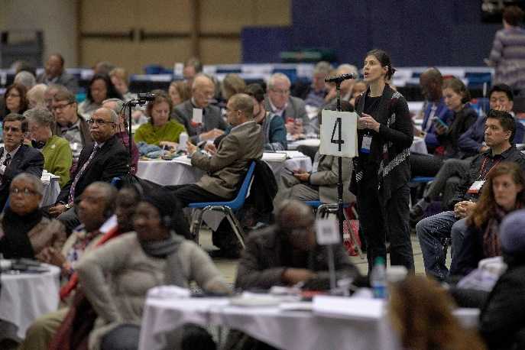
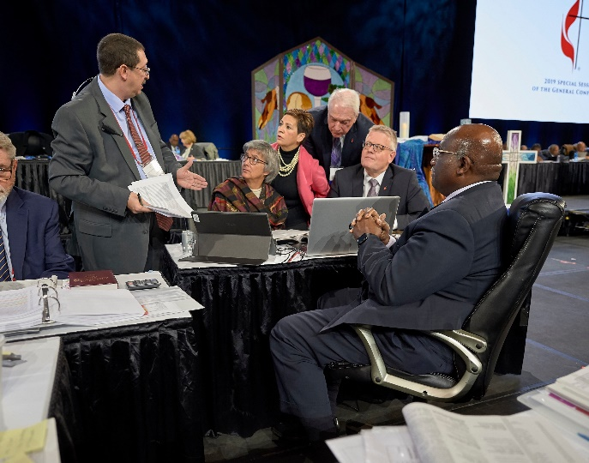
What Is The Budget Process?
At General Conference
At General Conference, budget petitions are brought before the Financial Administration Committee (Week One). This committee adopts or amends the budget and makes a recommendation to the plenary regarding the quadrennial budget.
Once the plenary starts (Week Two), GCFA and The Connectional Table meet to determine whether the proposed budget needs to be amended if any petition passes that has financial implications (outside of the budget).
Revisions to the budget reports are made as necessary and published in the DCA.
The final proposed reports come before General Conference on the last day for approval or amendment.
Yay! We have a final budget!
BUDGET PROCESS

Slide 12
More Reading
WANT TO LEARN MORE?
www.gcfa.org/reports
GCFA publishes a quarterly finance video to update the denomination on collections
Jurisdictional and Central Conference Collections
General Agency Finances & Audits
Financial Impact of Proposed Legislation
Apportionment Sustainability Report
Financial Commitment Booklet

Slide 13
THANK YOU!
CONTACT US
1908 Grand Ave
Nashville, TN 37212
615-329-2338
gcfa@gcfa.org
www.gcfa.org
THANK YOU

Slide 14
Understanding The Budget
Jurisdictional Conference Formula
UNDERSTANDING THE BUDGET
The budget, as passed by General Conference, is a formula of two major factors that goes into the apportionment formula, or the rate at which apportionments will be assessed. (A)
We start with the TOTAL budget for the UMC, which consists of the net expenditures of local churches. (E)
The second factor is the Base Percentage, which is the rate of apportionment. (P)

Slide 15
Understanding The Budget
Jurisdictional Conference Formula
UNDERSTANDING THE BUDGET
The formula is: A = E * P
A represents an annual conference’s general Church apportionment
E represents the annual conference’s “Net Expenditures”
P represents the Base Percentage
Note: There was previously an economic adjustment factor (i) that is being eliminated.

Slide 16
Understanding The Budget
Central Conference Formula
IMPORTANT THINGS TO NOTE
We don’t have net expenditures for local churches in the Central Conferences, so we use membership as a base.
Central Conference apportionments only go toward the Episcopal Fund and the General Administration Fund
More information can be found in the Financial Commitment Booklet.
UNDERSTANDING THE BUDGET

Slide 17
Understanding The Budget
Central Conference Formula
The formula is: A = (J * M) * i
A represents a central conference annual conference’s General Church Apportionment
J represents the Jurisdictional Apportionments per Professing Member (only for Episcopal & Gen Admin funds)
M represents the number of Professing Members in the Central Conference Annual Conference
I represents the central conference’s “Economic Adjustment Factor”
UNDERSTANDING THE BUDGET

Slide 18
Apportionments Paid
YTD October 2023
JURISDICTIONAL CONFERENCES
$68,607,419
CENTRAL CONFERENCES
$601,248
UNDERSTANDING THE BUDGET

Slide 19
How Is The Budget Funded?
Our dollars do more in a Connectional system than a congregational system.
A portion of all dollars given at the local church level go to fund mission and ministry at a general Church level. These are called “apportionments.”
Local churches pay their apportionments to their annual conferences, who in turn pay apportionments to the general church for the apportioned funds.
Members and those donating to their local UMC fund our general Church budget.
ABOUT THE BUDGET

