Slide 1
Information Security
Best Practices Training
Sharon Asmus
Jan 2024

Slide 2
Agenda
Internet Access
Electronic & Voice Communication
Data & Information Security
System Access & Passwords
Wired, Wireless, Remote Access
Removable Media
Mobile Devices
Personal Devices
Cloud Services
Security Awareness Training
We ALL must protect UMC from data loss due to misuse, disclosure, fraud or destruction

Slide 3
Internet Access
Ways to use your Internet access responsibly. The types of activities that are encouraged include:
Communicating within the context of responsibilities
Acquiring or sharing information necessary
Participating in educational or professional development activities
Treating all in accordance with human rights codes, organizational values, organizational policies, and social decorum.
Assuming everything on the Internet is copyrighted work.
Notes:
Users should not:
Staff members should not use the organization’s equipment with their personal accounts or to reach personal sites unless it is for legitimate business purposes.
Access sites that provide information relating to pornography, racism, gambling, criminal activities or any other unethical, illegal or unlawful purposes, including, but not limited to, copyright infringement, obscenity, libel, slander, fraud, defamation, plagiarism, harassment, intimidation, forgery, impersonation, illegal gambling, soliciting for illegal pyramid schemes, computer tampering (e.g. spreading computer viruses), terrorism, and illegal drugs.
Use the Internet in any way that violates policies, rules, or administrative orders.
Use anonymous Internet surfing software, open proxies, tunnels utilizing HTTP, peer-to-peer network tools or any other network service or software that is meant to intentionally evade access controls or monitoring.
Use Internet resources for personal (non-work related) reasons including video/audio streaming, file sharing, uploading/downloading of unreasonably large files, etc. org allows limited personal use for communication with family and friends, independent learning, and public service. Staff must act in accordance with their leader’s guidelines.

Slide 4
Electronic & Voice Communication
All org communication conducted via an approved email address
All voicemail accounts are protected with a PIN (don’t share)
All email accounts use multi-factor authentication
Know email addresses are easily spoofed.
Do not share personally identifiable information unless verified.
Use extreme caution when communicating confidential or sensitive information.
Demonstrate care when using the “Reply All”.
Treat email attachments or links that have been sent unsolicited with extreme caution.
Only use:
@holston.org
@arumc.org
@gbhem.org
Don’t use:
@hotmail.com
@gmail.com
Notes:
Do NOT communicate material that is harassing, embarrassing, sexually explicit, profane, threatening, obscene, intimidating, defamatory, offensive or otherwise unlawful or inappropriate.
Do NOT use tools and techniques to spoof, masquerade, or impersonate any identity or credentials.
Do NOT use an account assigned to another individual to either send or receive electronic or voice messages.
Do NOT use non-company accounts (e.g. Hotmail, Yahoo, Facebook, Skype, Dropbox, etc.) to conduct business.
Do NOT forward emails to accounts outside the control (e.g., personal server or email address).
Do NOT make unauthorized toll calls (e.g., long distance, 1-900 numbers).
Do NOT transfer confidential or sensitive information including personally identifiable information via unsecured method to any external account, this includes personal accounts employees. Any need to share this kind of information should be performed using only approved company procedures.
Do NOT transfer payment card information via unsecured methods like email, text or IM. Instead, only use authorized payment applications.
All electronic communication, telephones, telephony equipment and messages contained within email and voicemail are the property of RHP. RHP has the right to monitor all communication passing through its systems. This monitoring may include, but is not limited to review by the legal team, observation by management in cases of suspected abuse, and/or to monitor employee efficiency. RHP may also require that electronic and voice communication be retained for reasons such as litigation or government investigation. When litigation or investigations occur, the RHP Legal Department will notify the appropriate departments, divisions, or individuals and direct the appropriate retention requirements.

Slide 5
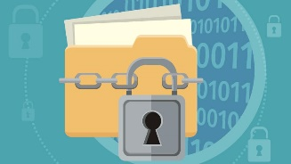
Data & Info Security
Data is typically comprised of four classifications of information:
Public/Unclassified
generally available to anyone within or outside of the organization
Private
info. kept within the org, can’t be distributed outside of the org.
Confidential
potentially damaging if released (e.g., HR or payroll data, SSN)
Secret/Restricted
harmful to UMC if leaked (e.g., legal documents, financial reports)
Confidential or Secret/Restricted classifications should be encrypted while in transit and at rest and should not be stored outside of any authorized system.
Notes:
It is the responsibility of everyone who works at RHP to protect our data. Even unintentional abuse of classified data will be considered punishable in accordance with the extent and frequency of the abuse.

Slide 6
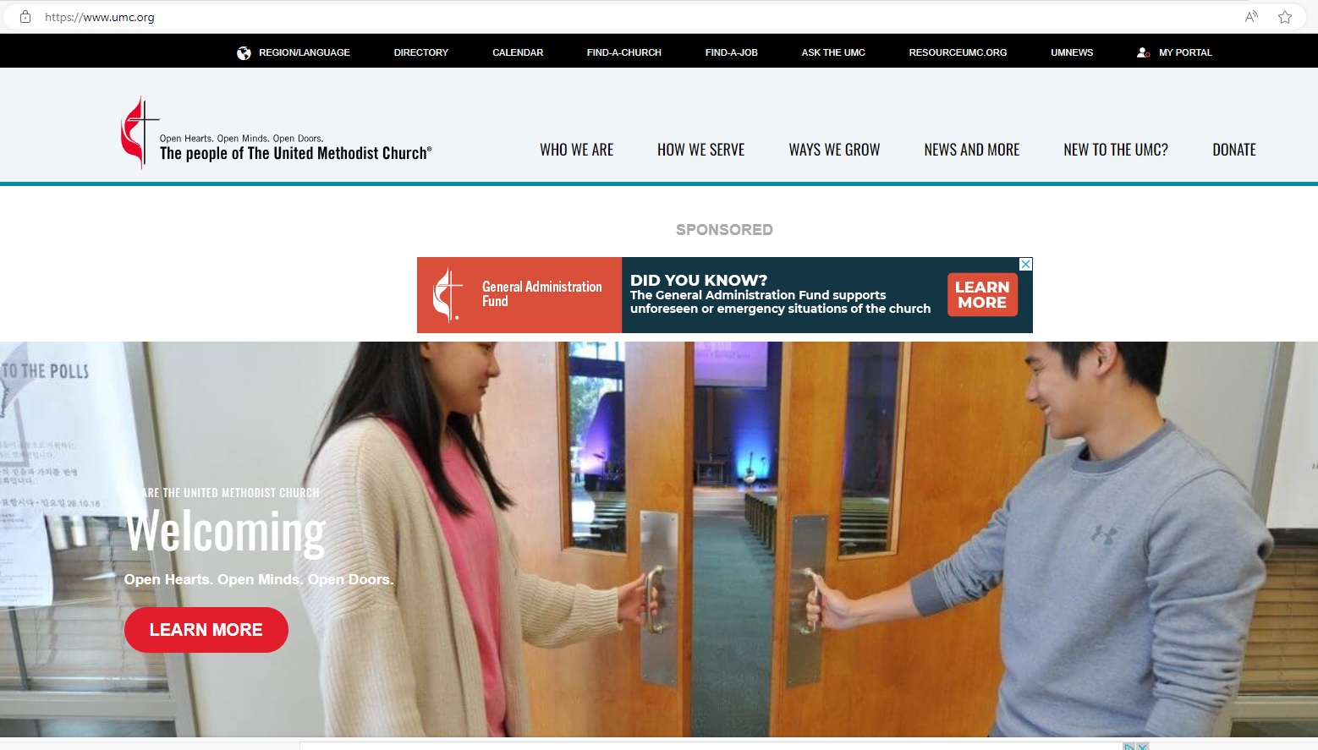
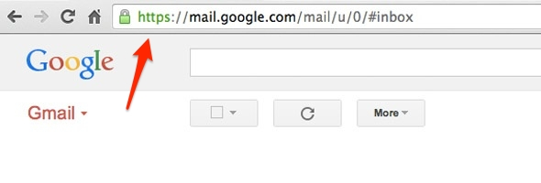
Data & Info - Encryption
What is Encryption? https://www.youtube.com/watch?v=ySP-dvcOgas
Notes:
Data that falls under Confidential or Secret/Restricted classifications must be encrypted with minimum 128-bit cryptography while in transit and at rest and should not be stored outside of any authorized system. This includes data stored on corporate systems and mobile computing devices, including personal devices used to access corporate systems.
https://blog.vrypan.net/2013/08/28/public-key-cryptography-for-non-geeks/

Slide 7
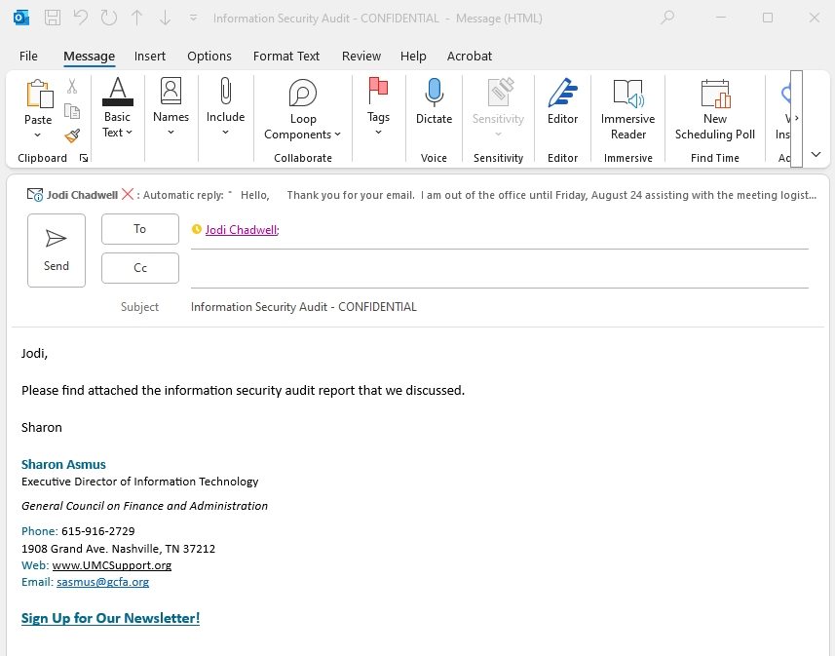
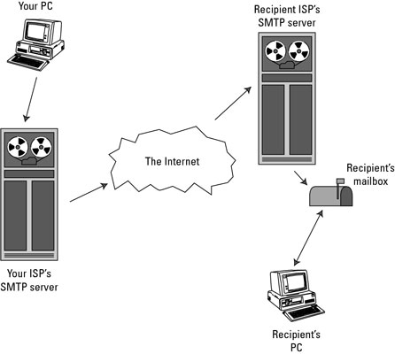
Data & Info – Email
NOT all email is secure.
Least secure email providers:
Yahoo Mail
AOL Mail
Gmail
Outlook
Apple Mail
Notes:
https://technet.microsoft.com/en-us/library/dn569286.aspx
Office 365 Message Encryption is an easy-to-use service that lets email users send encrypted messages to people inside or outside their organization. Designated recipients can easily view their encrypted messages and return encrypted replies. Regardless of the destination email service—whether it’s Outlook.com, Yahoo, Gmail, or another service—email users can send confidential business communications with an added level of protection against unauthorized access.
There are many scenarios in which email message encryption might be required, including the following:
A bank employee sending financial statements to customers
An insurance company representative providing policy details to customers
A mortgage broker requesting financial information from a customer for a loan application
A health care provider sending health care information to patients
An attorney sending confidential information to a customer or another attorney
A consultant sending a contract to a customer
Exchange Online and Exchange Online Protection (EOP) administrators set up Office 365 Message Encryption by defining encryption rules. As an administrator, you can also customize encrypted messages with your own text and logo, presenting a company brand that’s familiar to message recipients.

Slide 8
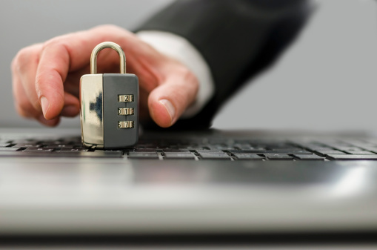
Data & Info – File Storage
Name | Encryption At Rest
Local Drives (C) | ?
Microsoft OneDrive | √
DropBox | √
Google Drive | √
iCloud | √
iCloud KeyChain | √
√
256-bit AES (Advanced Encryption Standard)= uncrackable
Tips & Tricks:
Enable two-step verification or multi-factor authentication
Double-check file sharing settings (are all folders public?)
Ensure timely user access controls (e.g., new hire access, promotions, terminations).
Notes:
DropBox: https://www.dropbox.com/en/help/27
http://www.alphr.com/dropbox/1000326/how-secure-are-dropbox-microsoft-onedrive-google-drive-and-apple-icloud
Box: https://community.box.com/t5/Account-Information/Is-My-Data-Encrypted/ta-p/32

Slide 9
System Access & Passwords
All access to information systems is granted/revoked TIMELY on a prescribed basis via a formal procedure.
Restrict access to least privilege
Protect the confidentiality of account and password information.
Reset your password immediately if you have reason to believe that any unauthorized person has learned your password.
Use Multi-factor authentication.
Keep desk and work area free of sensitive information.
Notes:
Do NOT provide records to those who do not have access to the system or are not authorized.
Anyone using their prescribed access to gain unauthorized access to areas of the RHP network, other information systems or data not explicitly granted to them, will be subject to disciplinary action not limited to termination or breach of contract.
Any changes to system or information access designed to create, expand, remove or change the access requires approval through the User Access Request process.
Users may not share account or password information with another person.
Accounts are to be used only by the assigned user of the account for authorized purposes.
Attempting to obtain another user’s account password is strictly prohibited.
Users are required to protect their usage against loss, damage, or theft and against possible misuse by others.
Where passwords are used, users will be able to select and change their own password by using a minimum of 8 characters (number, upper and lower case letters and special characters). The only exceptions to this are where the security controls on older computers are not available or system configuration passwords are not tied to a particular user.
Authorized system users must not leave account information or other clues that could aid another person to gain access to the system or impersonate the credentials of the authorized user. Objects and information must be secured in a manner commensurate with their value.
Where appropriate, computer media must be stored in a suitable locked cabinet when not in use, especially outside working hours
Paper media containing sensitive or critical business information must be locked away when not in use or securely destroyed once deemed obsolete
Sensitive or business critical information, when printed, faxed, scanned, or received must be cleared from printers and other machines immediately
Personal computers, computer terminals, and printers must not be left logged on when unattended and must be protected by a system lock screensaver function requiring a password to reinitiate a session
Any sensitive information must be securely destroyed. Third-party media destruction services may be utilized to ensure it’s performed in compliance with all pertinent RHP policies and standards.

Slide 10
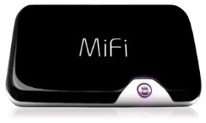
Wired/Wireless
Private / Secured Networks
Wired (Blue Wire)
Authenticate via certificate (GCFA)
Authenticate via password – WPA2 (Admin)
Private Home Network
Use WPA2
Use a strong password for your encryption key, such as a combination of letters and numbers of 14 characters or more. Change the default network name and password on your router
Hot Spot
Enable strong encryption on your hotspot: WPA2 w/password
Public / Unsecured Networks
Public Wi-Fi is inherently insecure – so be cautious.
Treat all Wi-Fi links with suspicion - Don’t connect to an unknown or unrecognized wireless access point
Consider using your cell phone instead of public Wi-Fi
Recommendations:
Protect your device against cyberattacks - anti-malware, updates, patches
Turn off sharing – Control Panel>Network and Internet>Network and Sharing Center – Change Advanced Sharing Settings
Enable a firewall – Windows Firewall for non-UMC Support devices
Use a VPN (virtual private network) - Creates a ‘private tunnel’ that encrypts all your data
Notes:
It takes zero hacking skills to monitor and/or hijack communications over a public Wi-Fi network. Widely available freeware makes eavesdropping on emails and web browsing as simple as pressing a button.
Peer-to-peer network: http://www.pcmag.com/encyclopedia/term/49056/peer-to-peer-network
Public: http://www.cnet.com/how-to/tips-to-stay-safe-on-public-wi-fi/
http://lifehacker.com/5576927/how-to-stay-safe-on-public-wi-fi-networks
http://www.forbes.com/sites/amadoudiallo/2014/03/04/hackers-love-public-wi-fi-but-you-can-make-it-safe/

Slide 11
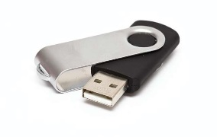
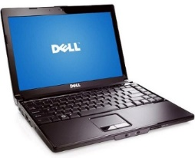
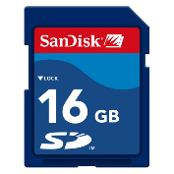
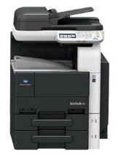
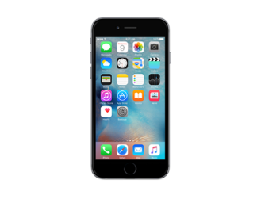
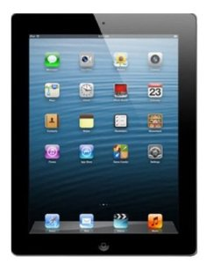
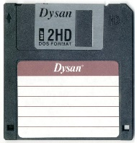
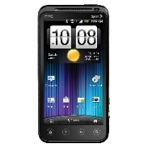
Removable Media
Laptops - Must Configure Disk Encryption
iPhone / iPad – Disk Encryption by default with iOSv8 & a passcode
Android 5.0+ Lollipop - Full Disk Encryption
USB Stick, SD Cards – Encrypt (Use Bitlocker)
Multi-Function Printers
Disks - Secure/Locked Location
Keep Safe from Theft/Loss
Erase / Wipe Prior to Disposal
Notes:
Consideration for Bluetooth, MFPs
iPhone & iPad Encryption - http://www.zdnet.com/article/how-to-turn-on-iphone-ipad-encryption-in-one-minute/
Android - http://www.androidcentral.com/how-does-android-lollipops-encryption-affect-me
Before you encrypt your device, prepare as follows:
Set a lock screen PIN, pattern, or password.
Plug your device into the charger.
Schedule an hour or more for the encryption process. If you interrupt the process, you will lose some or all of your data.
http://www.greenbot.com/article/2145380/why-and-how-to-encrypt-your-android-device.html
http://arstechnica.com/gadgets/2015/10/android-6-0-re-implements-mandatory-device-encryption-for-new-devices/
http://arstechnica.com/gadgets/2015/08/phone-and-laptop-encryption-guide-protect-your-stuff-and-yourself/
Hot Spot - http://netsecurity.about.com/od/secureyourwifinetwork/a/How-To-Secure-Your-Portable-Wifi-Hotspot.htm
USB Stick - https://technet.microsoft.com/en-us/magazine/ff404223.aspx

Slide 12
Personal Devices
Personal PCs (Desktop / Laptop):
Customize privacy/security settings for encryption
Add personal firewall & antivirus software
Keep updates & patches current for OS / Apps
Use VPN w/strong encryption
Use Multi-factor authentication
Use HTTPs when possible
Personal Mobile Phones/Tablets:
Customize privacy/security settings for encryption
Disable ad hoc connections / Bluetooth
Disallow auto connections to wireless networks
Keep updates & patches current for OS / Apps
Use Multi-factor authentication when possible
Use HTTPs when possible
The use of any member or HR-related identifiable information on staff-owned equipment is highly discouraged.

Slide 13
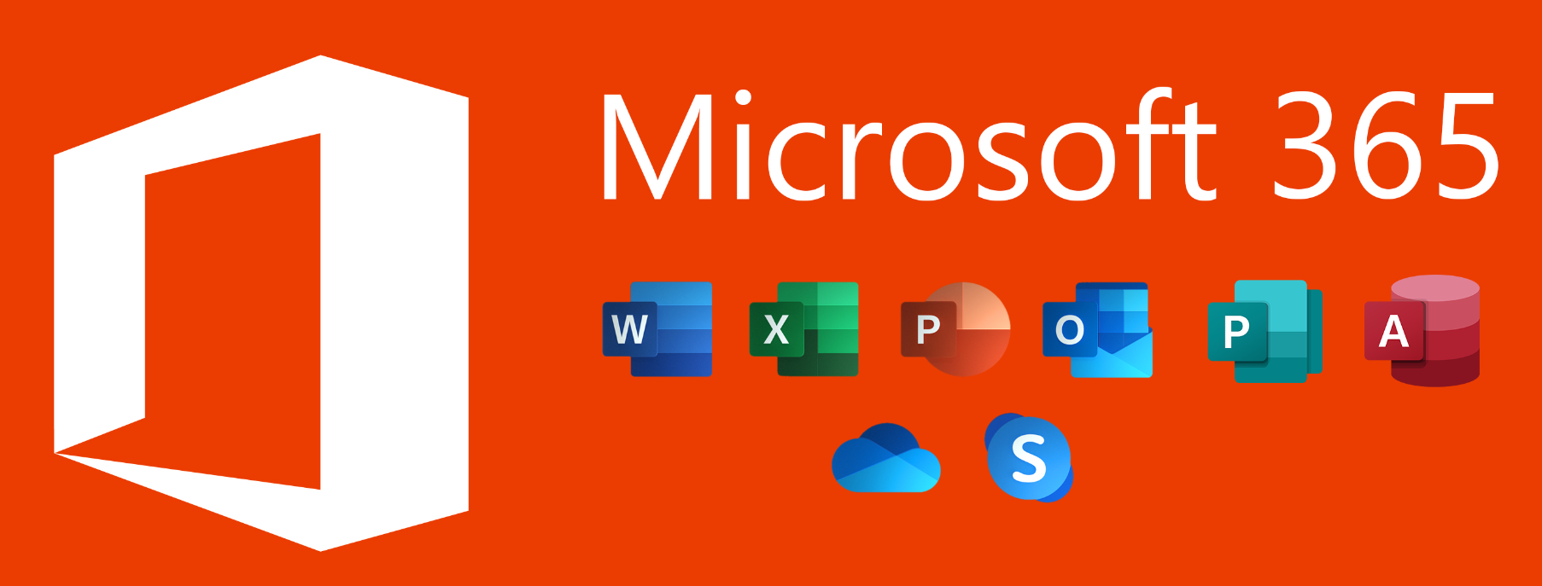
Cloud Services & 3rd Parties
Verify security policies, procedures & standards
Ensure data is encrypted in transit & at rest
Add data breach terms to contracts
Use organization-issued username
Use multi-factor authentication

Slide 14
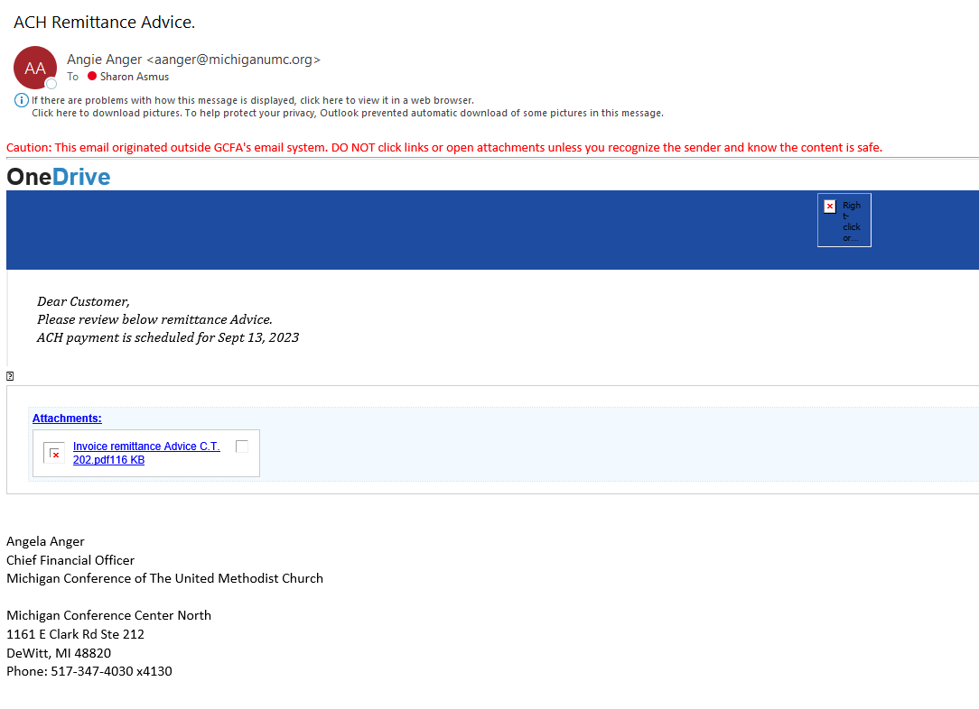
Why Security Awareness?
Did you know that 91% of successful data breaches started with a spear phishing attack?
What is spear phishing?
Sophisticated impersonation via email or text
Impersonation from legitimate contacts who have had their accounts hacked.
How hacked?
The example phishing email to the left came from a known UMC conference employee including the legitimate email address, signature and conference address.
Notes:
Phishing is the most common tactic employed by hackers, as it requires the least amount of effort and generally preys on the less cyber-aware. In fact, the FBI estimates that more than $1.75 billion was lost to business email scams like phishing in 2022. It's also the most common way for organizations to be exposed to ransomware. We’ve outlined a few different types of phishing attacks to watch out for:
Phishing: In this type of attack, hackers impersonate a real company to obtain your login credentials. You may receive an e-mail asking you to verify your account details with a link that takes you to an imposter login screen that delivers your information directly to the attackers.
Spear Phishing: Spear phishing is a more sophisticated phishing attack that includes customized information that makes the attacker seem like a legitimate source. They may use your name and phone number and refer to your organization’s name in the e-mail to trick you into thinking they have a connection to you, making you more likely to click a link or attachment that they provide.
Whaling: Whaling is a popular ploy aimed at getting you to transfer money or send sensitive information to an attacker via email by impersonating a real company executive. Using a fake domain that appears like ours, they look like normal emails from a high-level official of the company, typically the CEO or CFO, and ask you for sensitive information (including usernames and passwords).
Shared Document Phishing: You may receive an e-mail that appears to come from file-sharing sites like Dropbox or Google Drive alerting you that a document has been shared with you. The link provided in these e-mails will take you to a fake login page that mimics the real login page and will steal your account credentials.

Slide 15
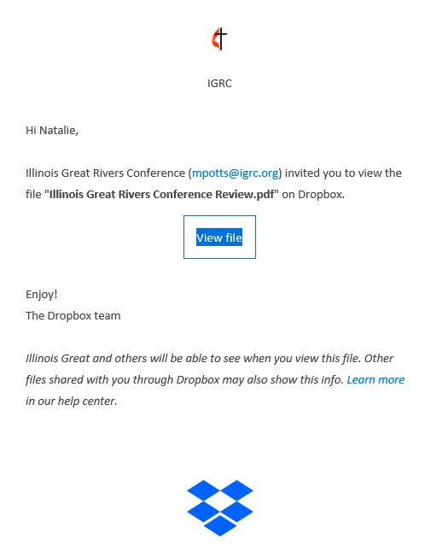
A Couple More Examples
Expecting this file?
Copycat email domain?
office@rebekahsimonpeter.com
office@rebekasimonpeter.com
Notes:
Phishing is the most common tactic employed by hackers, as it requires the least amount of effort and generally preys on the less cyber-aware. In fact, the FBI estimates that more than $1.75 billion was lost to business email scams like phishing in 2022. It's also the most common way for organizations to be exposed to ransomware. We’ve outlined a few different types of phishing attacks to watch out for:
Phishing: In this type of attack, hackers impersonate a real company to obtain your login credentials. You may receive an e-mail asking you to verify your account details with a link that takes you to an imposter login screen that delivers your information directly to the attackers.
Spear Phishing: Spear phishing is a more sophisticated phishing attack that includes customized information that makes the attacker seem like a legitimate source. They may use your name and phone number and refer to your organization’s name in the e-mail to trick you into thinking they have a connection to you, making you more likely to click a link or attachment that they provide.
Whaling: Whaling is a popular ploy aimed at getting you to transfer money or send sensitive information to an attacker via email by impersonating a real company executive. Using a fake domain that appears like ours, they look like normal emails from a high-level official of the company, typically the CEO or CFO, and ask you for sensitive information (including usernames and passwords).
Shared Document Phishing: You may receive an e-mail that appears to come from file-sharing sites like Dropbox or Google Drive alerting you that a document has been shared with you. The link provided in these e-mails will take you to a fake login page that mimics the real login page and will steal your account credentials.

Slide 16
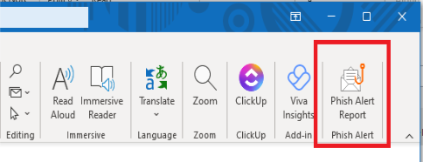
Free Resources
Phishing Alert Button
PC
Mac
Note: The Phish Alert Button supports Outlook 2010, 2013, 2016 & Outlook for Microsoft 365, Exchange 2013 & 2016, Chrome 54 and later (Linux, OS X and Windows) and Outlook Mobile!
Notes:
KnowBe4 Phish Alert Report Button
Purpose
The "Phish Alert Report" button is a feature in Outlook for Windows and MacOS that will help users immediately report phishing emails to Information Security.
By reporting phishing emails, proper steps can be taken to block senders as well as remove the malicious messages from the inboxes of other affected employees. We encourage all teams to use the “Phish Alert Report” button to efficiently communicate phishing attempts.
Steps
Go to your inbox.
Click ONCE on the suspicious email.
Click the "Phish Alert Report" button in the home tab.
Next, click "Yes" in the pop-up window that asks if you would like to report the phishing email.
Finally, click "OK" in the next pop-up window thanking you for reporting the phishing email.

Slide 17
Free Resources
GCFA.org Website Treasurers Resources - Forms | GCFA
Digging Deep: An Actionable IT Assessment Tool (gcfa.org)
7 STEPS TO MINIMIZE EXPOSURE OF YOUR MINISTRY’S SENSITIVE DIGITAL ASSETS (gcfa.org)
Cyber Security Awareness Month - October
Free Cybersecurity Tools | KnowBe4
Notes:
Training should be conducted with those who have an organizational email, domain/network access account or those who process, transmit and/or store sensitive data. This includes all employees, (full time or part time), contractors, consultants, partners, interns, or other third parties.
Training should be administered to all new-hires or role changes
Completion of regular computer-based training
Mock anti-spear phishing and social engineering tests and follow-up training as deemed necessary by the organization.
Upon completion of each security awareness training module, all computer users will be required to complete and pass a test.
Upon hire and annually, provide specialized training for individual job roles that manage high risk and sensitive information (e.g., credit card data, personally identifiable information (PII, PHI), etc.).
Upon hire and annually, provide specialized training for any employees that have administrator system access or hold other positions with significant and relevant information and/or application security operations responsibilities.
E-mail and Internet Security – What you can do?
To avoid these phishing schemes, please observe the following email best practices:
Do not click on links or attachments from senders that you do not recognize. Be especially wary of .zip or other compressed or executable file types.
Do not provide sensitive personal information (like usernames and passwords) over email.
Watch for email senders that use suspicious or misleading domain names.
Inspect URLs carefully to make sure they’re legitimate and not imposter sites.
Do not try to open any shared document that you’re not expecting to receive.
If you can’t tell if an email is legitimate or not, please contact IT.

Slide 18
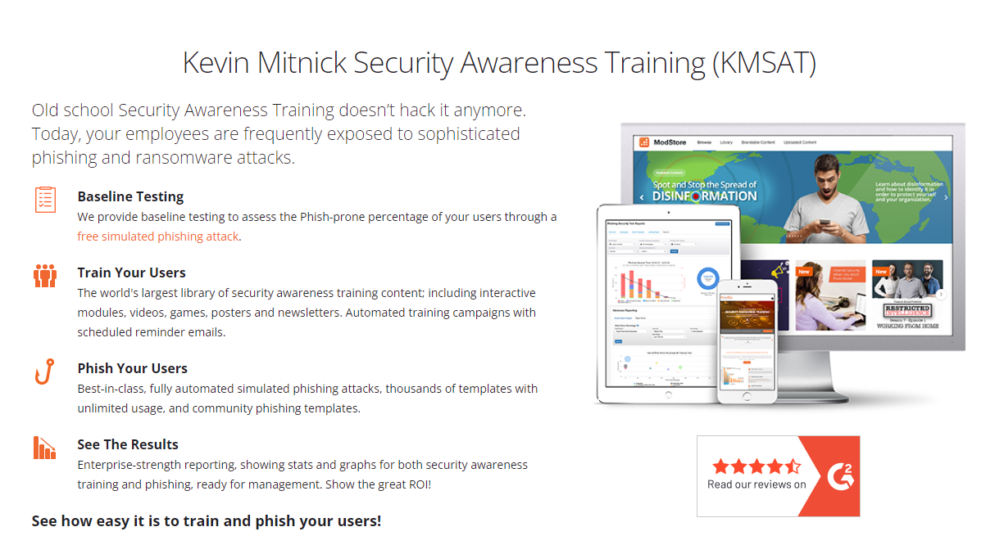
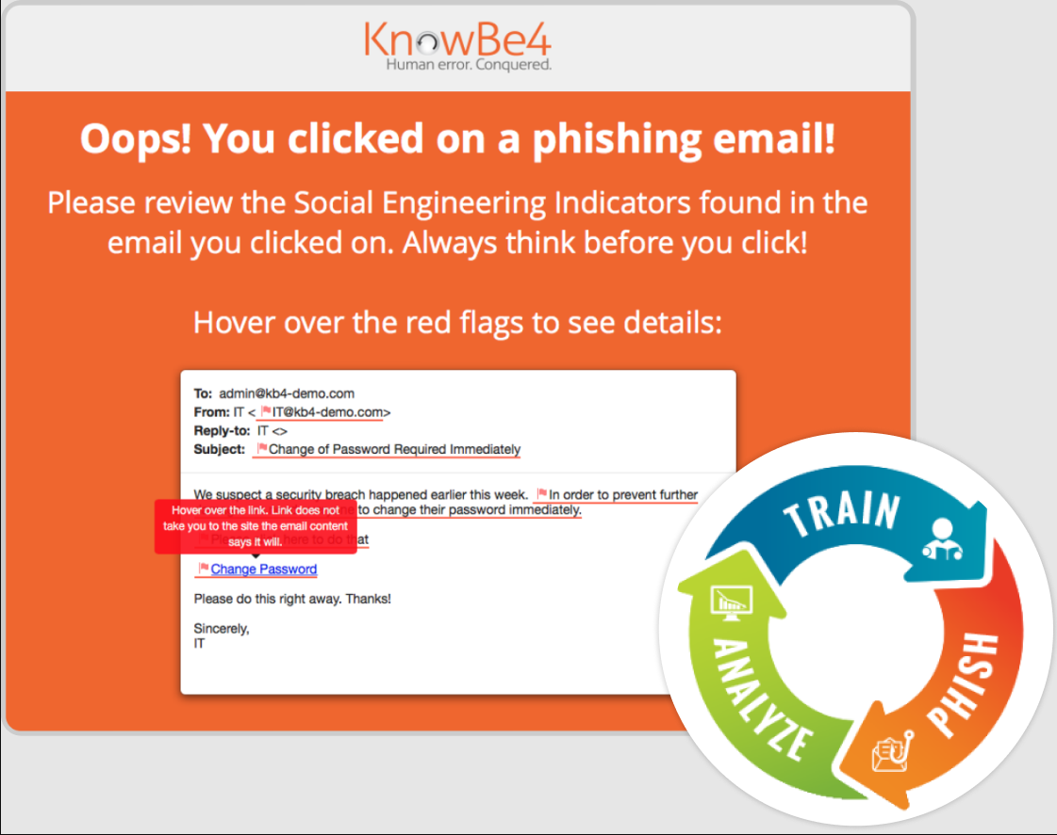
Resources
Training Campaigns
Simulation
Notes:
KnowBe4 Phish Alert Report Button
Purpose
The "Phish Alert Report" button is a feature in Outlook for Windows and MacOS that will help users immediately report phishing emails to Information Security.
By reporting phishing emails, proper steps can be taken to block senders as well as remove the malicious messages from the inboxes of other affected employees. We encourage all teams to use the “Phish Alert Report” button to efficiently communicate phishing attempts.
Steps
Go to your inbox.
Click ONCE on the suspicious email.
Click the "Phish Alert Report" button in the home tab.
Next, click "Yes" in the pop-up window that asks if you would like to report the phishing email.
Finally, click "OK" in the next pop-up window thanking you for reporting the phishing email.

Slide 19
Summary
Protect equipment
Protect areas
Protect passwords
Protect files
Back up data
Report security violations
Notes:
• Protect equipment. Keep it in a secure environment and keep food and drink from electronic systems. Know where the fire suppression equipment is located and how to use it in an emergency.
• Protect areas. Keep unauthorized people away from equipment and data. Challenge strangers in the area
• Protect passwords. Never write it down or give it to anyone. Don't use names, numbers or dates that are personally identified with the staff member. Change the password often and change it immediately if it has been compromised.
• Protect files. Don't allow unauthorized access to staff member's files and data. Never leave equipment unattended with the password activated - log off.
• Backing up data. Keep duplicates of critical data in a safe place.
• Report security violations. Staff members should tell their supervisor or GCF A management if they see any unauthorized changes to staff member's data. Immediately report any loss of data or programs, whether automated or hard copy.

Slide 20
1908 Grand Ave
Nashville, TN 37212
615-916-2729
sasmus@gcfa.org
UMC Church IT Support Services | General Council on Finance and Administration (gcfa.org)

Slide 21
Our Ministry
Provide the technology and support functions of an IT department so organizations within the Church can focus on their core ministry.
Leverage economies of scale to pass on volume discounts to organizations in the connection.
Combine specific knowledge of the United Methodist Church structure along with enterprise level technical expertise to provide relevant products and services.

Slide 22
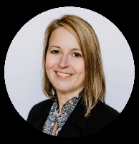
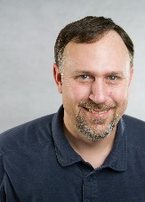
UMC IT Support Leadership Team
 | Sharon Asmus, Executive Director of IT We welcomed Sharon to the IT team last week. She comes to GCFA most recently from ACCSCIENT Digital based in Texas where she served as a Partner in Data & Analytics. She was directly responsible for business development & marketing, advisory services, and the portfolio lifecycle with ACCSCIENT Digital . She has also served professionally at CoreCivic, LBMC, and Ryman Hospitality Properties in Director and CIO positions. Sharon is located in Tennessee and enjoys hiking and spending time with her two daughters.
 | Josh Wallin, IT Operations Manager Josh joined GCFA in October of 2022. He resides Idaho and has 15 years of IT management experience supporting domestic and international teams. Josh and his team at GCFA support our customers’ IT projects, onboarding, and infrastructure needs, such as your managed servers and networks. When not leading his team and supporting our IT customers, Josh enjoys spending time outdoors and all things sports.
 | Andy Singh, Help Desk Manager Andy joined the team in January 2023. Residing in Florida, he comes to GCFA with 13 years of IT management experience. Most recently he worked with Universal Health Services in Fort Lauderdale where he supported several remote medical facilities in and around the south Florida area. When not at work and leading the Help Desk team, Andy enjoys travelling to different countries, spending time with his family and working on classic cars.
 | Adam Fahey, Great Plains Support Adam is not a new name to many of our IT Support customers. He has been with GCFA since 2012. Before officially joining GCFA, Adam worked as a GP consultant with Tribridge serving GCFA. He and his team support our ERP systems and integrations such as Microsoft Great Plains, Donor Direct, and Jet Reports. When not working, Adam enjoys walking his dog (Buddy), watching sports, and hiking/camping.

Slide 23
Our Support & Consulting Team
Support Center
Service Desk Analysts
Network Engineer
Systems Engineer
Implementations Engineer
Consulting
Financial ERP
Report Designer and Data Analyst
Telephony
Security & Compliance
Remote Service Desk, Maintenance & Project Consulting Services

Slide 24
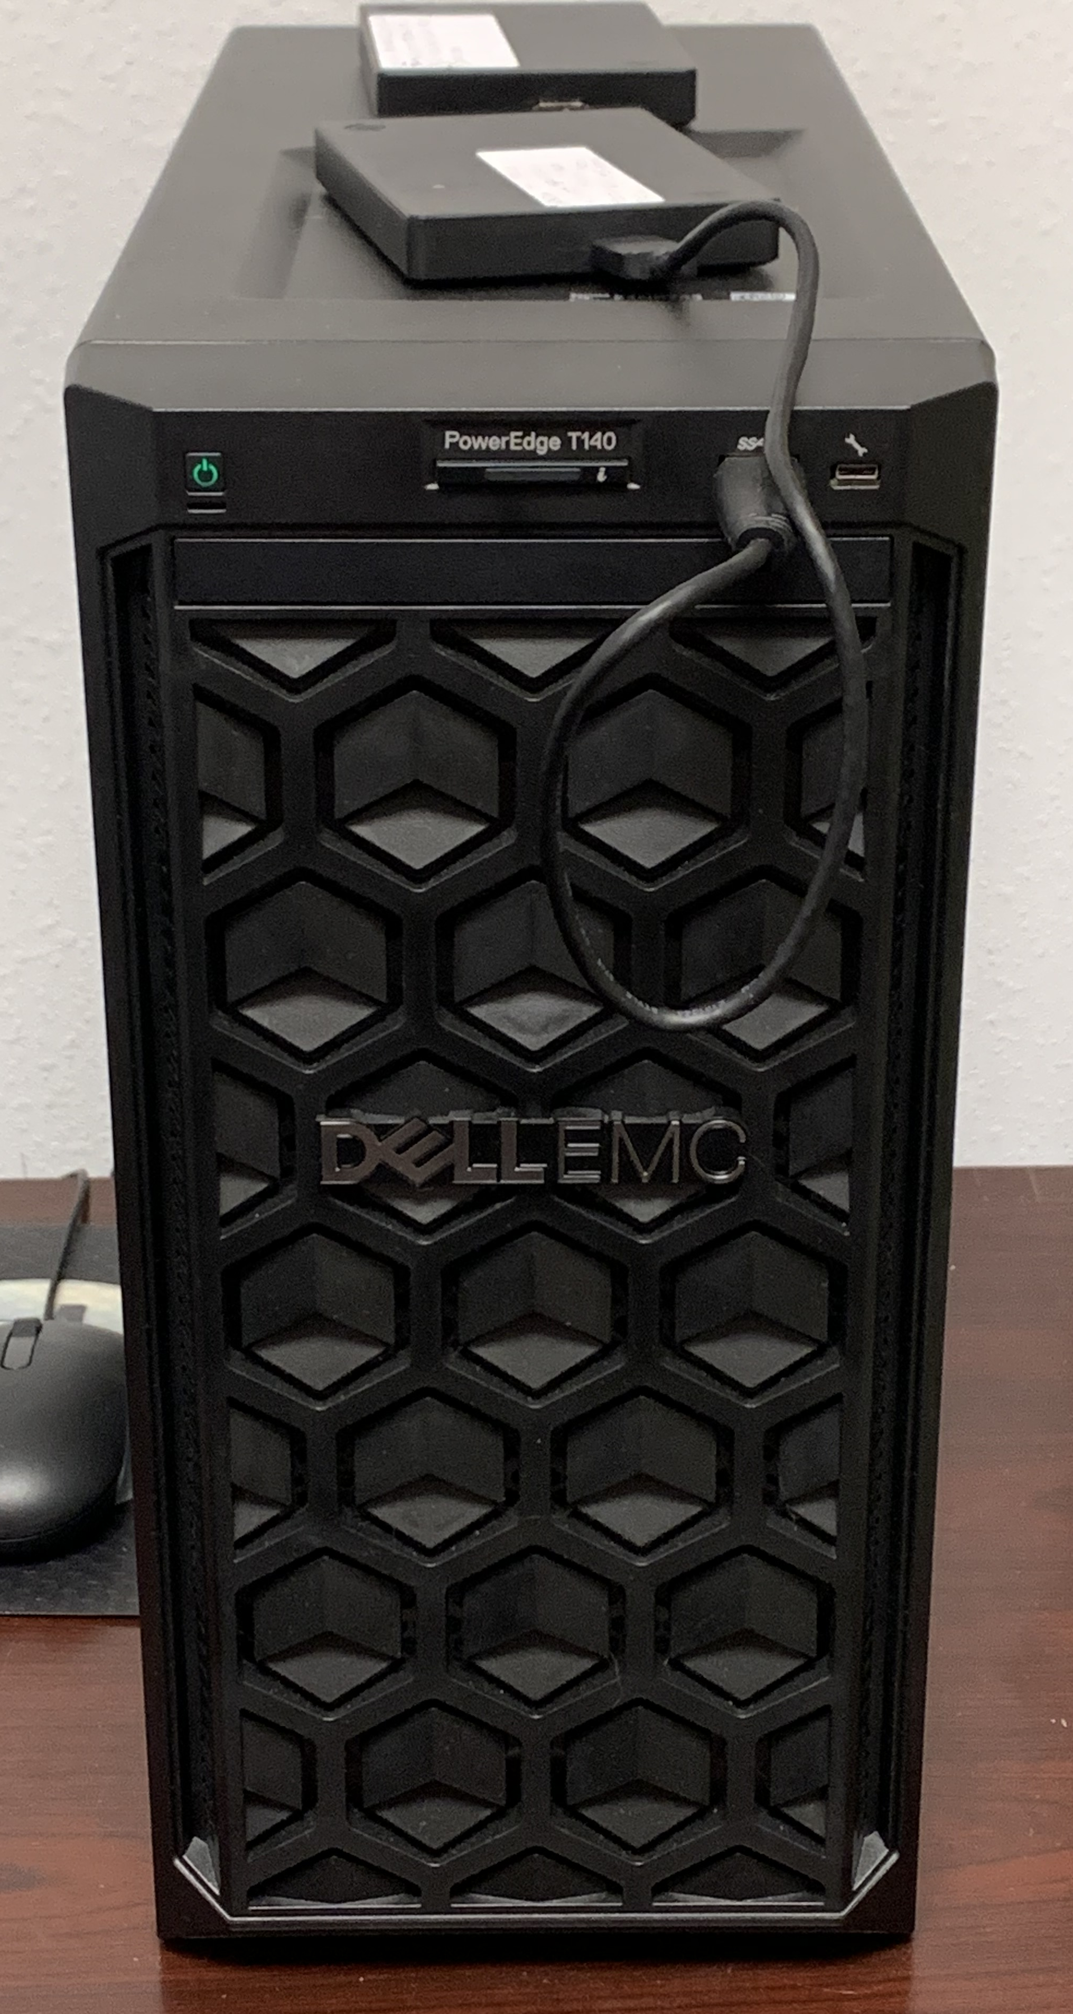
UCM Support - Technology Services
Managed Services
Hosted Server
Managed Workstation / Server
Advanced Device Monitoring
Move from in-house, dated server equipment to modern and secure infrastructure.
Monitored Anti-Virus Software, Automated Microsoft Windows Update Management, Third-Party Software Update Management, Automated Configuration Management, Remote Support Tools
Monitor uptime, nightly backup of configurations, notification options to alert appropriate technical resources for response, annual review.
Notes:
Server CPU:
One or more server instance(s) deployed on GCFA hosted cloud environment, one segregated subnet, Windows Server OS licensing, and VPN client access. Support of the operating system and applications installed on the hosted environment is not included in this service. Except where provided by other SOW’s, Client will have full responsibility for configuration of the server operating system and applications Client runs on the server including any licensing and related security to those systems.

Slide 25
UCM Support - Technology Services
Security & Compliance
Advanced Email Filtering
Workstation Intrusion Protection
Advanced DNS Filtering
Backup and Recovery
Workstation, Server, Email/Cloud Files
Security Awareness Training
Protect your people from advanced email attacks and identity-based threats.
Email Authentication Protocol (DMARC)
Provides intrusion protection from internet threats including blocking malicious domains, IP addresses, and cloud applications before a connection is ever established.
DNS (phone book of the Internet) security filter to monitor and block malicious connections.
You now have a way to better manage the urgent IT security problems of social engineering, spear phishing and ransomware attacks with training and simulated phishing tests.
Protect a domain from being used in business email compromise attacks, phishing email, email scams and other cyber threat activities. Required w/Google
Notes:
Reference: What is DNS Security? - Cisco Umbrella

Slide 26
UCM Support - Technology Services
Hardware & Software Sales
Adobe Acrobat Pro / Creative Cloud
Microsoft Office 365
Great Plains
Donor Direct
Integration
Endpoint Devices (e.g., laptops, desktops, handhelds)
Collective buying power with centralized purchasing, Pro = $10.55/month/user; Creative Cloud $29.46/month/user
GCFA will pass through all costs for Microsoft 365 software that Client selects through Client’s Microsoft Office account billed to GCFA.
Hosted finance and accounting platform. Access to system experts.
Hosted CRM and donor management system. Access to system experts.
Secure two-way integration capabilities between systems and organizations.
Connective buying power via resellers Dell and Ingram Micro.

Slide 27
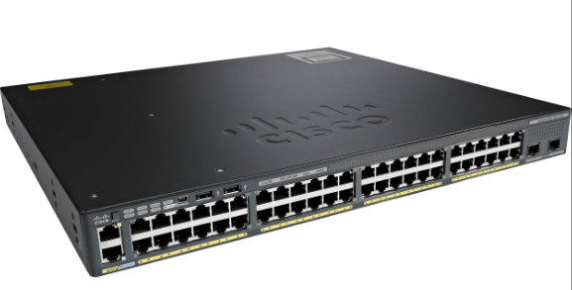
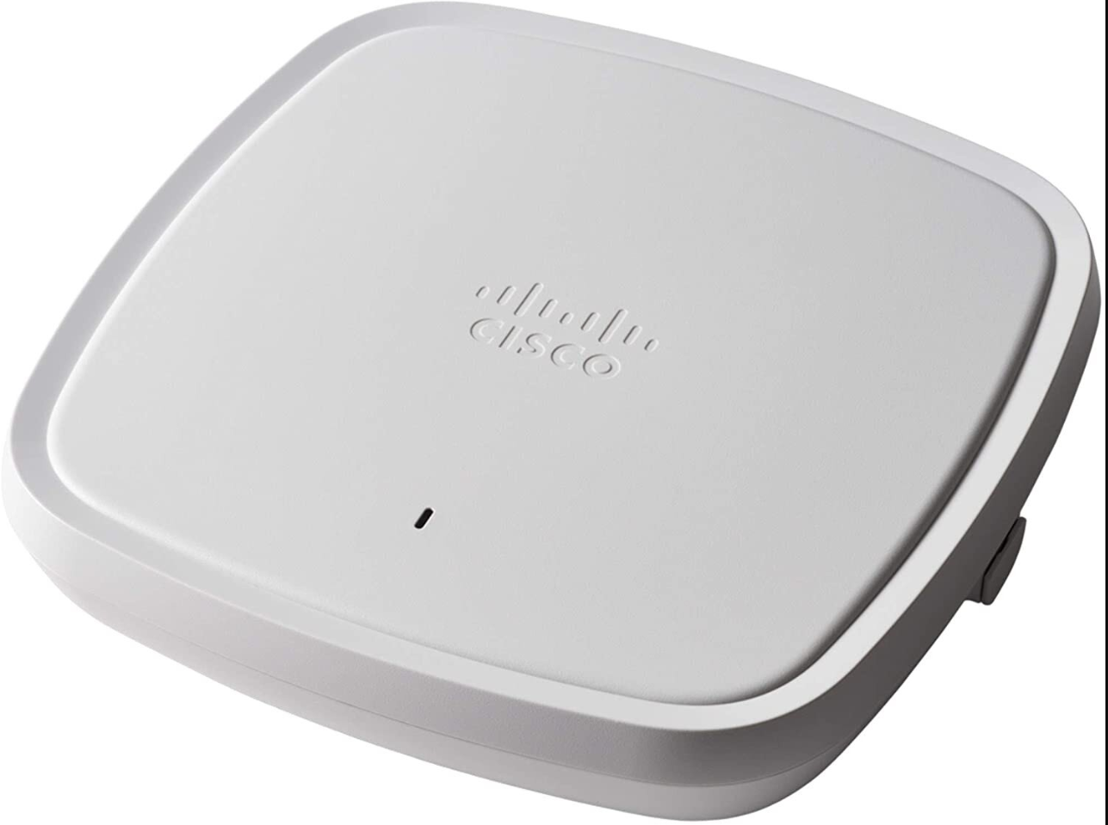
Project Support
Network Refresh
Update firewall, switch & wireless access points
Email & File Share Upgrade
Office 365 migration
SharePoint/OneDrive migration
Email spam filtering (Proofpoint)
Server Migration
Custom On-Prem ->
Hosted Shelby with GCFA
Workstation & Server Backups
Notes:
Users should not:
Staff members should not use the organization’s equipment with their personal accounts or to reach personal sites unless it is for legitimate business purposes.
Access sites that provide information relating to pornography, racism, gambling, criminal activities or any other unethical, illegal or unlawful purposes, including, but not limited to, copyright infringement, obscenity, libel, slander, fraud, defamation, plagiarism, harassment, intimidation, forgery, impersonation, illegal gambling, soliciting for illegal pyramid schemes, computer tampering (e.g. spreading computer viruses), terrorism, and illegal drugs.
Use the Internet in any way that violates RHP’s policies, rules, or administrative orders.
Use anonymous Internet surfing software, open proxies, tunnels utilizing HTTP, peer-to-peer network tools or any other network service or software that is meant to intentionally evade access controls or monitoring.
Use Internet resources for personal (non-work related) reasons including video/audio streaming, file sharing, uploading/downloading of unreasonably large files, etc. RHP allows limited personal use for communication with family and friends, independent learning, and public service. Staff must act in accordance with their leader’s guidelines.

Slide 28
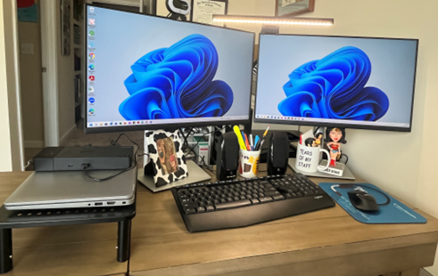
Equipment Refresh
PC Refresh
Dell Latitude 5540
Docking station
Monitor(s)
Refresh PC every 3 years
OS/Software
Enable patching
Get current with Windows 11

Slide 29
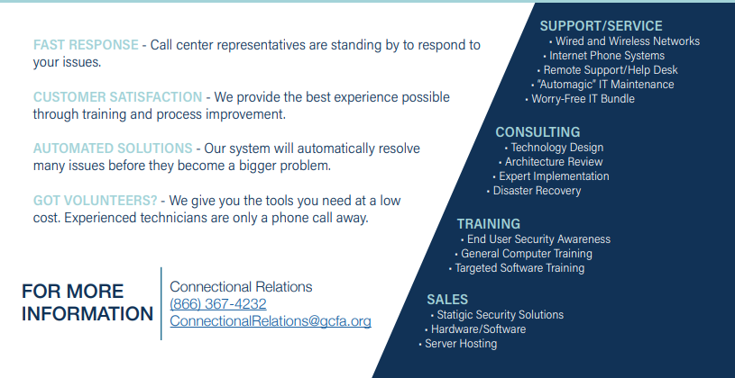
UMC Support Services
Technology Services Summary
UMC Church IT Support Services | General Council on Finance and Administration (gcfa.org)

