Slide 1
THE UNITED METHODIST CHURCH
New Treasurers Training

Slide 2
BRANDY BIVENS
Chief Communications Officer
bbivens@gcfa.org

Slide 3
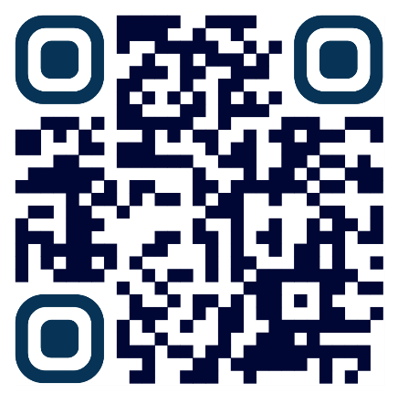
REPORTS
General Church Finance Summary
Apportionments
Episcopal Fund Reports
General Agency Finances
Jurisdictional Conference Data and Reports
General Church Budget
SUPPORT RESOURCES

Slide 4
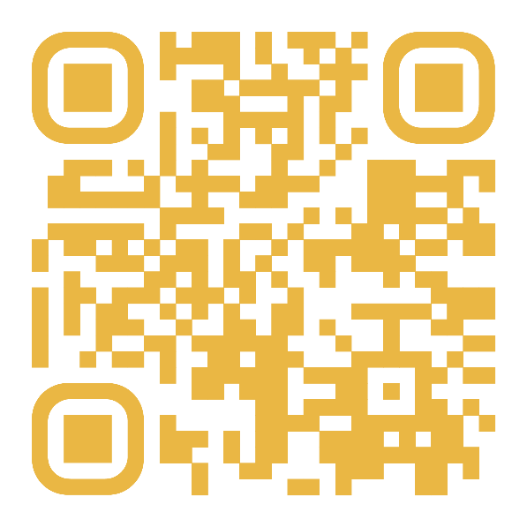
PUBLICATIONS
The Collaborator
Published the first full week of each month
Over 20,000 subscribers
31% Open Rate (10% higher than industry standard)
New Quarterly Update
Automatically Receive These
SUPPORT RESOURCES

Slide 5
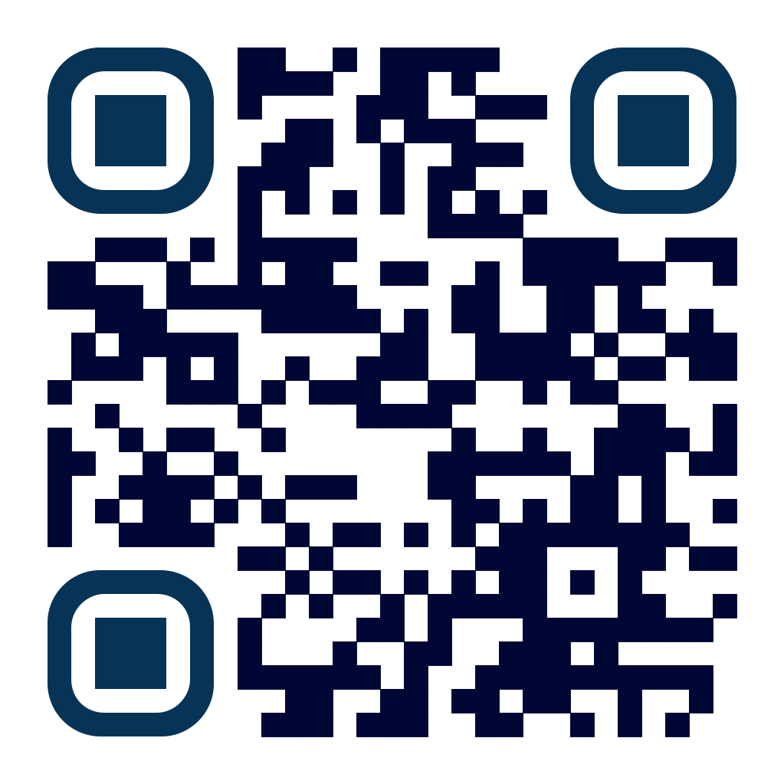
TREASURERS
RESOURCES
SUPPORT RESOURCES
NAACT Presentation Materials
Treasurer Training Materials
Legal Manual
Admin & Judicial Procedures Handbook

Slide 6
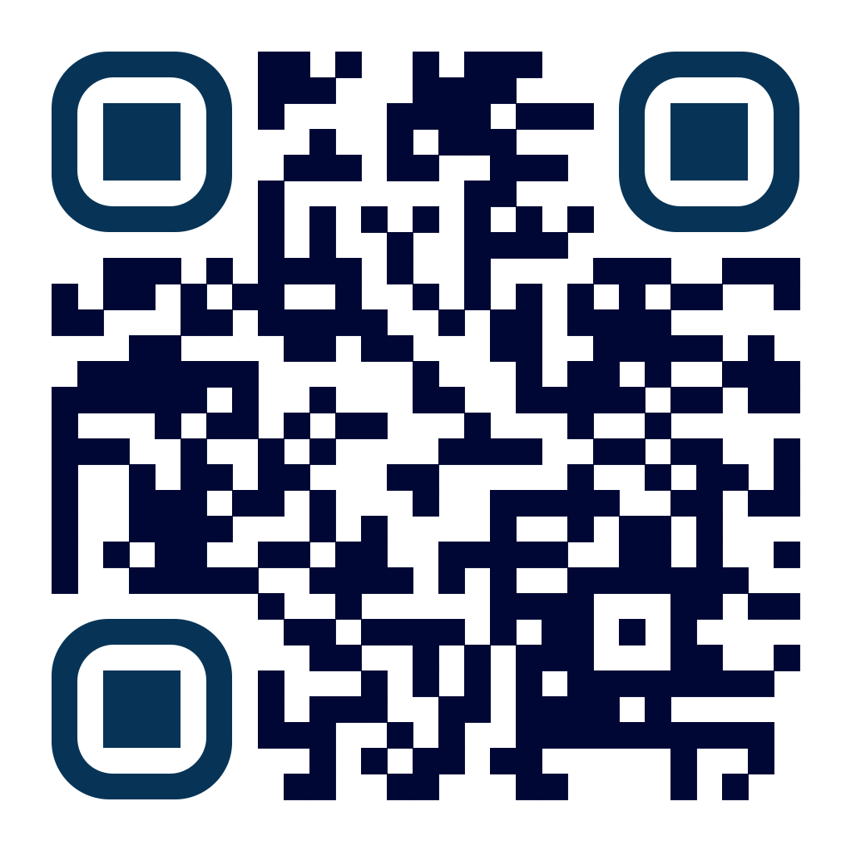
SERVICES
We currently offer more than 45 services to help provide support solutions for United Methodist-affiliated organizations. From developing a digital ministry home to assessing your organization's processes with a Human Relations assessment, UMC Support can help your ministry spend more time doing ministry.
Communications & Marketing
Data Services
Episcopal Services
Financial Services
Human Resources
Legal Services
Technology Services
Travel & Meeting Planning
SUPPORT RESOURCES

Slide 7
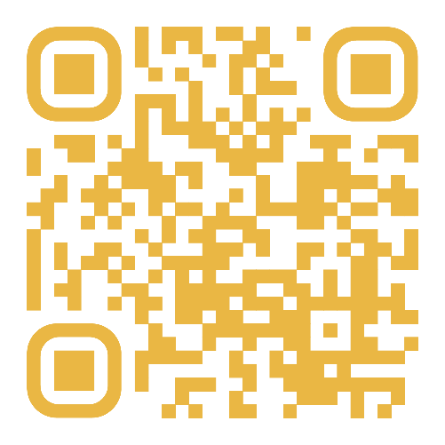
DATA-DRIVEN
DISCERNMENT
The Road To General Conference
Strengthening Episcopal Fund Video
Journey of a Dollar Video
Understanding the Budget Process
SUPPORT RESOURCES

Slide 8
THANK YOU!
CONTACT US
1908 Grand Ave
Nashville, TN 37212
615-329-2338
gcfa@gcfa.org
www.gcfa.org
THANK YOU

