Slide 1
Recruiting and Interviewing
Caitlin Congdon, Chief Officer of Human Resources
Tricia Baker, Executive Director of Human Resources

Slide 2
Recruiting Start to Finish
Job description development
Post the position
Review resumes
Conduct phone screens
Prepare interview questionnaire
Train selection committee on interviewing techniques
Facilitate interview process
Craft the offer letter, conduct background checks, and contact references
Tailor a custom onboarding orientation process
Although every effort has been made to provide a complete and compliant review and presentation, The General Council on Finance and Administration does not provide legal advice.

Slide 3
Job Descriptions
Job descriptions provide clearly written expectations about:
Why the job exists.
What the candidate is expected to accomplish.
What is required to be able to effectively perform in the position. This includes any physical requirements.
Having a written job description allows you to:
Quickly and concisely review essential requirements.
Identify whether candidates can perform the minimum requirements.
Protects against potential discrimination charges.
Although every effort has been made to provide a complete and compliant review and presentation, The General Council on Finance and Administration does not provide legal advice.

Slide 4
Job Descriptions
A written description for every position within the organization:
Provides a framework for job evaluation and salary comparison.
Forms the basis of classification and assignment within an organization’s pay structure.
Allows for promotional opportunity and career development within an organization.
Provides documentation from which an employee’s performance can measured.
Provides a foundation for consistency in communication and accountability for both employees and their managers.
Although every effort has been made to provide a complete and compliant review and presentation, The General Council on Finance and Administration does not provide legal advice.
Notes:
We firmly believe job descriptions are vital to an organization and suggest creating one for every position and updating them periodically and as needed. The North Georgia Conference should ensure when updating/developing ADA-compliant job descriptions that they reflect the exemption status, essential duties and responsibilities, reporting relationship, supervisory responsibilities, working conditions, education and experience requirements, and knowledge, skills, and abilities of the position.

Slide 5
Job Postings
When looking to fill a posting, your goal should be to have a diverse group of qualified candidates.
Utilize your job description to develop a job posting to attract talent.
Cast a wide net. Post the position in as many places as possible, both internally and externally.
Have one person that serves as the clearinghouse for all resumes and applications.
Keep both solicited and unsolicited resumes and applications for at least one year after the date of receipt.
Although every effort has been made to provide a complete and compliant review and presentation, The General Council on Finance and Administration does not provide legal advice.

Slide 6
Candidate Screenings
Determine interview process.
Who will review resumes and conduct phone screens?
How many in-person interviews will take place?
Review every resume and application that comes in.
Do they meet minimum job qualifications?
What skills, experience and credentials do they offer?
Review every application/resume that you receive.
If a cover letter is provided, make sure you review it.
Consider correct spelling, grammar and attention to detail.
Do not write notes on the application, resume or cover letter.
Although every effort has been made to provide a complete and compliant review and presentation, The General Council on Finance and Administration does not provide legal advice.

Slide 7
Candidate Screenings
Initial screenings should be conducted to gather basic information.
Does is seem like the applicant can perform the essential functions as laid out in the job description?
What is the applicant’s work history?
Do they have any red flags in their background?
If this person has never worked in a nonprofit environment before, have they had any volunteer activities or experiences that demonstrates the type of missional commitment you are seeking?
Although every effort has been made to provide a complete and compliant review and presentation, The General Council on Finance and Administration does not provide legal advice.

Slide 8
Phone Screenings
Phone screens are a great tool that allow you to focus your time on good quality applicants.
Ask the same questions of every candidate.
Ask questions that assess the candidate’s skills and experience.
Include questions that get at whether the candidate is a good fit for your workplace’s culture.
Have an objective rating system to rate candidate’s responses.
Try to record the candidates answer as closely as possible.
Although every effort has been made to provide a complete and compliant review and presentation, The General Council on Finance and Administration does not provide legal advice.
Notes:
A phone screen helps determine if the applicant’s qualifications, experience, workplace preferences and salary needs meet the needs of the position and organization
It is also a great way to save time by eliminating applicants that aren’t a match and let’s you focus on those applicants that you’d like to bring in to interview.

Slide 9
In-Person Interviews
Develop interview questionnaire ahead of time and distribute to interviewers.
Questions should be open-ended and based on the essential job functions.
Most questions should be situational-based.
These are questions that get at how the applicant would handle particular situations.
For example: Give me an example of a time when you handled conflict in the workplace.
Each candidate should be asked the same questions.
Although every effort has been made to provide a complete and compliant review and presentation, The General Council on Finance and Administration does not provide legal advice.

Slide 10
In-Person Interviews
Do not ask any questions that could be viewed as discriminatory.
Race, Ethnic Group, National Origin, etc.
Citizenship or country of birth.
Age.
Disabilities.
Children or marital status.
Applicant’s personal life.
Prior arrest records.
Although every effort has been made to provide a complete and compliant review and presentation, The General Council on Finance and Administration does not provide legal advice.
Notes:
Example: “Oh, that’s an interesting last name, is it *insert ethnic origin*?”

Slide 11
In-Person Interviews
Schedule time between interviews, about 15 minutes.
If using technology and conducting online interviews, always test your system ahead of time.
Keep interview notes for all applicants on file for at least 1 year.
Do not allow superficial impressions to influence your decision.
Having hiring standards that are not job related will make your interview invalid.
Although every effort has been made to provide a complete and compliant review and presentation, The General Council on Finance and Administration does not provide legal advice.

Slide 12
Conducting Interviews
Here are some helpful tips for when you to conduct an in-person interview.
Arrive on time.
Be Prepared. Have a copy of and be familiar with the application / resume. Make sure you review the job description as well.
Be welcoming. Create an environment where the applicant feels comfortable so they will talk to you.
Introduce yourself by name and title, and make sure you are correctly pronouncing the applicant’s name.
Although every effort has been made to provide a complete and compliant review and presentation, The General Council on Finance and Administration does not provide legal advice.
Notes:
Here are some helpful tips for when you to conduct an in-person interview.
First, As the Interviewer, make sure that you arrive on time. Being late can get send a bad message to your applicant.
Be Prepared
Have a copy of and be familiar with the application / resume. Many interviewers fail to review the candidate’s resume before going into the interview and the candidate can tell.
Make sure you review the job description beforehand as well.
Be welcoming: Begin the interview by greeting applicants with a smile and handshake. Tell them you are glad to see them and thank them for expressing interest in the position and organization. You want to establish an environment where the applicant feels comfortable so they will talk to you.
Introduce yourself by name and title, and make sure you are correctly pronouncing the applicant’s name

Slide 13
Conducting Interviews
Limit Interruptions: This includes phone calls and employees.
Listen to the applicant. Allow the applicant to fully respond before you ask the next question.
Allow silence. Allow the candidate time to formulate a thoughtful response to a question.
Redirect the conversation if an applicant gets off track during the interview.
Probe for more details.
Although every effort has been made to provide a complete and compliant review and presentation, The General Council on Finance and Administration does not provide legal advice.
Notes:
Limit Interruptions: This includes phone calls and interruptions from fellow employees.
Listen to the applicant. Focus on actively listening and do not dominate the conversation. Allow the applicant to fully respond before you ask the next question.
Allow silence. If you ask the candidate a question and they don’t immediately respond, don’t answer for them. Allow the candidate time to formulate a thoughtful response to a question.
Sometimes the interview can go in unexpected directions. Redirect the conversation if an applicant gets off track during the interview. And if a response doesn’t seem sufficient, probe for more details

Slide 14
Conducting Interviews
When the interview is coming to a close:
Ask the candidates if they have any additional questions about the job or the organization and record their answers.
Explain how and when the company will notify candidates to let them know whether they got the job or not.
Give the expected start date for the job to help candidates anticipate any scheduling conflicts. Tell candidates about possible next steps such as background checks and pre-employment testing.
Thank candidates for their time and effort.
Although every effort has been made to provide a complete and compliant review and presentation, The General Council on Finance and Administration does not provide legal advice.
Notes:
When the interview is coming to a close,
Ask the candidates if they have any additional questions about the job or the organization and record their answers.
Explain how and when the company will notify candidates to let them know whether they got the job or not.
Give the expected start date for the job to help candidates anticipate any scheduling conflicts. Tell candidates about possible next steps such as background checks and pre-employment testing.
Thank candidates for their time and effort. No matter how well or poorly someone did in an interview, he or she at least deserves your thanks. And, finally, escort the candidate back to the main reception area.

Slide 15
Post-Offer Checks
All job offers should be contingent on successfully passing pre-employment checks. These include:
Background checks
Drug Screens
Reference Checks
Be sure to include language in your offer letter that informs the candidate that the position is contingent upon them passing the required checks.
Although every effort has been made to provide a complete and compliant review and presentation, The General Council on Finance and Administration does not provide legal advice.
Notes:
Be sure to include language in your offer letter that informs the candidate that your organization will offer them a position contingent upon them passing the required pre-employment checks. This form also protects your organization in the event one of the pre-employment checks does not meet your standards.

Slide 16
Background Checks
Background checks should be done after you have received a signed offer letter.
Typically, a background check will:
Validate social security numbers
Verify education
Review any criminal convictions
Some positions may need more information. For example, if the job requires driving, you should include a motor vehicle records check.
Although every effort has been made to provide a complete and compliant review and presentation, The General Council on Finance and Administration does not provide legal advice.
Notes:
Be sure to include language in your offer letter that informs the candidate that your organization will offer them a position contingent upon them passing the required pre-employment checks. This form also protects your organization in the event one of the pre-employment checks does not meet your standards.

Slide 17
Reference Checks
Reference checks on candidates allow you to gain insight about an applicant from people that have worked closely with them.
You must either consistently check references on each candidate or on none at all.
It is recommended that you check references on all candidates and placing the documentation in the employee’s file.
Although every effort has been made to provide a complete and compliant review and presentation, The General Council on Finance and Administration does not provide legal advice.
Notes:
Reference checks on candidates can be an effective part of the selection process and allow you to gain insight about an applicant from people that have worked closely with them. You must either consistently check references on each candidate or on none at all. GCFA recommends checking references on all candidates and placing the documentation in the employee’s file.
Try to conduct and document at least 2-3 reference checks.
Make note of any attempts where person doesn’t call back and Document conversations where person says they can’t provide or can only provide limited information
Your first choice should be to talk with the applicant’s prior supervisor. If you cannot speak with supervisor, speak with individuals who have worked for and/or with the candidate for a long period of time and in different settings.
When you conduct a reference check verify the person’s position, workplace, and relation to the applicant.

Slide 18
Reference Checks
Try to conduct and document at least 2-3 reference checks.
Your first choice should be to talk with the applicant’s prior supervisor.
When you conduct a reference check verify the person’s position, workplace, and relation to the applicant.
This is also a good time to find out what others see as the applicant’s strengths.
Although every effort has been made to provide a complete and compliant review and presentation, The General Council on Finance and Administration does not provide legal advice.
Notes:
Reference checks on candidates can be an effective part of the selection process and allow you to gain insight about an applicant from people that have worked closely with them. You must either consistently check references on each candidate or on none at all. GCFA recommends checking references on all candidates and placing the documentation in the employee’s file.
Try to conduct and document at least 2-3 reference checks.
Your first choice should be to talk with the applicant’s prior supervisor. If you cannot speak with supervisor, speak with individuals who have worked for and/or with the candidate for a long period of time and in different settings.
When you conduct a reference check verify the person’s position, workplace, and relation to the applicant.
This is also a good time to find out what others see as the applicant’s strengths. A couple ways to do this would be to ask for the applicant’s top 2 strengths and an area for development. How would they characterize working with the applicant? Or, Would they rehire the applicant?
For those candidates found through referrals or past employment relationships where you know the applicant or the person referring the applicant first-hand, simply note that information on the reference form.

Slide 19
Employment Law

Slide 20
Employment Laws
Americans with Disabilities Act (ADA)
Prohibits employers from discriminating against qualified individuals with disabilities.
Hiring, terminations, promotions, training, and privileges of employment.
An employer is required to make reasonable accommodation to the known disability of a qualified applicant or employee if it would not pose an “undue hardship” on the operation of the employer’s business.
Although every effort has been made to provide a complete and compliant review and presentation, The General Council on Finance and Administration does not provide legal advice.

Slide 21
Employment Laws
Americans with Disabilities Act (ADA)
Examples:
An applicant that is hearing impaired may need a sign language interpreter during a job interview.
An employee with diabetes may need regularly scheduled breaks during the workday to eat or monitor blood sugar and insulin levels.
An employee with cancer may need time off to attend radiation or chemotherapy treatments.
Although every effort has been made to provide a complete and compliant review and presentation, The General Council on Finance and Administration does not provide legal advice.

Slide 22
Employment Laws
Family Medical Leave Act (FMLA)
Provides certain employees with up to 12 weeks of unpaid leave per year for their own serious medical condition, or a serious medical condition of a qualified family member.
Applies to employers with 50 employees within a 75-mile radius.
To qualify, employees must:
Have worked for the employer for 12 months.
Have worked 1,250 hours within the past 12 months.
Provide certification from a provider that they or the family member need the leave.
Although every effort has been made to provide a complete and compliant review and presentation, The General Council on Finance and Administration does not provide legal advice.

Slide 23
Employment Laws
Health Information Portability and
Accountability Act (HIPAA)
Employers must protect the confidentiality of health information of employees.
Any medical or health related information must be secured in a locked file cabinet at all times.
Medical or health related information may not be shared with anyone except on a strict “need to know” basis.
Although every effort has been made to provide a complete and compliant review and presentation, The General Council on Finance and Administration does not provide legal advice.
Notes:
Examples of an employee out on medical leave, other employees may ask why or want to send flowers, etc.

Slide 24
Employment Laws
Title VII of the Civil Rights Act
Prohibits employers from discriminating against employees on the basis of:
Race
Color
Sex
National Origin
Religion
Pertains to all aspects of employment (hiring, terminations, promotions, etc.).
Prohibits harassment in the workplace based on a protected class.
Although every effort has been made to provide a complete and compliant review and presentation, The General Council on Finance and Administration does not provide legal advice.

Slide 25
Employment Laws
Age Discrimination in Employment Act (ADEA)
Prohibits employers from discriminating against employees age 40 or older.
Equal Pay Act (EPA)
Requires men and women with the same knowledge, skills, and abilities be paid equally for equal work.
Although every effort has been made to provide a complete and compliant review and presentation, The General Council on Finance and Administration does not provide legal advice.

Slide 26
Employment Laws
Fair Labor Standards Act (FLSA)
FLSA ensures employers fairly compensate employees:
Sets a minimum wage that employers must pay employees.
Effective July 2009 = $7.25
Ensures employers compensate non-exempt employees properly for overtime.
Although every effort has been made to provide a complete and compliant review and presentation, The General Council on Finance and Administration does not provide legal advice.

Slide 27
Employment Laws
EEOC Fiscal Year 2019 Statistics
Retaliation: 39,110 (53.8 percent of all charges filed)
Disability: 24,238 (33.4 percent)
Race: 23,976 (33.0 percent)
Sex: 23,532 (32.4 percent)
Age: 15,573 (21.4 percent)
National Origin: 7,009 (9.6 percent)
Color: 3,415 (4.7 percent)
Religion: 2,725 (3.7 percent)
Equal Pay Act: 1,117 (1.5 percent)
Genetic Information: 209 (0.3 percent)
eeoc.gov
Although every effort has been made to provide a complete and compliant review and presentation, The General Council on Finance and Administration does not provide legal advice.

Slide 28
Office Best Practices

Slide 29
Employee Handbooks
A valuable resource for both the employer and employees.
Should include the organization’s:
Mission and Vision statements
Policies and Procedures
Benefits
Provides an overview of what is expected from employees and reflects the employers’ standards and objectives relating to various activities.
Although every effort has been made to provide a complete and compliant review and presentation, The General Council on Finance and Administration does not provide legal advice.

Slide 30
Employee Handbooks
Each policy should begin on a new page.
Handbooks should include a written acknowledgement of receipt stating that an employee has received the handbook and is responsible for familiarizing themselves with the policies and procedures.
Signed acknowledgement forms should be collected and kept in the employee’s personnel files.
Handbooks should be easily accessible to all employees.
An employment attorney should review the employee handbook.
Although every effort has been made to provide a complete and compliant review and presentation, The General Council on Finance and Administration does not provide legal advice.

Slide 31
Employee Files
For ADA compliance purposes, all employee files should be kept in a secure cabinet at all times.
I-9 forms should be kept together in a separate file.
Medical files (FMLA, benefits, etc.) should be kept in a separate locking file cabinet.
Have 1-2 designated persons that can access employee personnel files.
Although every effort has been made to provide a complete and compliant review and presentation, The General Council on Finance and Administration does not provide legal advice.

Slide 32
Employee Files– Personnel Files
The Employee Personnel File should contain the following information:
Application/Resume
All documents pertaining to hiring information such as background
checks, reference checks, work history information, etc.
W-4 form
Promotion/transfer records
Performance evaluations
Disciplinary records
Personal commendations
Vacation/PTO days
Pay records
Although every effort has been made to provide a complete and compliant review and presentation, The General Council on Finance and Administration does not provide legal advice.

Slide 33
Employee Files– Personnel Files
When an employee is terminated the following records should be added to their Personnel File:
Exit interview form
Copy of the State Separation Notice
Layoff information – selection process
Firing for cause information
Resignation letter
Although every effort has been made to provide a complete and compliant review and presentation, The General Council on Finance and Administration does not provide legal advice.

Slide 34
Employee Files– Benefit Files
The Employee Benefit File should contain the following information:
All medical information including doctors’ statements
Benefit enrollment forms
401(k) enrollment forms and documentation
Change forms and/or waiver forms
Workers’ compensation information including injury reports
Beneficiary designations
Drug test results
Although every effort has been made to provide a complete and compliant review and presentation, The General Council on Finance and Administration does not provide legal advice.

Slide 35
Employee Files– Benefit Files
Benefits information is to be kept in strict confidence and access should be extremely limited to those individuals who have a recognized need for such information.
Even inadvertent or accidental disclosure of information can result in legal liability for employers.
Written consent from employees should be required for medical information disclosures.
Although every effort has been made to provide a complete and compliant review and presentation, The General Council on Finance and Administration does not provide legal advice.
Notes:
Information in these files is to be kept in strict confidence and access should be extremely limited to those individuals who have a recognized need for such information. These steps are essential to avoid violating employee privacy rights. For example, employers can be liable for invasion of a worker’s privacy if supervisors talk to co-workers about an employee’s illness or health problems or if staff members give out employee information to third parties. Even inadvertent or accidental disclosure of information can result in legal liability for employers. Therefore, written consent from employees should be required for medical information disclosures.

Slide 36
File Retention
Recommended to keep employee personnel and benefit files 7 years after termination.
Recommended to keep I-9 Forms 1 year after termination or 3 years after date of hire, whichever is later.
Recommended to keep time sheets 3 years.
Although every effort has been made to provide a complete and compliant review and presentation, The General Council on Finance and Administration does not provide legal advice.

Slide 37
Best Practices – Self Audits
GCFA recommends a complete review of employee files to ensure compliance with the separation of personnel and benefits information.
For example, if you receive a Notice of Inspection from ICE, you only have 3 days to gather all of your I-9’s.
A self-audit is a good way to maintain compliance and ensure that any mistakes are caught before you get fined.
Although every effort has been made to provide a complete and compliant review and presentation, The General Council on Finance and Administration does not provide legal advice.
Notes:
ICE: Immigration and Customs Enforcement
The agency will initiate an audit through a Notice of Inspection, which asks you to produce certain I-9s for inspection within three days. In addition to I-9 forms for current and recently terminated employees, you will most likely be asked to turn over a list of current employees, quarterly wage and hour reports, payroll records, E-Verify confirmations (if the company uses the system), and related business information, including the business owner’s Social Security Number.

Slide 38
Best Practices – Self Audits
To conduct a self audit:
Gather all forms.
Get rid of old forms.
Identify missing forms.
Find and correct mistakes.
Make notes of any changes and who made the changes.
Although every effort has been made to provide a complete and compliant review and presentation, The General Council on Finance and Administration does not provide legal advice.
Notes:
To conduct a self-audit,
First gather all of your for I-9’s. This should be pretty easy if you’ve kept them separate from the other employee files.
Get rid of any old forms. Remember, you only need to keep forms for either 3 years after the hire date, or 1 year after termination, depending on which date is later.
Next, Identify any missing forms. Make sure you have an I-9 for all of your current employees.
Find and Correct any mistakes. Only the employees can make changes to Section 1. Section 2 can be corrected by whoever completed it originally. If that person is no longer working at your organization, you may make the changes. Just attach a note to the I-9 explaining the situation.
Finally, it’s important to make detailed notes about what changes were made, who made the changes, and why. Having a document like this will help explain things to ICE, should they come knocking.
Always remember, when in doubt, reach out to a local employment attorney. They will be your best source of information to prepare for an audit or inspection.

Slide 39
Form I-9 and E-Verify

Slide 40
Form I-9
Determines an individual’s authorization to work in the United States.
Cannot be completed until after an offer of employment has been accepted.
Form I-9 has two sections.
Section 1 must be completed by the employee.
Section 2 must be completed by the employer.
Although every effort has been made to provide a complete and compliant review and presentation, The General Council on Finance and Administration does not provide legal advice.

Slide 41
Form I-9
Penalties for incomplete or missing forms.
Range from $110 to $1,100 per violation or form.
Could be issued for failure to produce a Form I-9.
Forms must be retained for terminated employees.
1 year from date of termination or 3 years from date of hire, whichever is later.
Although every effort has been made to provide a complete and compliant review and presentation, The General Council on Finance and Administration does not provide legal advice.

Slide 42
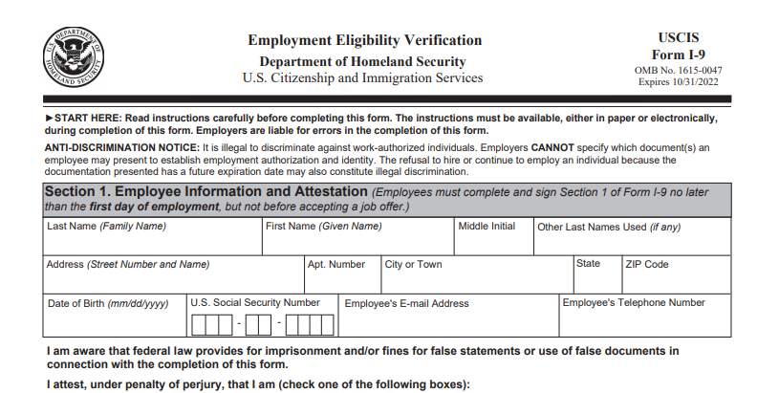
Form I-9 – Section 1
Although every effort has been made to provide a complete and compliant review and presentation, The General Council on Finance and Administration does not provide legal advice.
Notes:
Section 1 needs to be completed by the employee. Your turn to fill out forms will come soon enough. Have the employee fill out full name and address in the appropriate areas. This includes their Maiden name – if applicable.
Employees must include their date of birth.
If you use E-Verify, employees must enter their Social Security Number. Otherwise this is optional. We’ll talk more about E-Verify later in this training.
The email address and phone number are optional.

Slide 43
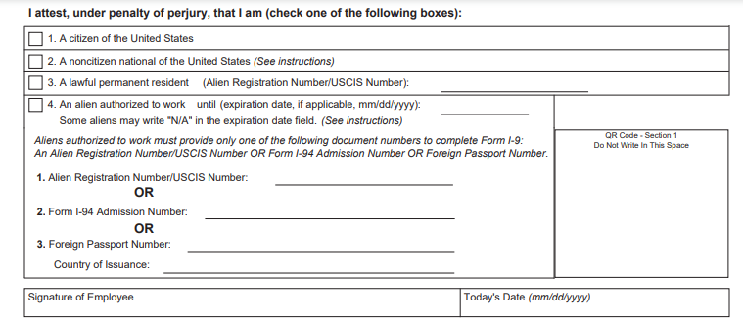
Form I-9 – Section 1
Although every effort has been made to provide a complete and compliant review and presentation, The General Council on Finance and Administration does not provide legal advice.
Notes:
The employee must mark their citizenship status. Make sure employee selects their status and puts Alien # and expiration date where applicable. Then have the employee sign and date the form.

Slide 44
Form I-9 – Section 1
Although every effort has been made to provide a complete and compliant review and presentation, The General Council on Finance and Administration does not provide legal advice.
Notes:
The Preparer/Translator section is usually not used, however, if someone else must fill out Section 1 for the employee due to disability or language issues, the person filling it out MUST complete this section. We recommend someone other than the employer.

Slide 45
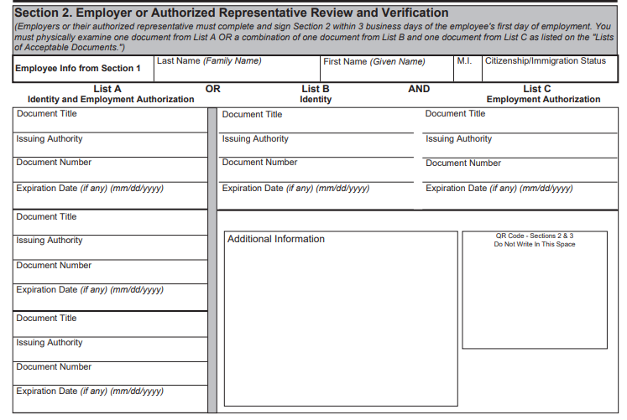
Form I-9 – Section 2
Although every effort has been made to provide a complete and compliant review and presentation, The General Council on Finance and Administration does not provide legal advice.
Notes:
Section 2 is filled out by YOU – the employer. All parts of this section MUST be completed by the same person. It is not negotiable with the US Government.
Employees must provide either 1 document from List A, OR 1 document from both List B AND List C.
You must fill out each I-9 with the required information in order and on the correct line!
Document Title
Issuing Authority
Document Number
Expiration Date
Be sure that you are putting the correct documents in the correct area. They should be under either the “A,” “B,” or “C” areas.

Slide 46
Form I-9 – Section 2 Documents
Employee must provide required documents within 3 business days after date of hire.
For example: If an employee is hired on Monday, they must provide forms by end of day Thursday.
You cannot require employees to bring certain documents and cannot ask them to bring in more than what is required.
If they bring in more on their own, do not document, or make copies of them!
Documents cannot be expired.
Copies of documents must be legible.
Although every effort has been made to provide a complete and compliant review and presentation, The General Council on Finance and Administration does not provide legal advice.

Slide 47
Form I-9 – Section 2
Although every effort has been made to provide a complete and compliant review and presentation, The General Council on Finance and Administration does not provide legal advice.
Notes:
Next, you need to certify that you have received the document, or documents, that you just listed. Be sure to fill out all the Certification section AFTER you have collected the required documents.
Don’t forget to put the hire date on the form! This is one of the most common errors that leads to penalties.

Slide 48
E-Verify
Web based system that allows employers to confirm the eligibility of their employees to work in the United States.
You may not verify current employees, only those newly hired.
Requirements to enroll are based on state.
States that Require E-Verify
Alabama | Arizona | Colorado | Florida | Georgia
Idaho | Indiana | Louisiana | Nebraska | North Carolina
Oklahoma | Pennsylvania | South Carolina | Tennessee | Texas
Utah | Virginia | West Virginia | Mississippi | Missouri
Although every effort has been made to provide a complete and compliant review and presentation, The General Council on Finance and Administration does not provide legal advice.
Notes:
The details of E-Verify requirements vary by state. At the more strict end of the scale, states like Arizona and Georgia want almost all employers, both public and private, to use the verification system. Yet, public employers and contractors are the only entities covered in states like Nebraska and Missouri.
Further, Idaho’s mandate applies only to public agencies and Louisiana’s ruling only covers public contractors.
Finally, three states (California, Illinois, and Rhode Island) have actually passed legislation preventing E-Verify from being a requirement for any organization. However, employers may still use it voluntarily.
This is why it is important for businesses to understand the requirements in their own state. In Georgia, any organization that has more than 10 full-time employees must enroll in E-Verify.
In addition, for businesses operating in multiple regions, it may make sense to simply implement E-Verify across the board. That is to say, even if it is not required by the law in every state. This ensures that there is consistency for all work sites and no appearance of discriminatory practices or lax standards based on new hire location.

Slide 49
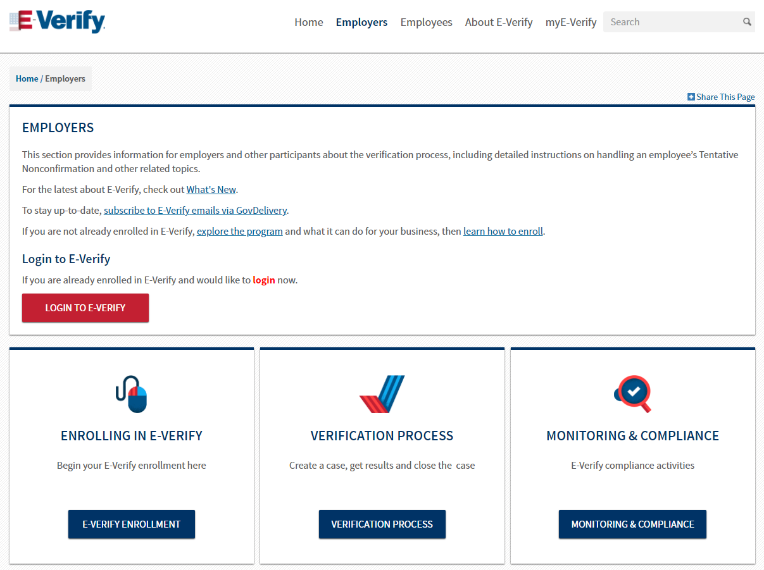
E-Verify
E-Verify is voluntary, on the federal level but many states have enacted state laws requiring employers to enroll.
https://www.e-verify. gov/employers
Although every effort has been made to provide a complete and compliant review and presentation, The General Council on Finance and Administration does not provide legal advice.
Notes:
The details of E-Verify requirements vary by state. At the more strict end of the scale, states like Arizona and Georgia want almost all employers, both public and private, to use the verification system. Yet, public employers and contractors are the only entities covered in states like Nebraska and Missouri.
Further, Idaho’s mandate applies only to public agencies and Louisiana’s ruling only covers public contractors.
Finally, three states (California, Illinois, and Rhode Island) have actually passed legislation preventing E-Verify from being a requirement for any organization. However, employers may still use it voluntarily.
This is why it is important for businesses to understand the requirements in their own state. In Georgia, any organization that has more than 10 full-time employees must enroll in E-Verify.
In addition, for businesses operating in multiple regions, it may make sense to simply implement E-Verify across the board. That is to say, even if it is not required by the law in every state. This ensures that there is consistency for all work sites and no appearance of discriminatory practices or lax standards based on new hire location.

Slide 51
1 Music Circle North
Nashville, TN 37203
615-329-2393
ConnectionalRelations@gcfa.org
www.gcfa.org

