Slide 1


UMC Finance &
Administration
Training

Slide 2
Episcopal

Slide 3
Episcopal Funds
ENG
General Council on Finance and Administration, through the Episcopal Services Department, administers the Episcopal Fund.
FRA
A travers le Département des services épiscopaux, GCFA administre le Fonds épiscopal
POR
O Conselho Geral de Finanças e Administração, através do Departamento de Serviços Episcopais, administra o Fundo Episcopal
SWA
Baraza Kuu la Feza na Utawala, kupitiya Idara/Nkudi ya Nkundi za Maaskofu, linalo simamia Akiba ya Maaskofu
Notes:
I am Director of Episcopal Services. General Council on Finance and Administration, through the Episcopal Services Department, administers the Episcopal Fund

Slide 4
Episcopal Funds
ENG
Why is the General Council on Finance and Administration the agency who administers the Episcopal Fund?
FRA
Pourquoi le Conseil général des finances et de l’administration est-il l’organisme qui administre le Fonds épiscopal?
POR
Porque é que o Conselho Geral de Finanças e Administração é a agência da IMU que administra o Fundo Episcopal?
SWA
Sababugani Baraza Kuu la Feza na Utawala inachunga Feza ya Maaskofu?
Notes:
Why is the General Council on Finance and Administration the agency who administers the Episcopal Fund?

Slide 5
Episcopal Funds
ENG
¶806 Fiscal Responsibilities of GCFA
All monies contributed by a local church to any of the general funds of the Church…
¶806.1.a The council shall make recommendations to the General Conference as to the amount and distribution of the Episcopal Fund…
FRA
¶806 Responsabilités financières du GCFA
Toutes les sommes versées par une église locale à l’un des fonds généraux de l’église...
¶806.1.a Le conseil fait des recommandations à la Conférence générale quant au montant et à la répartition du Fonds épiscopal...
POR
¶806 Responsabilidades Fiscais do GCFA
Todo o dinheiro contribuído por uma igreja local para qualquer um dos fundos gerais da Igreja …
¶806.1.a O Conselho deve fazer recomendações à Conferência Geral quanto ao valor e distribuição do Fundo Episcopal...
SWA
¶806 Kazi ya GCFA
Feza yote zilizochangiwa na kanisa la mahili popote kwa feza ya jumla ya kanisa ...
¶806.1.a Baraza litatoa mapendekezo kwa Mkutano Mkuu kuhusu kiasi na usambazaji ku Akiba ya Maaskofu...
Notes:
The Book of Discipline outlines the responsibilities to the General Council on Finance and Administration in paragraphs 806 and 806.1.a in paragraphs 806 and 806.1.a

Slide 6
Episcopal Funds
ENG
Who makes decisions about the Episcopal Fund?
General Conference; General Council on Finance and Administration/General Agency & Episcopal Matters Committee; Council of Bishops/Finance Committee
FRA
Qui prend les décisions concernant le Fonds épiscopal ?
Conférence générale; Conseil général des finances et de l’administration/Comité des questions générales et épiscopales ; Conseil des évêques/Comité des finances
POR
Quem toma decisões sobre o Fundo Episcopal?
A Conferência Geral; o Conselho Geral de Finanças e Administração/o Comité Geral de Agências e Assuntos Episcopais; o Conselho de Bispos/o Comité de Finanças
SWA
Nani anafanya maamuzi kuhusu Akiba ya Maaskofu?
Mkutano Mkuu; Baraza Kuu la Feza na Utawala / Shirika la Jumla na Kamati ya Mambo ya Maaskofu; Baraza la Maaskofu/Kamati ya Feza
Notes:
General Conference sets the quadrennial budget for the Episcopal Fund and the number of bishops that are to be supported. The General Council on Finance and Administration through it’s General Agency and Episcopal Matter Committee sets the annual spending plan and approves policies for how the Episcopal Fund can be used. The Council of Bishops and the Council of Bishops Finance Committee work with the General Council on Finance and Administration to determine spending plans and policies.

Slide 7
Episcopal Funds
ENG
How are decisions communicated?
Financial Commitment Book- Report No. 5; Episcopal Fund Travel Policies and Procedures; Meeting Minutes; Press Releases
FRA
Comment les décisions sont-elles communiquées?
Le Livre d’engagements financiers - Rapport n° 5; les politiques et procédures relatives aux voyages du Fonds épiscopal; procès-verbaux de réunions; Communiqués
POR
Como é que as decisões são comunicadas?
Livro de Compromissos Financeiros - Relatório nº 5; Políticas e Procedimentos de Viagens do Fundo Episcopal; Atas de Reuniões; Comunicados de imprensa
SWA
Ni kwa jinsi gani mipango inatangazwa?
Kitabu cha Kujitolea kwa Feza- Ripoti No. 5; Taratibu za Usafiri wa Akiba ya Maaskofu; repoti za Mikutano; Matangazo ya Vyombo vya Habari
Notes:
Once decisions are made they are communicated through several means. The Financial Commitment Book in Report No 5 outlines the budget and policies set by General Conference. The Episcopal Fund Travel Policies and Procedures communicate policies set by the Council of Bishops and the General Council on Finance and Administration. Decisions are also communicated through Meeting Minutes of the Council of Bishops and the General Council on Finance and Administration and through press releases.

Slide 8
Episcopal Services Department
ENG
Payroll; Housing; Office Grants; Benefits; Expense Reimbursements; Travel Bookings; Insurance; International Taxes
FRA
Gestion de la paie; Logement; Subventions de bureau; Avantages; le remboursement des dépenses; Réservations de voyages; Assurance; Taxes internationales
POR
Folhas de pagamento; Habitação; Subsídios de escritório; Benefícios; Reembolsos de despesas; Reservas de viagens; Seguro; Impostos internacionais
SWA
Malipo; Nyumba; Misaada ya Ofisi; Faida; Malipo ya kurudisha; Uhifadhi wa Kusafiri; Bima; Kodi ya Kimataifa
Notes:
The General Council on Finance and Administrations Episcopal Services Department manages the Episcopal Fund. The staff of three persons process payroll monthly for the bishops, sends out the office and housing grants, works closely with Human Resources and Wespath to determine and manage benefits, process travel expense reimbursements, assist with travel and business insurance and assist central conference bishops with international taxes.

Slide 9
Episcopal Services Department
ENG
Other Responsibilities
COB Staff Office support; Executive Assistant Training; New Bishop Orientation; Bishop Moves; Financial Reports and Budgets
FRA
Autres responsabilités
Appui au personnel du Conseil des Evêques (COB); Formation des assistants exécutifs; Orientation des nouveaux évêques; déménagement des évêques; Rapports financiers et budgets
POR
Outras Responsabilidades
Apoio aos funcionários do Gabinete do Conselho de Bispos (COB); Formação de Assistente Executivo; Orientação de Novos Bispos; Mudanças de Bispos; Relatórios Financeiros e Orçamentos
SWA
Kazi zingine
Msaada wa Ofisi ya Wafanyakazi wa COB; Mafunzo ya Msaidizi wa Mtendaji; Mwelekeo Mpya wa Askofu; Askofu anasonga; Taarifa za Feza na Bajeti
Notes:
The Episcopal Services staff also provide support to the Council of Bishops staff office in Washington DC, provide training for both the Jurisdictional and Central Conference Executive Assistants to the Bishops, provide training to newly elected bishops at a New Bishop Orientation, assist with bishop’s moves and provide Financial Reports and Budgets.

Slide 10
Episcopal Fund Provides
ENG
Benefits
Medical; Dental; Vision; Life Insurance; Pension
FRA
Avantages
Régimes médicaux; dentaires; vision; assurance-vie; pension retraite
POR
Benefícios de:
Assistência médica; Odontologia; Visão; Seguro de Vida; Pensão
SWA
Faida
Matibabu; Meno; Maono; Bima ya Maisha; Pensheni
Notes:
The Episcopal Fund provides benefits to the bishops and their immediate families to include medical, dental and visions plans, life insurance and pension benefits.

Slide 11
Episcopal Fund Provides
ENG
Salary; Housing Grant; Office Grant and Equipment; Travel Expense Reimbursements
FRA
Salaire; Allocation de logement; Subvention de bureau et équipement; Remboursement des frais de déplacement
POR
Salário; Subsídio de habitação; Subsídio para equipamento de escritório; Reembolsos de despesas de deslocação
SWA
Mshahara; Feza ya Nyumba; Msaada wa Ofisi na Vifaa; Malipo za Kusafiri
Notes:
The Episcopal Fund provides salary to the bishops as well as an office grant to assist with the Episcopal Office operations and a housing grant that is sent to the annual conference to assist with providing housing for the bishop and their family. The office and housing grant amounts are determined by the General Council on Finance and Administration on an annual basis, typically at the summer meeting that is usually held in August. Approved travel expenses are also covered by the Episcopal Fund and are paid on a reimbursement basis after appropriate documentation of the expenses is provided.

Slide 12
Episcopal Fund Provides
ENG
Audits
A full audit of the episcopal office and housing fund will be conducted annually based on generally accepted auditing standards (GAAS)
FRA
Audits
Une vérification complète du bureau épiscopal et du fonds de logement sera effectuée chaque année sur la base des normes de vérification généralement reconnues (GAAS).
POR
Auditorias
Uma auditoria completa do fundo para o gabinete episcopal e a habitação realizar-se-á anualmente com base nos padrões de auditoria geralmente aceites
SWA
Ukaguzi(Kutazamiya)
Ukaguzi/Kutazamiya kamili wa ofisi ya maaskofu na feza ya makazi utafanyika kila mwaka kulingana/kufwatana na kazi inavyokubalika (GAAS)
Notes:
Each Episcopal Office is required to submit an audit annually of the funds received from the Episcopal Fund. The cost of the annual audit is an office spending item and should be included in the budget for the office grant that is provided to each Episcopal Office.

Slide 13
Episcopal Fund Provides
ENG
Audits
A written report will be provided to GCFA by July 31st of the following year (ie: 2022 due by July 31, 2023)
FRA
Audits
Un rapport écrit sera fourni au GCFA au plus tard le 31 juillet de l’année suivante (c.-à-d. rapport audité 2022 soumis au plus tard le 31 juillet 2023)
POR
Auditorias
Um relatório por escrito será fornecido ao CGFA até 31 de Julho do ano seguinte (ou seja: para 2022 o relatório tem de ser entregue até 31 de Julho de 2023)
SWA
Ukaguzi/Kutazamiya
Ripoti iliyoandikwa itatolewa kwa GCFA na mwezi seba 31 ya mwaka uliofuata (mfano: 2022 kutokana na mwezi ya saba 31, 2023)
Notes:
The audits are due each year by July 31st for the previous year. For instance, the audit for the full year of 2022 is due to the Episcopal Services office by July 31st of this year.

Slide 14
Episcopal Fund Provides
ENG
Audits
Annually updated Audit Guidelines will be emailed at the beginning of each year and will also be posted on the GCFA Website
FRA
Audits
Les directives d’audit mises à jour annuellement seront envoyées par courriel au début de chaque année et seront également affichées sur le site Web du GCFA.
POR
Auditorias
As Directrizes de Auditoria actualizadas anualmente serão enviadas por e-mail no início de cada ano e também serão publicadas no site do GCFA
SWA
Ukaguzi/Kutazamiya
Kutazamiya Feza iliyofanikwa kila mwaka itatumwa kwa barua pepe mwanzoni mwa kila mwaka na pia itachapishwa kwenye Tovuti ya GCFA
Notes:
Guidelines for the Audits are sent to each office in January.

Slide 15
Travel Expenses Covered- Active Bishops
ENG
Area Travel
Moving Expenses
College of Bishop Meetings
Council of Bishops Meetings
General Conference
Central Conference Meetings
General Agency Board Meetings
Board of Trustee Board Meetings
Other travel as assigned by the College or Council of Bishops
FRA
Les déplacements dans la région de service
les frais de déménagement
participation aux réunions des Collèges des évêques
Réunions du Conseil des évêques; Conférence générale
Réunions de la Conférence centrale
les réunions du conseil d’administration de l’Agence générale dont il est membre
Réunions du conseil d’administration
Autres déplacements assignés par le Collège ou le Conseil des évêques
POR
Deslocações dentro da área episcopal
Despesas de mudança
Reuniões do Colégio de Bispos
Reuniões do Conselho de Bispos
Conferência Geral
Reuniões da Conferência Central
Reuniões do Conselho de Administração da Agência Geral
Outras viagens designadas pelo Colégio ou Conselho de Bispos
SWA
Offisi ya Usafiri
Feza ya Hama
Mikutano ya Maaskofu
Mikutano ya Baraza ya Maaskofu
Mkutano Mkuu
Mikutano ya Mkutano ya Kati
Mikutano ya Baraza
Mikutano ya wenye Kutazamiya Vifungo vya Kanisa
Safari nyingine kama ilivyopangiwa na Chuo au Baraza la Maaskofu
Notes:
The Episcopal Fund covers certain travel for bishops including:
Area Travel, which is any travel within the assigned episcopal area
Moving expenses for newly elected or newly assigned bishops
Expenses for the bishop and their spouse to visit the new area once before the assignment begins
Full College of Bishops meetings (active only are not covered)
Council of Bishops Meetings
General Conference
Jurisdiction meetings
General Agency board and executive meetings as assigned by the COB
Board of Trustees board and executive meetings as assigned by the COB or College
Assignments within the jurisdiction boundaries by the College of Bishops
Other travel as assigned by the Council of Bishops

Slide 16
Travel Expenses Not Covered- Active Bishops
ENG
FRA
Voyager en dehors de la zone épiscopale de service
Conférencier invité lors des événements
les déplacements pour assister à la conférence annuelle
les déplacements du conjoint
Cadeaux
Repas pour les invités
Travel Outside Episcopal Area
Guest speaker at events outside the episcopal area
Commuting Expenses to and from the office
Spouse Travel
Gifts
Meals for Guests
POR
SWA
Deslocações fora da área episcopal
Orador convidado para eventos fora da área episcopal
Despesas de deslocação de e para o gabinete
Deslocações do cônjuge
Presentes ou ofertas
Refeições para convidados
Kusafiri nje ya eneo la Askofu
Mgeni rasmi katika hafla nje ya eneo la Askofu
Kulipa safari za kwenda na kutoka ofisini
Safari ya Wamama Askofu
Sadaka
Chakula kwa Wageni
Notes:
Not all travel is covered for bishops including:
Area Travel- any travel outside the assigned episcopal area
Exceptions:
visits to seminary students from the episcopal area
Area events (ie: cabinet retreats) that require a location that cannot be found in the area as long as within the same state or neighboring state
For states that contain more than one episcopal area, travel outside the area for statewide events that require both bishops

Slide 17
Travel Expenses Covered- Retired Bishops
ENG
Moving Expenses at retirement
College of Bishop Meetings
Council of Bishops Meetings
General Conference
Central Conference Meetings
Other travel as assigned by the College or Council of Bishops
FRA
Frais de déménagement à la retraite
Collège des réunions des évêques
Réunions du Conseil des évêques
Conférence générale
Réunions de la Conférence centrale
Autres déplacements assignés par le Collège ou le Conseil des évêques
POR
SWA
Despesas de mudança na reforma
Reuniões do Colégio de Bispos
Reuniões do Conselho de Bispos
Conferência Geral
Reuniões da Conferência Central
Outras viagens designadas pelo Colégio ou Conselho de Bispos
Feza za Kuhamia wakati wa kumaliza kazi
Mikutano ya kundi ya Maaskofu
Mikutano ya Baraza la Maaskofu
Mkutano Mkuu
Mikutano ya Mkutano Mkuu
Safari nyingine kama ilivyopangiwa na kundi au Baraza la Maaskofu
Notes:
For retired bishops we do still cover travel expenses but it is more limited. The Episcopal Fund will cover one final move at retirement for the bishop, travel to College and Council of Bishops meetings, General Conference and Central Conference meetings and other travel as assigned by the College or Council of Bishops.

Slide 18
Travel Expenses Not Covered- Retired Bishops
ENG
FRA
Conférencier invité lors des événements
les déplacements pour assister à la conférence annuelle
les déplacements du conjoint
Cadeaux
Repas pour les invités
Guest speaker at events
Travel to Annual Conference
Spouse Travel
Gifts
Meals for Guests
POR
SWA
Orador convidado para eventos
Deslocações para a Conferência Anual
Deslocações do cônjuge
Presentes ou ofertas
Refeições para convidados
Mgeni rasmi katika hafla
Safari ya Mkutano wa Mwaka
Safari ya mume ya Maaskofu
Sadaka
Chakula kwa Wageni
Notes:
For retired bishops we do still cover travel expenses but it is more limited. The Episcopal Fund will cover one final move at retirement for the bishop, travel to College and Council of Bishops meetings, General Conference and Central Conference meetings and other travel as assigned by the College or Council of Bishops.
Travel that is not covered for retired bishops is the same as for active. Guest speaking or invitations to attend meetings are not covered, travel to annual conference sessions is not covered, spouse travel, gifts or meals for guests is not covered.

Slide 19
Questions?

Slide 20
Legal Update on Disaffiliation
Notes:
My name is Bryan Mills. I am the General Counsel for GCFA. I am going to give you a brief overview of the process for local churches to disaffiliate from The United Methodist Church.

Slide 21
Book of Discipline ¶ 2553
ENG
Adopted by the 2019 General Conference special session
FRA
Adoptée par la session extraordinaire de la Conférence générale de 2019
POR
Adoptado pela sessão especial da Conferência Geral de 2019
SWA
Kupitishwa na Mkutano Mkuu wa 2019 Mkutano maalum
Notes:
Paragraph 2553 was adopted by the 2019 General Conference special session.

Slide 22
Book of Discipline ¶ 2553
ENG
  Provides a defined process for local churches to disaffiliate
FRA
Fournit un processus défini pour que les églises locales se désaffilient
POR
  Fornece um processo definido para as igrejas locais se desfiliarem
SWA
  Inatoa utaratibu uliofafanuliwa kwa makanisa kutenganisha
Notes:
It provides a defined process for local churches to disaffiliate.

Slide 23
Book of Discipline ¶ 2553
ENG
  Sunsets after December 31, 2023
FRA
  Sunsets after December 31, 2023
POR
  O processo termina em 31 de dezembro de 2023
SWA
Itasimamishwa baada ya mwezi wa kumi na mbili 31, 2023
Notes:
It sunsets after December 31, 2023.

Slide 24
Book of Discipline ¶ 2553
ENG
Only applicable in the United States
GC2019 added language to ¶ 543.17: “Legislation passed at the 2019 called session of General Conference shall not take effect in central conferences until twelve months after the close of the 2020 General Conference in order to afford the necessary time to organize a central conference and ‘to make such rules and regulations for the administration of the work within their boundaries including such changes and adaptations of the General Discipline as the conditions in the respective areas may require, subject to the powers that have been or shall be vested in the General Conference’ (¶ 31.5 of the Constitution), without regard to the language used in a central conference.”
FRA
Applicable uniquement aux États-Unis
GC2019 a ajouté un libellé au numéro 543.17 : « Les lois adoptées lors de la session convoquée de la Conférence générale de 2019 n’entreront en vigueur dans les conférences centrales que douze mois après la clôture de la Conférence générale de 2020 afin de donner le temps nécessaire pour organiser une conférence centrale et « d’établir ces règles et règlements pour l’administration des travaux à l’intérieur de leurs frontières, y compris les changements et adaptations de la discipline générale que les conditions dans les domaines respectifs peuvent exiCes dispositions prennent fin après le 31 décembre 2023 ger, sous réserve des pouvoirs qui ont été ou seront conférés à la Conférence générale » (¶ 31.5 de la Constitution), sans égard à la langue utilisée dans une conférence centrale.
POR
Aplicável apenas nos Estados Unidos
O CG2019 adicionou texto ao ¶ 543.17: “A legislação aprovada na sessão convocada da Conferência Geral de 2019 não entrará em vigor nas conferências centrais até doze meses após o encerramento da Conferência Geral de 2020, a fim de proporcionar o tempo necessário para organizar uma conferência central e ‘criar as regras e os regulamentos para a administração do trabalho dentro dos seus limites, incluindo as mudanças e adaptações da Disciplina Geral conforme as condições nas respectivas áreas possam exigir, sujeito aos poderes que foram ou serão investidos na Conferência Geral' (¶ 31.5 da Constituição), independentemente da língua usada numa conferência central”.
SWA
Inatumiwa tu nchini Marekani
GC2019 aliongeza lugha kwa ¶ 543.17: "Utawala uliopitishwa katika kikao cha Mkutano Mkuu wa 2019 hautaanza kutumika katika mikutano kuu hadi miezi kumi na mbili baada ya kumalizika kwa Mkutano Mkuu wa 2020 ili kumudu muda muhimu wa kuandaa mkutano mkuu na 'kufanya sheria na kanuni hizo kwa ajili ya usimamizi wa kazi ndani ya mipaka yao ikiwa ni pamoja na mabadiliko hayo na marekebisho ya Nidhamu ya Jumla kama hali katika Maeneo husika yanaweza kuhitaji, kulingana na mamlaka ambayo yamekuwepo au yatawekwa katika Mkutano Mkuu' (¶ 31.5 ya Katiba), bila kujali lugha inayotumika katika mkutano mkuu."
Notes:
It currently only applies to churches in the United States. This is because the 2019 special session added language to paragraph 543.17 that says legislation passed at the 2019 special session do not go into effect in the central conferences until 12 months after the 2020 General Conference. As we all know, the 2020 General Conference session does not meet until next year, so paragraph 2553 is not yet effective in the central conferences. Because it expires at the end of this year, that raises a question as to whether it will ever apply to churches in the central conferences.

Slide 25
Is It Constitutional?
ENG
Yes, As decided by Judicial Council Decision 1379
FRA
Est-ce constitutionnel?
Oui, Conformément à la décision 1379 du Conseil Juridique
POR
É constitucional?
Sim, tal como decidido pela Decisão 1379 do Conselho Judicial
SWA
Ndiyo, kama ilivyoamuliwa na Uamuzi wa Baraza la Kanuni 1379
Notes:
Questions were raised about whether paragraph 2553 is constitutional. The Judicial Council ruled in Decision 1379 that it is.

Slide 26
Is It Constitutional?
ENG
But only constitutional after the Judicial Council added a requirement that annual conference must ratify the disaffiliation agreement - This requirement is not stated in ¶ 2553
FRA
Mais seulement constitutionnelle après que le Conseil Juridique a ajouté une exigence selon laquelle la conférence annuelle doit ratifier l’accord de désaffiliation - Cette exigence n’est pas énoncée au numéro 2553
POR
Mas só é constitucional depois do Conselho Judicial ter acrescentado uma exigência de que a conferência anual deve ratificar o acordo de desfiliação - Este requisito não é declarado no ¶ 2553
SWA
Lakini ni ya kikatiba tu baada ya Baraza la Mahakama kuongeza sharti kwamba mkutano wa kila mwaka lazima uidhinishe makubaliano ya kukanusha - Sharti hili halijasemwa katika ¶ 2553
Notes:
It is only constitutional, however, because the Judicial Council added a requirement that an annual conference must ratify the disaffiliation agreement. That requirement is not stated in Paragraph 2553.

Slide 27
Initial Requirements For Disaffiliation
ENG
Per ¶ 2553, a church may disaffiliate for “reasons of conscience regarding a change in the requirements and provisions of the Book of Discipline related to the practice of homosexuality or the ordination or marriage of self-avowed practicing homosexuals as resolved and adopted by the 2019 General Conference, or the actions or inactions of its annual conference related to these issues which follow”
FRA
Conditions initiales pour la désaffiliation
Selon le numéro 2553, une église peut se désaffilier pour « des raisons de conscience concernant un changement dans les exigences et les dispositions du Livre de discipline relatives à la pratique de l’homosexualité ou à l’ordination ou au mariage d’homosexuels pratiquants autoproclamés tels que résolus et adoptés par la Conférence générale de 2019, ou les actions ou inactions de sa conférence annuelle liées à ces questions qui suiventvc
POR
Requisitos Iniciais para a Desfiliação
De acordo com o ¶ 2553, uma igreja pode desfiliar-se por “razões de consciência em relação a uma mudança nos requisitos e disposições do Livro da Disciplina relacionados com a prática da homossexualidade ou com a ordenação ou o casamento de homossexuais praticantes declarados conforme resolvido e adoptado pela Conferência Geral de 2019, ou pelas acções ou inacções da sua conferência anual relacionadas com as questões que se seguem”
SWA
Kwa mujibu ya ¶ 2553, kanisa linaweza kujitenga kwa "maoni ya dhamiri kuhusu mabadiliko katika mahitaji na masharti ya Kitabu cha Kanuni kuhusiana na mazoezi ya ushoga au kulambishwa au ndoa ya watu wa jinsia moja kama ilivyotatuliwa na kupitishwa na Mkutano Mkuu wa 2019, au vitendo au kutochukua hatua za mkutano wake wa kila mwaka kuhusiana na masuala haya yanayofuata"
Notes:
Per ¶ 2553, a church may disaffiliate for “reasons of conscience regarding a change in the requirements and provisions of the Book of Discipline related to the practice of homosexuality or the ordination or marriage of self-avowed practicing homosexuals as resolved and adopted by the 2019 General Conference, or the actions or inactions of its annual conference related to these issues which follow”

Slide 28
Initial Requirements For Disaffiliation
ENG
In practice, conferences have approved the disaffiliation of many churches for other reasons, including “conservative” churches that agree with the Discipline’s stance on homosexuality
FRA
Conditions initiales pour la désaffiliation
Dans la pratique, les conférences ont approuvé la désaffiliation de nombreuses Églises pour d’autres raisons, y compris les Églises « conservatrices » qui sont d’accord avec la position de la Discipline sur l’homosexualité.
POR
Requisitos Iniciais para a Desfiliação
Na prática, as conferências aprovaram a desfiliação de muitas igrejas por outros motivos, inclusive igrejas “conservadoras” que concordam com a postura da Disciplina sobre a homossexualidade
SWA
Mahitaji ya mwanzo ya kutengwa
Katika mazoezi, mikutano iliruhusu kutengwa kwa makanisa mengi kwa sababu zingine, ikiwa ni pamoja na makanisa ya "kuhifadhi" ambayo yanakubaliana na Kitabu cha Kanuni juu ya ushoga
Notes:
In practice, conferences have approved the disaffiliation of many churches for other reasons, including “conservative” churches that agree with the Discipline’s stance on homosexuality

Slide 29
Initial Requirements For Disaffiliation
ENG
Judicial Council has given conferences wide latitude in determining what steps are required of churches that wish to disaffiliation, such as mandating “discernment periods”
Conditions initiales pour la désaffiliation
Le Conseil Juridique a donné aux conférences une grande latitude pour déterminer les mesures à prendre par les Églises qui souhaitent se désaffilier, telles que l’imposition de « périodes de discernement ».
FRA
POR
Requisitos Iniciais para a Desfiliação
O Conselho Judicial deu às conferências ampla latitude para determinar quais são as etapas necessárias para as igrejas que se desejam desfiliar, tais como a determinação de “períodos de discernimento”
Mahitaji ya mwanzo ya kutengwa
Baraza la Sheriya limetoa kwa Mikutano ni hatua gani zinazohitajika kwa makanisa ambayo yanataka kujitenga, kama vile kuleta ruhusa “wakati wa utambuzi"
SWA
Notes:
Judicial Council has given conferences wide latitude in determining what steps are required of churches that wish to disaffiliation, such as mandating “discernment periods”

Slide 30
Disaffiliation Agreement
ENG
¶ 2553 required GCFA to create a form disaffiliation agreement which could be modified/supplemented by annual conferences
FRA
Accord de désaffiliation
¶ 2553 exigeait que la GCFA crée un formulaire d’accord de désaffiliation qui pourrait être modifié / complété par des conférences annuelles
POR
Acordo de Desfiliação
O ¶ 2553 exigia que o CGFA criasse um formulário de acordo de desfiliação que poderia ser modificado/suplementado por conferências anuais
SWA
Mkataba wa kutoshirikishwa
¶ 2553 ilihitaji GCFA kuunda makubaliano ya kutoshiriki ambayo inaweza kubadilishwa / kutolewa na mikutano ya kila mwaka
Notes:
Paragraph 2553 required GCFA to create a form disaffiliation agreement which could be modified/supplemented by annual conferences

Slide 31
Disaffiliation Agreement
ENG
Each conference’s board of trustees develops its own version of the agreement
FRA
Accord de désaffiliation
Une fois qu’il est finalisé avec une église particulière, il doit être approuvé par un vote de la session de la conférence annuelle
POR
Acordo de Desfiliação
O conselho de fiduciários de cada conferência desenvolve a sua própria versão do acordo
SWA
Mkataba wa kutoshirikishwa
Kundi ya wadhamini ya kila mkutano inaendeleza toleo lake la makubaliano
Notes:
Each conference’s board of trustees develops its own version of the agreement

Slide 32
Disaffiliation Agreement
ENG
Once it is finalized with a particular church, it must be approved by a vote of the annual conference session
FRA
Accord de désaffiliation
Le conseil d’administration de chaque conférence élabore sa propre version de l’accord.
POR
Acordo de Desfiliação
Uma vez finalizado com uma determinada igreja, o acordo deve ser aprovado por um voto da sessão da conferência anual
SWA
Mkataba wa kutoshirikishwa
Mara tu itakapokamilishwa na kanisa fulani, lazima ikubaliwe kwa kura ya kikao cha mkutano wa kila mwaka
Notes:
Once it is finalized with a particular church, it must be approved by a vote of the annual conference session

Slide 33
What Must Churches Pay?
ENG
Any unpaid apportionments for the 12 months prior to disaffiliation
FRA
Que doivent payer les églises ?
Toute contributions impayées pour les 12 mois précédant la désaffiliation
POR
As igrejas devem pagar o quê?
Quaisquer contribuições não pagas nos 12 meses anteriores à desfiliação
SWA
Je, makanisa yanapaswa kulipa nini?
Malipo yoyote ambayo hayajalipwa kwa miezi 12 kabla ya kutenganishwa
Notes:
Paragraph 2553 requires departing churches to make several payments. They must pay any unpaid apportionments for the 12 months prior to disaffiliation

Slide 34
What Must Churches Pay?
ENG
An additional 12 months of apportionments
FRA
Que doivent payer les églises ?
12 mois supplémentaires de contributions
POR
As igrejas devem pagar o quê?
12 meses adicionais de contribuições
SWA
Je, makanisa yanapaswa kulipa nini?
Nyongeza ya miezi 12 ya malipo
Notes:
An additional 12 months of apportionments

Slide 35
What Must Churches Pay?
ENG
The church’s portion of any unfunded pension obligation of the conference
FRA
Que doivent payer les églises ?
La part de l’église de toute obligation de retraite non capitalisée de la conférence
POR
As igrejas devem pagar o quê?
A parte da igreja de qualquer obrigação de pensão não financiada da conferência
SWA
Je, makanisa yanapaswa kulipa nini?
Sehemu ya kanisa ya wajibu wowote wa pensheni usio na feza yaa mkutano
Notes:
The church’s portion of any unfunded pension obligation of the conference

Slide 36
What Must Churches Pay?
ENG
Any other debts it may have to the annual conference
FRA
Que doivent payer les églises ?
Toute autre dette qu’elle pourrait avoir envers la conférence annuelle
POR
As igrejas devem pagar o quê?
Quaisquer outras dívidas que possam ter para com a conferência anual
SWA
Je, makanisa yanapaswa kulipa nini?
Madeni mengine yoyote ambayo yanaweza kuwa nayo kwenye mkutano wa kila mwaka
Notes:
And any other debts it may have to the annual conference

Slide 37
What Must Churches Pay?
ENG
Value for the property?
¶ 2553 doesn’t say, so requirements here vary by conference
FRA
Valeur pour la propriété?
¶ 2553 doesn’t say, so requirements here vary by conference
POR
Valor pela propriedade?
O ¶ 2553 não menciona isso, e como tal, os requisitos neste caso variam de conferência para conferência
SWA
Bei ya Majengo?
¶ 2553 haisemi, kwa hivyo mahitaji hapa hutofautiana na mkutano
Notes:
Paragraph 2553 does not explicitly state whether churches must pay some amount in relation to the value of the church’s property, so requirements here have varied by conference.

Slide 38
What Must Churches Pay?
ENG
Value for the property?
Most do not require churches to pay any amount based on the value of property/assets
FRA
Valeur pour la propriété?
La plupart n’exigent pas des églises qu’elles paient un montant basé sur la valeur des biens / actifs
POR
Valor pela propriedade?
A maioria não exige que as igrejas paguem qualquer valor com base no valor da propriedades/bens
SWA
Bei ya jengo?
Wengi hawahitaji makanisa kulipa kiasi chochote kulingana na thamani ya mali/mali.
Notes:
Most do not require churches to pay any amount based on the value of property/assets

Slide 39
Questions?

Slide 40
Data Services

Slide 41
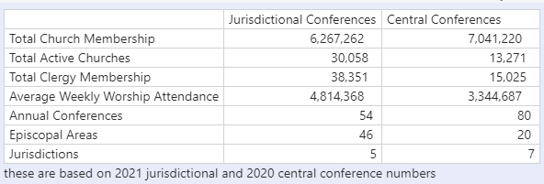
Central Conference / Jurisdictional Conference
ENG
Central conferences have surpassed the Jurisdictional Conferences in Total Church Membership
FRA
Les conférences centrales ont dépassé les conférences juridictionnelles en nombre total de membres de l’Église
POR
As Conferências Centrais ultrapassaram as Conferências Jurisdicionais quanto ao número total de membros da Igreja
SWA
Mikutano mikuu imepita Mikutano ya Kimamlaka katika Ushiriki wa Jumla wa Kanisa
*Based on 2021 Jurisdictional and 2020 Central Conference numbers
Notes:
My name is Leslie Ohrin and I am the Manager of Data Services and IT Projects at GCFA. Data Services is comprised of four members, including myself. We have a couple main functions:
We maintain the official records of the United Methodist Church, including conference, district, church, clergy, leadership and appointment information
We gather statistical information for the denomination which includes membership, income and expenses information.
We wanted to share some metrics with you today.
As you can see from the chart, Total Church Membership in the Central Conferences have surpassed the Jurisdictional total for the first time.

Slide 42
What Documentation Needs To Be Sent To GCFA?
ENG
Required on a yearly basis:
Statistics form
Annual Conference Journal, which includes the Business of the Annual Conference (BAC) and Statistics form
FRA
Requis sur une base annuelle:
Formulaire de statistiques
Journal de la conférence annuelle, qui comprend les Travaux de la conférence annuelle (BAC) et le formulaire des statistiques
POR
Obrigatoriamente, cada três meses:
Formulário de liderança da conferência
Lista de distritos
Lista de Igrejas
SWA
Inahitajika kila mwaka:
- Karatasi ya wingi
- Kazeti la Mkutano wa Mwaka, ambalo linajumuisha Kazi ya Mkutano wa Mwaka (BAC) na karatasi ya wingi
Notes:
What documentation needs to be sent to GCFA?
On a yearly basis, we require the Statistics form and the Annual Conference Journal, which includes the Business of the Annual Conference (BAC) and Statistics form to be completed and sent to GCFA.
I will talk more about these in the slides that follow.

Slide 43
What Documentation Needs To Be Sent To GCFA?
ENG
Required on a quarterly basis:
Conference Leadership form
List of Districts
List of Churches
FRA
Requis sur une base trimestrielle:
Les Responsables de la conférence (Formulaire)
Liste des districts
Liste des églises locales
POR
Obrigatoriamente, cada três meses:
Formulário de liderança da conferência
Lista de distritos
Lista de Igrejas
SWA
Inahitajika kwa kila kipande ya mwaka:
- Karaasi ya Uongozi wa Mkutano
- Orodha/Liste ya Wilaya
- Orodha/Liste ya Makanisa
Notes:
On a quarterly basis, we require your Conference Leadership form – This includes your leadership and your District Superintendent information, a List of Districts and a List of Churches to be completed and sent to GCFA.
If your conferences has any changes outside of these timings, please notify GCFA and Data Services as soon as possible so we can update and maintain our records. This includes, but is not limited to changes in leadership, redistricting, new areas being created and conference name changes.

Slide 44
Statistics Form
ENG
The statistics form shown is for the Central Conferences. This is to be filled out yearly and included in your Annual Conference Journal in addition to sending to GCFA separately
FRA
Le formulaire de statistiques présenté concerne les conférences centrales. Celui-ci doit être rempli chaque année et inclus dans votre journal de conférence annuelle en plus de l’envoyer séparément à GCFA.
POR
O formulário de dados estatísticos mostrado é para as Conferências Centrais. Destina-se a ser preenchido anualmente e incluído no Diário da Conferência Anual, para além de ser enviado ao CGFA separadamente
SWA
Kartasi iliyoonyeshwa ni kwa Mikutano Kati. Hii inapaswa kujazwa kila mwaka na kujumuishwa katika Gazeti lako la Mkutano wa Mwaka pamoja na kutuma kwa GCFA
Notes:
The statistics form shown on the following slide is for the Central Conferences. This is to be filled out yearly and included in your Annual Conference Journal in addition to sending to GCFA separately

Slide 45
Statistics Form
ENG
GCFA will be making small changes to the form e.g. ask for totals and not just the male/female breakdown
FRA
GCFA apportera de petits changements au formulaire, par exemple demander des totaux et pas seulement la répartition hommes/femmes
POR
O CGFA fará pequenas alterações ao formulário, por exemplo, pedir totais e não apenas a desagregação entre homens e mulheres
SWA
GCFA itakuwa ikifanya mabadiliko madogo kwenye karatasi kwa mfano kuuliza jumla na sio tu kuvunjika kwa kiume /
Notes:
The slide indicated GCFA will be making small changes, but we have already made the change to the statistics form to include totaling areas.

Slide 46
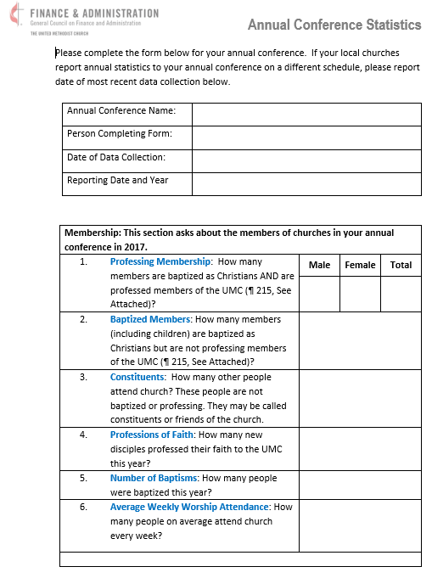
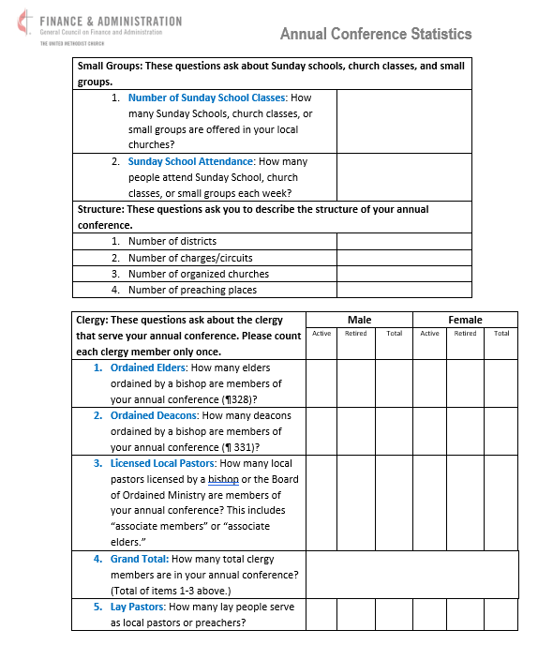
Annual Conference Statistics Form
z
ENG
Forms can be found in English, Korean, Spanish, Portuguese, French, and Kiswahili at https://www.gcfa.org/forms-and-assets
FRA
POR
Podem obter-se formulários em inglês, coreano, espanhol, português, francês e kiswahili em https://www.gcfaorg/forms-and-assets
SWA
Notes:
This is a copy of the Annual Conference Statistics form for Central Conferences. I know the information is small and I am not going to read through each entry. I wanted to show you what the form looks like.
All the forms that I discuss today are in the process of being translated into French, Swahili, and Portuguese. These forms will be sent out with the materials after today and also posted on the GCFA.org website.
Please be sure to fill out the form completely. When the Statistics form is placed in your journal, be sure to have the entire Conference Summary added. Historically, some central conferences have broken down the information by district, however, you also need to include the complete Conference summary.

Slide 47
Annual Conference Journal Submission
BOD Journal Requirements Information
ENG
The General Council on Finance and Administration (GCFA), on behalf of the Commission on General Conference (COGC), requests annual conference journals on a yearly basis.
FRA
Le Conseil général des finances et de l’administration (GCFA), au nom de la Commission de la Conférence générale (COGC), demande des journaux annuels de la conférence.
POR
O Conselho Geral de Finanças e Administração (CGFA), em nome da Comissão da Conferência Geral (CDCG), solicita, anualmente, os diários da conferência anual.
SWA
Baraza Kuu la Feza na Utawala (GCFA), kwa ruhusa ya Mkutano Mkuu (COGC), huomba majarida ya mkutano wa kila mwaka kila mwaka.
Notes:
The General Council on Finance and Administration (GCFA), on behalf of the Commission on General Conference (COGC), requests annual conference journals on a yearly basis.

Slide 48
Annual Conference Journal Submission
BOD Journal Requirements Information
ENG
The annual conference journal is comprised of the minutes taken during the annual conference’s yearly meeting
FRA
Le journal de la conférence annuelle est composé des procès-verbaux pris lors de la réunion annuelle de la conférence annuelle.
POR
O diário da conferência anual é composto pelas atas lavradas durante a reunião anual da conferência anual.
SWA
Gazeti la mkutano wa kila mwaka linajumuisha dakika zilizochukuliwa wakati wa mkutano wa kila mwaka wa mkutano wa kila mwaka
Notes:
The annual conference journal is comprised of the minutes taken during the annual conference’s yearly meeting

Slide 49
Annual Conference Journal Submission
BOD Journal Requirements Information
ENG
According to the Book of Discipline (BOD) ¶ 606.3:
“The annual conference may form a committee on journal publication. The annual conference journal shall include the following divisions, in the following order:
FRA
Selon le Livre de discipline (DB0) ¶ 606.3 :
« La conférence annuelle peut former un comité sur la publication des revues. Le journal annuel de la conférence comprend les sections ci-après, dans l’ordre suivant:
POR
Conforme o Livro da Disciplina ¶ 606.3:
“A conferência anual pode formar um comité de publicação de diários. O diário da conferência anual deve incluir as seguintes divisões, na seguinte ordem:
SWA
Kufwatana na Kitabu cha Kanuni (BOD) ¶ 606.3:
"Mkutano wa kila mwaka unaweza kutunga kamati ya uchapishaji wa gazeti. Gazeti la mkutano wa kila mwaka inafai kuwa na mgawanyiko ufuatao, kwa utaratibu ufuatao:
Notes:
According to the Book of Discipline (BOD) ¶ 606.3:
“The annual conference may form a committee on journal publication. The annual conference journal shall include the following divisions, in the following order:

Slide 50
Annual Conference Journal Submission
BOD Journal Requirements Information
A.
ENG
  Officers of annual conference
A.
FRA
  Dirigeants de la conférence annuelle
A.
POR
  Membros responsáveis da conferência anual
A.
SWA
Watangulizi wa mkutano wa kila mwaka
Notes:
Officers of annual conference

Slide 51
Annual Conference Journal Submission
BOD Journal Requirements Information
B.
ENG
  Boards, commissions, committees; rolls of conference members,
B.
FRA
  Conseils, commissions, comités; les listes des membres de la conférence,
B.
POR
  Conselhos, comissões, comités; listas de membros da conferência
B.
SWA
  Bodi, tume, kamati; Wajumbe wa mkutano,
Notes:
Boards, commissions, committees; rolls of conference members,

Slide 52
Annual Conference Journal Submission
BOD Journal Requirements Information
C.
ENG
  Daily proceedings
C.
FRA
  Délibérations quotidiennes
C.
POR
  Procedimentos diários
C.
SWA
Maendeleo ya kila siku
Notes:
Daily proceedings

Slide 53
Annual Conference Journal Submission
BOD Journal Requirements Information
D.
ENG
  Business of the annual conference report (formerly known as the disciplinary questions)
D.
FRA
  Activité du rapport de la conférence annuelle (anciennement appelées questions disciplinaires)
D.
POR
  Actividades do relatório da conferência anual (anteriormente denominadas questões disciplinares)
D.
Maneno ya ripoti ya mkutano wa kila mwaka (zamani inayojulikana kama maswali ya kanuni)
SWA
Notes:
Business of the annual conference report (formerly known as the disciplinary questions)

Slide 54
Annual Conference Journal Submission
BOD Journal Requirements Information
E.
ENG
  Appointments
E.
FRA
  Rendez-vous
E.
POR
  Nomeações
E.
SWA
  Madaraka
Notes:
Appointments

Slide 55
Annual Conference Journal Submission
BOD Journal Requirements Information
F.
ENG
  Reports as ordered by the annual conference
F.
FRA
  Rapports ordonnés par la conférence annuelle
F.
POR
  Relatórios conforme ordenados pela conferência anual
F.
SWA
Repoti kama ilivyoagizwa na mkutano wa kila mwaka
Notes:
Reports as ordered by the annual conference

Slide 56
Annual Conference Journal Submission
BOD Journal Requirements Information
G.
ENG
  Annual report of the district superintendents, if any
G.
FRA
  Rapport annuel des surintendants de district, le cas échéant
G.
POR
  Relatório anual dos superintendentes distritais, se houver
G.
SWA
Repoti ya mwaka ya mkuu wa distriki/wilaya
Notes:
Annual report of the district superintendents, if any

Slide 57
Annual Conference Journal Submission
BOD Journal Requirements Information
H.
ENG
  Memoirs as ordered by the annual conference following the guidelines of the General Commission on Archives and History
H.
FRA
  Mémoires commandés par la conférence annuelle suivant les directives du Commissariat général aux archives et à l’histoire
H.
POR
  Memórias ordenadas pela conferência anual conforme as directrizes da Comissão Geral de Arquivos e História
H.
Kumbukumbu kama ilivyoagizwa na mkutano wa kila mwaka kufuatia miongozo ya Tume Kuu ya Kumbukumbu na Historia
SWA
Notes:
Memoirs as ordered by the annual conference following the guidelines of the General Commission on Archives and History

Slide 58
Annual Conference Journal Submission
BOD Journal Requirements Information
I.
ENG
  Roll of dead-deceased clergy members
I.
FRA
  Liste des membres du clergé décédés et décédés
I.
POR
  Lista de membros do clero falecidos
I.
SWA
Majina ya wapastori waliofariki
Notes:
Roll of dead-deceased clergy members

Slide 59
Annual Conference Journal Submission
BOD Journal Requirements Information
J.
ENG
  Historical
J.
FRA
  Historique
J.
POR
  Histórico
J.
SWA
  Kihistoria
Notes:
Historical

Slide 60
Annual Conference Journal Submission
BOD Journal Requirements Information
K.
ENG
  Miscellaneous
K.
FRA
  Divers
K.
POR
  Diversos
K.
SWA
Tofauti ya/ Vigine
Notes:
Miscellaneous

Slide 61
Annual Conference Journal Submission
BOD Journal Requirements Information
L.
ENG
  Pastoral record (including the records of accepted local pastors in such manner as the conference may determine)
L.
  Registre pastoral (y compris les registres des pasteurs locaux acceptés de la manière déterminée par la conférence)
FRA
L.
  Registo pastoral (incluindo os registos de pastores locais aceites conforme a conferência determinar)
POR
L.
Rekodi ya wachungaji (ikiwa ni pamoja na kumbukumbu za wachungaji wa mahali hapo waliokubaliwa kwa njia kama vile mkutano unaweza kuamua)
SWA
Notes:
Pastoral record (including the records of accepted local pastors in such manner as the conference may determine)

Slide 62
Annual Conference Journal Submission
BOD Journal Requirements Information
M.
ENG
  Statistics
M.
FRA
  Statistiques
M.
POR
  Dados estatísticos
M.
SWA
Takwimu/wingi
Notes:
Statistics

Slide 63
Annual Conference Journal Submission
BOD Journal Requirements Information
N.
ENG
  Index
N.
FRA
  Index
N.
POR
  Índice
N.
SWA
  Kielezo
Notes:
Index

Slide 64
Annual Conference Journal Submission
BOD Journal Requirements Information
ENG
Examples of Conference Journals can be provided upon request.
FRA
Des exemples de journaux de conférence peuvent être fournis sur demande.
POR
  Exemplos de Diários de Conferências podem ser fornecidos mediante pedido
SWA
Mifano ya Gazeti za Mkutano zinaweza kutolewa kwa ombi
Notes:
Examples of Conference Journals can be provided upon request.

Slide 65
Annual Conference Journal Submission
BOD Journal Requirements Information
ENG
The Journal should be completed soon after the annual conference meeting and then sent to specific general agencies as described in the BOD, ¶ 606.2:
FRA
Le Journal devrait être terminé peu après la réunion de la conférence annuelle, puis envoyé à des organismes généraux spécifiques, comme décrit dans le Livre de Discipline ¶606.2:
POR
O Diário deve ser completado logo após a reunião da conferência anual e, em seguida, enviado para agências gerais específicas, conforme descrito no Livro da Disciplina, ¶ 606.2
SWA
Gazeti linapaswa kukamilika mara tu baada ya mkutano wa kila mwaka na kisha kutumwa kwa baraza kama ilivyoelezwa katika BOD, ¶ 606.2:
Notes:
The Journal should be completed soon after the annual conference meeting and then sent to specific general agencies as described in the BOD, ¶ 606.2:

Slide 66
Annual Conference Journal Submission
BOD Journal Requirements Information
  “Each annual conference shall send without charge to the General Council on Finance and Administration, the General Board of Pension and Health Benefits, the General Commission on Archives and History, the Central Conference or Jurisdictional Commission on Archives and History, and the Annual Conference Commission on Archives and History two printed copies or a digital version of its annual journal. In addition, the annual conference shall send one printed copy or a digital version of its annual journal to the Connectional Table and one printed copy or a digital version to United Methodist Communications. If available, one copy of a digital version of the journal shall be sent to the General Commission on Archives and History and one copy to United Methodist Communications.”
ENG
FRA
  « Chaque conférence annuelle envoie gratuitement au Conseil général des finances et de l’administration, au Conseil général des pensions et des prestations de santé, au Commissariat général aux archives et à l’histoire, à la Conférence centrale ou à la Commission juridictionnelle des archives et de l’histoire et à la Commission des archives et de l’histoire de la Conférence annuelle deux exemplaires imprimés ou une version numérique de son journal annuel. En outre, la conférence annuelle enverra une copie imprimée ou une version numérique de son journal annuel à la Table de connexion et une copie imprimée ou une version numérique à Communications Méthodistes Unies. Si disponible, un exemplaire d’une version numérique de la revue sera envoyé au Commissariat général aux archives et à l’histoire et un exemplaire à Communications Méthodistes Unies.
POR
  “Cada conferência anual enviará gratuitamente para o Conselho Geral de Finanças e Administração, a Junta Geral de Pensões e Benefícios de Saúde, a Comissão Geral de Arquivos e História, a Conferência Central ou a Comissão Jurisdicional de Arquivos e História e a Comissão de Arquivos e História da Conferência Anual duas cópias impressas ou uma versão digital do seu diário anual. Além disso, a conferência anual enviará uma cópia impressa ou uma versão digital de seu diário anual para a Mesa Conexional e uma cópia impressa ou uma versão digital para as Comunicações Metodistas Unidas. Se disponível, uma cópia de uma versão digital do diário deve ser enviada para a Comissão Geral de Arquivos e História e uma cópia para as Comunicações Metodistas Unidas”.
SWA
"Kila mkutano wa kila mwaka utatuma bila malipo kwa Baraza Kuu la Fedha na Utawala, Baraza Kuu ya Pensheni na Faida za Afya, Tume Kuu ya Kumbukumbu na Historia, Mkutano Mkuu au Tume ya Mahakama ya Kumbukumbu na Historia, na Tume ya Mkutano wa Mwaka juu ya Kumbukumbu na Historia nakala mbili zilizochapishwa au toleo la dijiti la jarida lake la kila mwaka. Kwa kuongezea, mkutano wa kila mwaka utatuma nakala moja iliyochapishwa au toleo la dijiti la jarida lake la kila mwaka kwa Jedwali la Muunganisho na nakala moja iliyochapishwa au toleo la dijiti kwa Mawasiliano ya United Methodist. Ikiwa inapatikana, nakala moja ya toleo la dijiti la jarida itatumwa kwa Tume Kuu ya Kumbukumbu na Historia na nakala moja kwa Mawasiliano ya Methodist ya Umoja."
Notes:
This paragraph outlines the agencies that are to receive the Annual Conference Journal. GCFA is to receive two printed copies or one digital copy.

Slide 67
Annual Conference Journal Submission
BOD Journal Requirements Information
ENG
In order to simplify this process, a digital copy of the journal may be uploaded to a Dropbox area. The link is provided by GCFA and the Data Services team. It will then be distributed to all the appropriate general agencies
FRA
Afin de simplifier ce processus, une copie numérique du journal peut être téléchargée sur Dropbox. Le lien est fourni par GCFA et l’équipe des services des données. GCFA est chargé ensuite de distribué à toutes les agences générales appropriées.
POR
Para simplificar este processo, uma cópia digital do diário pode ser telecarregada numa área da Dropbox. O link é fornecido pelo CGFA e pela equipa de Serviços de Dados. Em seguida, será distribuído por todas as agências gerais apropriadas.
SWA
Ili kurahisisha mchakato huu, nakala ya dijiti ya jarida inaweza kupakiwa kwenye eneo la Dropbox. Kiungo kinatolewa na GCFA na timu ya Huduma za Takwimu. Kisha itasambazwa kwa mashirika yote ya jumla yanayofaa
Notes:
In order to simplify this process, a digital copy of the journal may be uploaded to a Dropbox area. The link is provided by GCFA and the Data Services team. It will then be distributed to all the appropriate general agencies

Slide 68
Annual Conference Journal Submission
BOD Journal Requirements Information
ENG
Any hard copies may be sent through the mail to:
  GCFA
  ATTN: Data Services Department
  1908 Grand Ave
  Nashville, TN 37203
FRA
Toute copie papier peut être envoyée par la poste à l’adresse suivante :
GCFA
À l’attention de : Département des services de données
1908, avenue Grand
Nashville, TN 37203
POR
Quaisquer cópias impressas podem ser enviadas pelo correio para:
  GCFA
  ATTN: Data Services Department
  1908 Grand Ave
  Nashville, TN 37203
SWA
  Nakala ngumu zozote zaweza kutumwa kibarua kwa
  GCFA
  ATTN: Data Services Department
  1908 Grand Ave
  Nashville, TN 37203
Notes:
Any hard copies may be sent through the mail to the address listed. Please note that this is a new address and make sure your records are updated accordingly.

Slide 69
Annual Conference Journal Submission
BOD Journal Requirements Information
ENG
The Commission on General Conference uses the statistical reports in the annual conference journals to determine the number of delegates for General Conference. This is described in BOD ¶ 511.5:
FRA
La Commission de la Conférence générale utilise les rapports statistiques des journaux annuels de la Conférence pour déterminer le nombre de délégués à la Conférence générale. Ceci est décrit dans ¶ 511.5 du Livre de Discipline:
POR
A Comissão da Conferência Geral usa os relatórios de dados estatísticos nos diários da conferência anual para determinar o número de delegados para a Conferência Geral. Isto está descrito no Livro da Disciplina (LDD) no ¶ 511.5
SWA
Tume la Konfarasa ya kijumla utumia riporti za takwimu katika jarida la mkutano wa kila mwaka hili kuamua namabri ya wajumbe wa Konfarasa ya kijumla. Hii imeelezwa katika kitabu cha nidhamu BOD ¶ 511.5:
Notes:
One of the many uses of your Annual Conference Journal is The Commission on General Conference uses the statistical reports in the annual conference journals to determine the number of delegates for General Conference.
This is described in BOD ¶ 511.5 which states:

Slide 70
Annual Conference Journal Submission
BOD Journal Requirements Information
  “The secretary of the General Conference shall calculate the number of delegates to be elected by each annual conference, based on the factors specified in ¶ 502.1, 2, using the most recent clergy and professing lay membership figures reported by the local congregation to the annual conference and from the annual conference to the General Council on Finance and Administration through their conference journals, as follows:
ENG
FRA
  “Le secrétaire de la Conférence générale calcule le nombre de délégués à élire par chaque conférence annuelle, en fonction des facteurs précisés aux numéros 502.1, 2, en utilisant les chiffres les plus récents du clergé et des professant laïcs déclarés par la congrégation locale à la conférence annuelle et de la conférence annuelle au Conseil général des finances et de l’administration par l’intermédiaire de leurs journaux de conférence, comme suit:
  “O secretário da Conferência Geral deve calcular o número de delegados a eleger por cada conferência anual, com base nos factores especificados no ¶ 502.1, 2, usando os números mais recentes de membros do clero e membros leigos professos comunicados pela congregação local à conferência anual e da conferência anual ao Conselho Geral de Finanças e Administração através dos seus diários de conferência, tal como se segue:
POR
  Katibu wa mkutano wa kijumla atahesabu nambari ya wajumbe watakaochaguliwa na kila konfarasa ya kimwaka, kulingana na sababu maalum zilizo katika ¶ 502.1, 2, wakitumia namabari za ushirika za hivi karibuni zilizoripotiwa na kanisa la mtaa kwa mkutano wa kimwaka na kutoka kwa mkutano wa mwak kwenedela kwa baraza la kuu la Fedha na utawala.
SWA
Notes:
“The secretary of the General Conference shall calculate the number of delegates to be elected by each annual conference, based on the factors specified in ¶ 502.1, 2, using the most recent clergy and professing lay membership figures reported by the local congregation to the annual conference and from the annual conference to the General Council on Finance and Administration through their conference journals, as follows:

Slide 71
Annual Conference Journal Submission
BOD Journal Requirements Information
A.
ENG
    One clergy delegate for the first 375 clergy members of the annual conference and one clergy delegate for each additional 375 clergy members or major fraction thereof, and
A.
FRA
    un délégué du clergé pour les 375 premiers membres du clergé de la conférence annuelle et un délégué du clergé pour chaque tranche supplémentaire de 375 membres du clergé ou fraction majeure de ceux-ci, et
A.
POR
    Um delegado do clero para os primeiros 375 membros do clero da conferência anual e um delegado do clero para cada 375 membros adicionais do clero ou fracção maior, e
A.
SWA
    Mjumbe mmoja wa makasisi kwa washiriki wa kwanza wa makasisi 375 wa mkutano wa kila mwaka na mjumbe mmoja wa makasisi kwa kila washiriki wa ziada wa makasisi 375 au sehemu yake kuu, na
Notes:
One clergy delegate for the first 375 clergy members of the annual conference and one clergy delegate for each additional 375 clergy members or major fraction thereof, and

Slide 72
Annual Conference Journal Submission
BOD Journal Requirements Information
B.
    One clergy delegate for the first 26,000 members of local churches of the annual conference and one clergy delegate for each additional 26,000 local church members or major fraction thereof, and
ENG
    Un délégué du clergé pour les 26 000 premiers membres des églises locales de la conférence annuelle et un délégué du clergé pour chaque tranche supplémentaire de 26 000 membres d’église locale ou fraction majeure de ceux-ci, et
B.
FRA
B.
POR
    Um delegado do clero para os primeiros 26.000 membros das igrejas locais da conferência anual e um delegado do clero para cada 26.000 membros adicionais da igreja local ou fracção maior, e
B.
SWA
    Mjumbe mmoja wa kasisi kwa washiriki 26,000 wa kwanza wa makanisa ya mtaa wa konferensi ya kila mwaka na mjumbe mmoja wa kasisi kwa kila washiriki 26,000 wa ziada wa kanisa la mtaa au sehemu yake kuu, na
Notes:
One clergy delegate for the first 26,000 members of local churches of the annual conference and one clergy delegate for each additional 26,000 local church members or major fraction thereof, and

Slide 73
Annual Conference Journal Submission
BOD Journal Requirements Information
C.
    A number of lay delegates equal to the total number of clergy delegates authorized as above
ENG
    Un nombre de délégués laïcs égal au nombre total de délégués du clergé autorisés comme ci-dessus.
C.
FRA
C.
POR
    Um número de delegados leigos igual ao número total de delegados do clero autorizados conforme acima
C.
SWA
    Idadi ya wajumbe walei sawa na jumla ya idadi ya wajumbe wa makasisi walioidhinishwa kama ilivyo hapo juu.
Notes:
A number of lay delegates equal to the total number of clergy delegates authorized as above

Slide 74
Annual Conference Journal Submission
BOD Journal Requirements Information
D.
D.
ENG
    Every annual conference shall be entitled to at least one clergy and one lay delegate
D.
FRA
    Chaque conférence annuelle a droit à au moins un membre du clergé et un délégué laïc.
D.
POR
    Cada conferência anual terá direito a pelo menos um membro do clero e um delegado leigo
D.
SWA
    Kila mkutano wa kimwaka litastahiki angalau kasisi mmoja na mjumbe mlei mmoja.

Slide 75
Annual Conference Journal Submission
BOD Journal Requirements Information
E.
    This formula is designated to comply with the Constitution, Division Two, Section II, Article I (¶ 13), which defines the minimum and maximum number of delegates to a General Conference. Should the computations provided in the paragraph result in a figure below the prescribed minimum or above the prescribed maximum for delegates, the Commission on the General Conference shall be authorized to remedy the situation by adjusting up or down the numbers of clergy members and members of local churches of the annual conference necessary to entitle an annual conference to elect delegates, any such adjustment to be proportionally the same for the two factors.”
ENG
E.
    Cette formule est conçue pour se conformer à l’article I (¶ 13) de la section II, section II, de la Constitution, qui définit le nombre minimum et maximum de délégués à une conférence générale. Si les calculs prévus au paragraphe aboutissent à un chiffre inférieur au minimum prescrit ou supérieur au maximum prescrit pour les délégués, la Commission de la Conférence générale est autorisée à remédier à la situation en ajustant à la hausse ou à la baisse le nombre des membres du clergé et des membres des Églises locales de la Conférence annuelle nécessaire pour donner à une conférence annuelle le droit d’élire des délégués, cet ajustement devant être proportionnellement le même pour les deux facteurs.
FRA
E.
    Esta fórmula é designada para cumprir a Constituição, Divisão Dois, Seção II, Artigo I ( ¶ 13), que define o número mínimo e máximo de delegados para uma Conferência Geral. Se os cálculos fornecidos no parágrafo resultarem em um número abaixo do mínimo prescrito ou acima do máximo prescrito para delegados, a Comissão da Conferência Geral será autorizada a remediar a situação ajustando para cima ou para baixo o número de membros do clero e membros das igrejas locais da conferência anual necessário para autorizar uma conferência anual a eleger delegados. Qualquer ajuste desse tipo deve ser proporcionalmente o mesmo para os dois factores.
POR
E.
    Fomula hii imeteuliwa kuambatana na Katiba, Kitengo cha Pili, Kifungu cha II, Kifungu cha I ( ¶ 13), ambacho kinafafanua idadi ya chini na ya juu zaidi ya wajumbe wa Mkutano Mkuu. Endapo hesabu zilizotolewa katika aya zitasababisha kielelezo chini ya kiwango cha chini kilichowekwa au zaidi ya kiwango kilichowekwa kwa wajumbe, Tume ya Konferensi Kuu itaidhinishwa kurekebisha hali hiyo kwa kurekebisha au kupunguza idadi ya makasisi na washiriki wa makanisa ya kila mwaka ya konferensi ya kila mwaka inayohitajika ili kutoa haki kwa konferensi ya kila mwaka ya kuwachagua wajumbe, marekebisho yoyote kama hayo yawe sawa kwa uwiano wa vipengele viwili.”
SWA
Notes:
This formula defines the minimum and maximum number of delegates to a General Conference.
If the total number of delegates falls outside the parameters for minimum and maximum delegate counts, the Commission on the General Conference will make adjustments accordingly.

Slide 76
Annual Conference Journal Submission
BOD Journal Requirements Information
ENG
NOTE
The most recent clergy and professing lay membership figures come from your Journal which is why it is so vital to include your Statistics form in the Journal to allow delegate calculations to be up to date
FRA
NOTE
Les chiffres les plus récents du clergé et des laïcs proviennent de votre Journal, c’est pourquoi il est si important d’inclure votre formulaire de statistiques dans le Journal pour permettre aux calculs des délégués d’être à jour.
POR
NOTA
Os números mais recentes de membros do clero e membros leigos professos vêm do seu Diário e, é por isso que é essencial incluir o seu formulário de Dados Estatísticos no Diário para permitir que os cálculos dos delegados estejam actualizados.
SWA
NOTE
Idadi ya hivi majuzi ya makasisi na walei wanaodai kuwa wanachama hutoka katika Jarida lako ndiyo maana ni muhimu sana kujumuisha fomu yako ya Takwimu kwenye Jarida ili kuruhusu hesabu za wajumbe kusasishwa.
Notes:
The most recent clergy and professing lay membership figures come from your Journal which is why it is so vital to include your Conference Statistics form in the Journal to allow delegate calculations to be up to date.
If your Annual Conference Journal does not have your statistical form within it, we will look at prior year journals until we find the statistical form.

Slide 77
Annual Conference Journal Submission
BOD Journal Requirements Information
ENG
GCFA uses the professing membership statistics reports in the annual conference journals to determine the apportionments for each one
FRA
GCFA utilise les rapports statistiques des membres professant dans les journaux de la conférence annuelle pour déterminer les contributions de chaque conférence.
POR
O CGFA usa os relatórios estatísticos dos membros professos nos diários da conferência anual para determinar as contribuições para cada um
SWA
GCFA hutumia ripoti za takwimu za wanachama wanaodai katika majarida ya mkutano wa kila mwaka ili kubainisha mgao wa kila moja.
Notes:
GCFA uses the professing membership statistics reports in the annual conference journals to determine the apportionments for each conference

Slide 78
Annual Conference Journal Submission
BOD Journal Requirements Information
ENG
The apportionment formula is discussed in detail in Report 8 of the Financial Commitment Book and also presented in the Finance section of the materials
FRA
La formule de répartition est examinée en détail dans le rapport 8 du Livre d’engagements financiers et également présentée dans la section Finances des documents.
POR
A fórmula da contribuição é discutida em pormenor no Relatório 8 do Livro de Compromissos Financeiros e também é apresentada na secção de Finanças dos materiais
SWA
Fomula ya ugawaji imejadiliwa kwa kina katika Ripoti ya 8 ya Kitabu cha Ahadi za Kifedha na pia kuwasilishwa katika sehemu ya Fedha ya nyenzo.
Notes:
The apportionment formula is discussed in detail in Report 8 of the Financial Commitment Book and also presented in the Finance section of the materials

Slide 79
Leadership Form
Conference Leadership form
ENG
The Conference Leadership form is to be filled out quarterly and sent to GCFA so your Leadership staff can be updated in our records
FRA
Le formulaire des Responsables de la conférence doit être rempli tous les trimestres et envoyé au GCFA afin que votre liste des responsables courante puisse être mis à jour dans notre base de données.
POR
O formulário para Lideres da Conferência deve ser preenchido trimestralmente e enviado para o GCFA para que os seus responsáveis pela liderança possam ser actualizados nos nossos registos
SWA
Fomu ya Uongozi wa Konfarasa inapaswa kujazwa kila baada ya miezi mitatu na kutumwa kwa GCFA ili wafanyakazi wako wa Uongozi wasasishwe katika rekodi zetu.
Notes:
The Conference Leadership form is to be filled out quarterly and sent to GCFA so your Leadership staff can be updated in our records

Slide 80
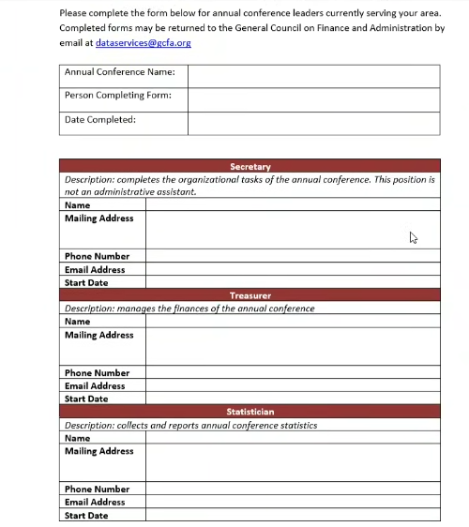
Leadership Form
Conference Leadership form
z
ENG
FRA
POR
SWA
Notes:
This is page one of the Annual Conference Leadership form for conferences. We have updated this form so please be sure you are using the latest version.
As a reminder, all the forms that I discuss today are in the process of being translated into French, Swahili, and Portuguese and will be sent out with the materials after today and also posted on the GCFA.org website.

Slide 81
Additional Information
ENG
Reminders:
Deaconesses are considered LAY and not CLERGY
Home Missioners are considered LAY and not CLERGY
Enter your Clergy count in the journal within the BAC
FRA
Rappels:
Les diacres sont considérés comme des laïcs et non des membres du clergé
Les Missionaires internes sont considérés comme des laïcs et non des membres du clergé
Entrez votre nombre de membres du clergé dans le journal (document de travail de la conférence annuelle)
POR
Lembretes:
Os diáconos e as diaconisas são considerados LEIGOS e não CLERO
Os Missionários Nacionais são considerados LEIGOS e não CLERO
Insira a sua contagem do Clero no diário no BAC
SWA
Vikumbusho:
Shemasi/ Mashemashi wanachukuliwa kuwa WALEI na sio MKADHA
Wamisionari wa Nyumbani wanachukuliwa kuwa WALEI na sio MKADHA
Ingiza idadi yako ya Makasisi kwenye jarida ndani ya BAC
Notes:
When you are filling out your Statistics and BAC, please keep these items in mind:
Deaconess are considered LAY and not CLERGY
Home Missioners are considered LAY and not CLERGY
Enter your Clergy count in the journal within the BAC

Slide 82
Additional Information
ENG
Changes:
GCFA will be updating the BAC after General Conference (May 2024)
FRA
Changements:
Après la Conférence générale (mai 2024) GCFA va actualiser l’ordre des travaux de la conférence annuelle.
POR
Mudanças:
O CGFA actualizará o BAC após a Conferência Geral (maio de 2024)
SWA
Mabadiliko:
GCFA itakuwa ikisasisha BAC baada ya Mkutano Mkuu (Mei 2024)
Notes:
GCFA will be updating the BAC after General Conference (May 2024)

Slide 83
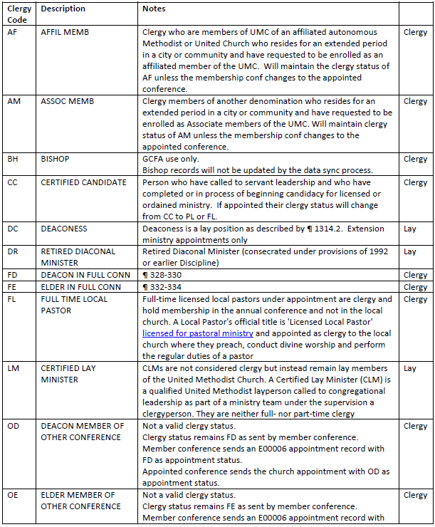
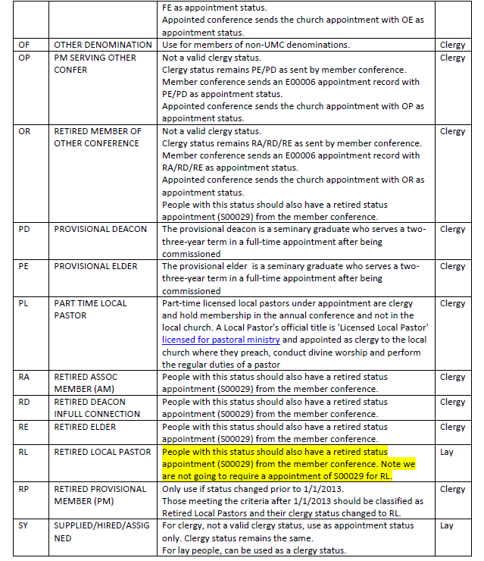
Clergy/Church Breakdown
Clergy Codes and Descriptions
z
ENG
FRA
POR
SWA
Notes:
The following slides will show some pictures of our Clergy Codes and Descriptions document and also define the various Church Types.
As a reminder, we will provide this information to you.

Slide 84
Church Definitions
ENG
Definitions of Church Types
Chartered: Une église locale affiliée est une congrégation autonome et pleinement opérationnelle dont un pasteur y est affecté et qui doit présenter un rapport financier et participatif annuel à sa conférence annuelle. L’organisation de l’église locale est définie dans le Livre de Discipline au ¶ 244. Une église affiliée n’a pas le statut de « nouvelle église débutante», elle n’est ni une église de mission ou rattachée à une autre congrégation, à moins d’être satellite à une communauté mère.
FRA
Définitions des types d’église
Affiliées: Une église locale affiliée est une congrégation autonome et pleinement opérationnelle dont un pasteur y est affecté et qui doit présenter un rapport financier et participatif annuel à sa conférence annuelle. L’organisation de l’église locale est définie dans le Livre de Discipline au ¶ 244. Une église affiliée n’a pas le statut de « nouvelle église débutante», elle n’est ni une église de mission ou rattachée à une autre congrégation, à moins d’être satellite à une communauté mère.
POR
Definições de tipos de Igreja
Oficial: Uma igreja local oficial é uma congregação independente e totalmente operacional para a qual foi nomeado um pastor. Espera-se que forneça um relatório financeiro e participativo anual à sua conferência anual. A organização da igreja local está definida no Livro de Disciplina ¶ 244. Uma igreja oficial não tem o estado de “Igreja Nova”, nem é uma igreja de missão ou anexada a outra congregação, a menos que seja a matriz de uma igreja satélite.
SWA
Ufafanuzi wa Aina za Kanisa
Imeidhinishwa: Kanisa la mtaa lililokodishwa ni kutaniko lililo huru, linalofanya kazi kikamilifu, ambalo limeteuliwa kuwa mchungaji, na linatarajiwa kutoa ripoti ya kila mwaka ya fedha na shirikishi kwa kongamano lake la kila mwaka. Mpangilio wa kanisa la mtaa umefafanuliwa katika BOD ¶ 244. Kanisa lililokodishwa haliko katika hadhi ya "Kuanza Kanisa Jipya", wala si kanisa la misheni au kuunganishwa na kutaniko lingine, isipokuwa kama mzazi kwa satelaiti.
Notes:
There are four church types that are defined:
Chartered
New Church Start
Satellite and
Mission
We also recognize central conferences have
Preaching Places
Fresh Expressions
We will provide definitions for these at a later date.
A chartered local church is a freestanding, fully operational, congregation that has been appointed a pastor, and is expected to give an annual financial and participatory report to its annual conference. A chartered church is not in “New Church Start” status, nor is it a mission church or attached to another congregation, unless as the parent to a satellite.

Slide 85
Church Definitions
Definitions of Church Types
New Church Start: A New Church Start is a church that has been established with the consent of the Bishop, but has not yet reached a level of organization to garner it a “chartered” church. A New Church Start may be appointed a pastor or submit statistics, but it is considered new (and given considerations associated with any newcomer) until the conference authorizes its charter. More information can be found in the BOD ¶ 259.2.
ENG
Définitions des types d’église
Nouvelle Église Débutantee: Une nouvelle église débutante est une église qui a été établie avec le consentement de l’évêque, mais qui n’a pas encore atteint un niveau d’organisation requise pour être une église « affiliée ». Un pasteur peut être affecté dans une nouvelle église débutante, elle peut soumettre des statistiques, mais elle est considérée comme nouvelle (et compte tenu des considérations associées à tout nouveau venu) jusqu’à ce que la conférence autorise son affiliation. Vous trouverez plus d’informations dans le BOD ¶ 259.2.
FRA
POR
Definições de tipos de Igreja
Igreja nova: Uma Igreja Nova é uma igreja que foi estabelecida com o consentimento do Bispo, mas ainda não atingiu um nível de organização para ser uma igreja “oficial”. Uma Igreja Nova pode ter um pastor nomeado ou enviar dados estatísticos, mas é considerada nova (e recebe considerações associadas a qualquer recém-chegado) até que a conferência autorize a sua oficialização. No Livro da Disciplina ¶ 259.2 podem encontrar=se mais informações.
SWA
Kuanzishwa kwa kanisa mpya: Anzisho Jipya la Kanisa ni kanisa ambalo limeanzishwa kwa idhini ya Askofu, lakini bado halijafikia kiwango cha shirika ili kulitengenezea kanisa "lililoidhinishwa". Anzisho Jipya la Kanisa linaweza kuteuliwa mchungaji au kuwasilisha takwimu, lakini linachukuliwa kuwa jipya (na kuzingatia mambo yanayohusiana na mgeni yeyote) hadi mkutano uidhinishe katiba yake. Habari zaidi inaweza kupatikana katika BOD ¶ 259.2.
Notes:
A New Church Start is a church that has been established with the consent of the Bishop, but has not yet reached a level of organization to garner it a “chartered” church. A New Church Start may be appointed a pastor or submit statistics, but it is considered new (and given considerations associated with any newcomer) until the conference authorizes its charter.

Slide 86
Church Definitions
Definitions of Church Types
Satellite: When authorized by the district superintendent and the district board of church location and building, chartered local churches may sponsor or serve as “parent” to a satellite church. The satellite is often a separate site or campus of a larger local church congregation.
ENG
Définitions des types d’église
Satellite: Lorsqu’elles sont autorisées par le surintendant de district et le conseil de district de l’emplacement et de la construction de l’église, les églises locales affiliées peuvent parrainer ou servir de « parent » à une église satellite. L’église satellite est souvent un site ou un campus séparé d’une plus grande congrégation ecclésiastique locale.
FRA
Definições de tipos de Igreja
Satélite: Quando autorizado pelo superintendente distrital e pela junta distrital de localização e construção da igreja, as igrejas locais oficiais podem patrocinar ou servir como “matriz” de uma igreja satélite. A igreja satélite geralmente é um local ou campus separado de uma congregação maior da igreja local.
POR
SWA
Sataleti: Yakiidhinishwa na msimamizi wa wilaya na halmashauri ya wilaya ya eneo na jengo la kanisa, makanisa ya mtaa yaliyokodishwa yanaweza kufadhili au kutumika kama "mzazi" kwa kanisa la satelaiti. Satelaiti mara nyingi ni tovuti tofauti au kampasi ya kutaniko kubwa la kanisa la mtaa.
Notes:
When authorized by the district superintendent and the district board of church location and building, chartered local churches may sponsor or serve as “parent” to a satellite church. The satellite is often a separate site or campus of a larger local church congregation.

Slide 87
Church Definitions
ENG
Definitions of Church Types
Mission: Congregations are designated as “Missions” when membership opportunities and resources place limits on the church’s abilities to obtain charter status. These churches often are created strategically in order to serve a limited population such as those of a minority demographic or to cater to other cultures or languages. Missions are often funded by sources outside of the congregation and rarely support the UMC connection through apportionments or other income, and the annual conference usually provides long-term administrative guidance of the congregation. The mission congregation may be organized in the same manner of any local church and can have the same rights and powers, as such submitting statistics to GCFA, as decided by the annual conference. The BOD ¶ 259.1a provides further detail.
FRA
Définitions des types d’église
Mission: Les congrégations sont désignées comme « missions » lorsque les possibilités d’adhésion et les ressources limitent les capacités de l’église à obtenir le statut d’affiliée. Ces églises sont souvent créées stratégiquement afin de servir une population limitée telle que celles d’une minorité démographique ou de répondre aux besoins d’autres cultures ou langues. Les missions sont souvent financées par des sources extérieures à la congrégation et soutiennent rarement la connexion de l’EMU par le biais de contributions ou d’autres revenus, et la conférence annuelle fournit généralement une orientation administrative à long terme de la congrégation. La congrégation missionnaire peut être organisée de la même manière que n’importe quelle église locale et peut avoir les mêmes droits et pouvoirs, en tant que telle en soumettant des statistiques à la GCFA, comme décidé par la conférence annuelle. Le BOD ¶ 259.1a fournit plus de détails. detail.
POR
Definições de tipos de Igreja
Missão: As congregações são designadas como “Missões” quando as oportunidades e recursos de membresia colocam limites na capacidade da igreja para obter o estado de oficial. Estas igrejas geralmente são criadas estrategicamente para servir uma população limitada, como as de uma minoria demográfica ou para atender a outras culturas ou idiomas. As missões são frequentemente financiadas por fontes independentes da congregação e raramente apoiam a conexão da IMU através de contribuições ou outras receitas, e a conferência anual geralmente fornece orientação administrativa a longo prazo para a congregação. A congregação da missão pode ser organizada da mesma forma que qualquer igreja local e pode ter os mesmos direitos e poderes, como tal, apresentar estatísticas ao CGFA, conforme decidido pela conferência anual. O Livro da Disciplina ¶ 259.1a fornece mais pormenores.
Ufafanuzi wa Aina za Kanisa
Misheni: Makutaniko yameteuliwa kama “Misheni” wakati fursa za uanachama na rasilimali zinaweka mipaka kwenye uwezo wa kanisa kupata hadhi ya mkataba. Makanisa haya mara nyingi huundwa kimkakati ili kuhudumia idadi ndogo ya watu kama vile wale wa idadi ndogo ya watu au kuhudumia tamaduni au lugha zingine. Misheni mara nyingi hufadhiliwa na vyanzo vya nje ya kutaniko na mara chache haitumii muunganisho wa UMC kupitia mgao au mapato mengine, na mkutano wa kila mwaka kwa kawaida hutoa mwongozo wa utawala wa muda mrefu wa kutaniko. Kutaniko la misheni linaweza kupangwa kwa njia sawa na kanisa lolote la mtaa na linaweza kuwa na haki na mamlaka sawa, kama vile kuwasilisha takwimu kwa GCFA, kama ilivyoamuliwa na kongamano la kila mwaka. BOD ¶ 259.1a inatoa maelezo zaidi.
SWA
Notes:
Congregations are designated as “Missions” when membership opportunities and resources place limits on the church’s abilities to obtain charter status. These churches often are created strategically in order to serve a limited population such as those of a minority demographic or to cater to other cultures or languages. Missions are often funded by sources outside of the congregation and rarely support the UMC connection through apportionments or other income, and the annual conference usually provides long-term administrative guidance of the congregation. The mission congregation may be organized in the same manner of any local church and can have the same rights and powers, as such submitting statistics to GCFA, as decided by the annual conference.

Slide 88
Questions?
Notes:
Thank you very much for your time – are there any questions?

Slide 89
Financial Update
Notes:
My name is Rick King. I am the Chief Financial Officer at GCFA.

Slide 90
2025-2028
Budget Recommendations To The
General Conference 2024

Slide 91
Denomination Circumstances
Jurisdictional Conferences
ENG
Denominational base is shrinking
FRA
La base dénominationnelle se rétrécit
POR
A base da denominação está a diminuir
SWA
Msingi wa kimadhehebu unapungua

Slide 92
Denomination Circumstances
Jurisdictional Conferences
ENG
Prior to COVID-19 and disaffiliations, worship attendance was rapidly declining at an increasing rate. Worship attendance in 2019 declined by 4% from 2018 and was 24% lower than 2009.
FRA
Avant la COVID-19 et les désaffiliations, la moyenne de présence aux cultes diminuait à une vitesse croissante. La présence aux cultes en 2019 a diminué de 4% par rapport à 2018 et était inférieure de 24% à celle de 2009.
POR
Antes do COVID-19 e das desfiliações, a frequência ao culto estava a diminuir rapidamente a uma taxa crescente. A frequência ao culto em 2019 diminuiu 4% em relação a 2018 e foi 24% menor que em 2009.
SWA
Kabla ya COVID-19 na kutohusishwa, mahudhurio ya ibada yalikuwa yakipungua kwa kasi kwa kasi inayoongezeka. Hudhurio la ibada katika 2019 lilipungua kwa 4% kutoka 2018 na lilikuwa chini ya 24% kuliko 2009.
Notes:
Prior to COVID-19, worship attendance was rapidly declining at an increasing rate. Worship attendance in 2019 declined by 4% from 2018 and was 24% lower than 2009.

Slide 93
Denomination Circumstances
Jurisdictional Conferences
ENG
Impact of disaffiliations expected to be 20%+. Latest annual conference survey in July 2022 projected 21.3%
FRA
L’impact des désaffiliations devrait être de +20%. Le dernier sondage des conférences annuelle en juillet 2022 prévoyait 21,3%
POR
Espera-se que o impacto das desfiliações seja de 20%+. O último inquérito da conferência anual em Julho de 2022 projectou 21,3%.
SWA
Athari za kutoshirikishwa zinatarajiwa kuwa 20%+. Utafiti wa hivi karibuni wa mkutano wa kila mwaka mnamo Julai 2022 ulikadiriwa 21.3%.
Notes:
The latest annual conference survey in July 2022 projected disaffiliations at 21.3%.

Slide 94
Denomination Circumstances
Jurisdictional Conferences
ENG
Combined these factors will significantly impact the both the local church and annual conferences
FRA
Combinés, ces facteurs auront un impact significatif sur l’église locale et les conférences annuelles
POR
Combinados, estes factores terão um impacto significativo na igreja local e nas conferências anuais
SWA
Mambo haya yakiunganishwa yataathiri kwa kiasi kikubwa kanisa la mtaa na konferensi za kila mwaka.
Notes:
Lower worship attendance and disaffiliations will significantly impact both the local churches and annual conferences.

Slide 95
Denomination Circumstances
Church Finances Jurisdictional Conferences
z
ENG
FRA
POR
SWA
Notes:
Church Finances – Using 2018 as the base year in comparison to years 2019 through 2021:

Slide 96
Denomination Circumstances
Church Finances Jurisdictional Conferences
ENG
Income has declined by 5-6% from 2018 figures
FRA
Les revenus ont diminué de 5 à 6% par rapport aux chiffres de 2018
POR
O rendimento diminuiu 5-6% em relação aos valores de 2018
SWA
Mapato yamepungua kwa 5-6% kutoka kwa takwimu za 2018
Notes:
Income has declined by 5%-6% from 2020 to 2021.

Slide 97
Denomination Circumstances
Church Finances Jurisdictional Conferences
ENG
Operating expenses in 2021 were virtually unchanged from 2018
FRA
Les charges d’exploitation en 2021 sont demeurées pratiquement inchangées par rapport à 2018
POR
As despesas operacionais em 2021 mantiveram-se praticamente inalteradas em relação a 2018
SWA
Gharama za uendeshaji wa kazi mnamo 2021 hazijabadilika kutoka 2018
Notes:
Operating expenses in 2019 increased by 1.8% and slightly unchanged in 2021.

Slide 98
Denomination Circumstances
Church Finances Jurisdictional Conferences
ENG
Less discretionary income at the local church for:
  Apportionments (down 13-17%)
  Program & mission (down 22-26%)
  Capital improvements (down 14-18%)
FRA
Moins de revenus discrétionnaires à l’église locale pour:
  Les contributions connexionnelles (de -13% à -17%)
  Programmes et missions (ben baisse de -22 à -26 %)
  Améliorations des immobilisations (en baisse de -14 à -18 %)
POR
Menos rendimentos discricionários na igreja local para:
  Contribuições (redução de 13-17%)
  Programas e missão (redução de 22-26%)
  Melhoria de capital (redução de 14-18%)
SWA
Mapato ya chini ya hiari katika kanisa la mtaa kwa:
  Sehemu (chini ya 13-17%)
  Programu na dhamira (chini ya 22-26%)
  Maboresho ya mtaji (chini ya 14-18%)
Notes:
Spending at the local church – Apportionments are down between 13% and 17%; program and mission are down 22% to 26% and capital improvements are down between 14% and 18%.

Slide 99
Denomination Circumstances
Survey Jurisdictional Conferences
z
ENG
FRA
POR
SWA
Notes:
Conference Survey – Information Source: Annual Conference Survey July 2022. The cumulative impact of disaffiliation on local church net expenditures by year for 5 Jurisdictions ranged from 5.2% in year 2022 to a projection of 21.3% in year 2025.

Slide 100
Denomination Circumstances
Survey Jurisdictional Conferences
z
ENG
FRA
POR
SWA
Actual impact in 2022 was greater than Predicted by the survey and is approximately 1/3 of the estimated total over a 4 year period.
L’impact réel en 2022 a été plus important que prévu par l’enquête et représente environ 1/3 du total estimé sur une période de 4 ans.
O impacto real em 2022 foi maior do que o previsto pelo inquérito e é aproximadamente 1/3 do total estimado durante um período de 4 anos
Athari halisi katika 2022 ilikuwa kubwa kuliko ilivyotabiriwa na utafiti na ni takriban 1/3 ya jumla iliyokadiriwa katika kipindi cha miaka 4.
Notes:
Actual rate of disaffiliation in 2022 was 7% vs. projected survey of 5.2%. The actual impact in 2022 was greater than predicted by the survey and is approximately 1/3 of the estimated total over a 4-year period.

Slide 101
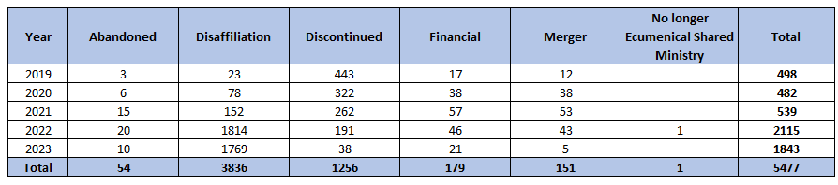
Denomination Circumstances
Church Closures Jurisdictional Conferences
z
ENG
Aggregated Data of Church Closures by Reason as of July 7, 2023
Chiffres consolidés sur les fermetures d’églises par raisons au 7 juillet 2023
Dados agregados de encerramentos de igrejas por motivo, a partir de 7 de Julho de 2023
Data Iliyojumlishwa ya Kufungwa kwa Kanisa kwa Sababu kuanzia tarehe 7 Julai 2023
FRA
POR
SWA
Notes:
Church Closures – Total church closures by reason are as shown. 23 churches disaffiliated in 2019, rising to total of 3,836 churches reported as of July 7, 2023.

Slide 102
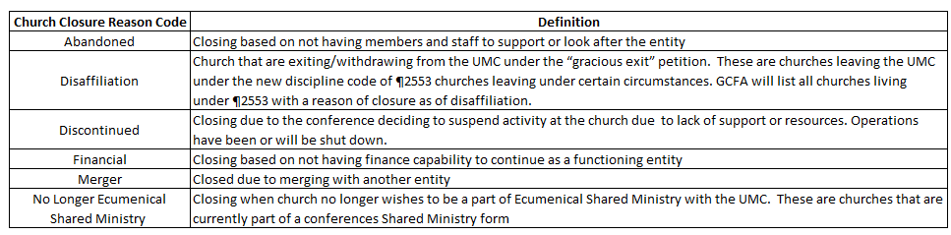
Denomination Circumstances
Church Closures Jurisdictional Conferences
z
ENG
FRA
POR
SWA
Notes:
Closure by reason of ‘Disaffiliation’ constitutes 70% of the total church closures, followed by 1,256 Discontinued churches, which is 23% of total churches closed and reported as of July 7, 2023.

Slide 103
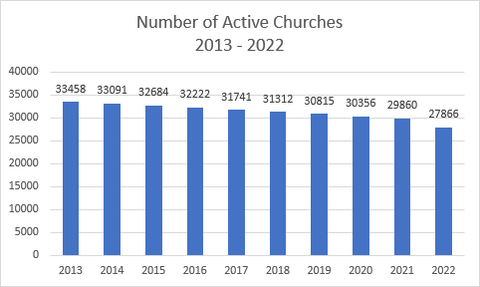
Denomination Circumstances
Active Churches in Jurisdictional Conferences
z
ENG
FRA
POR
SWA
Notes:
There were 33,458 active churches in 2013 which has declined down to 27,866 in 2022.

Slide 104
Denomination Circumstances
Jurisdictional Conferences
Overall General Church Apportionments declining by 38.7%
Shrinking Denomination
Reduction of Base Percentage
ENG
FRA
En générales, les contributions connexionnelles diminuent de 38,7 %
Décroissance de la dénomination
Réduction du Pourcentage de Base
POR
As contribuições globais da Igreja Geral estão a diminuir em 38,7%
Diminuição da denominação
Redução da percentagem de base
SWA
Ugawaji wa jumla wa Kanisa Kuu umepungua kwa 38.7%
Madhehebu Yanayopungua
Kupunguza Asilimia ya chini
Notes:
The overall General Church Apportionments are declining by 38.7%. The main factors are:
Shrinking Denomination
Reduction of the Base Percentage

Slide 105
Apportionments Formula 2025-2028
Jurisdictional Conferences
ENG
A = E x P
A = Apportionments
E = Net Expenditures consists of the total local church expenditures in the annual conference minus:
  Current capital expenditures
  Expenditures on capital debt
  Payments toward general Church apportionments
  Benevolent giving
P = Base Percentage (of net expenditures) approved by General Conference
FRA
R = D x P
R = Répartition (Contribution connexionnelle)
D = Les dépenses nettes comprennent les dépenses totales de l’église locale lors de la conférence annuelle moins :
  Dépenses d’investissement courantes
  Dépenses au titre de la dette en capital
  Paiements des contributions générales de l’Église
  Dons bienveillants
P = Pourcentage de base (des dépenses nettes) approuvé par la Conférence générale
POR
A = E x P
A = Contribuições
E = As despesas líquidas consistem nas despesas totais da igreja local na conferência anual menos:
  Despesas de capital actuais
  Despesas ligadas à dívida de capital
  Pagamentos para contribuições gerais da Igreja
  Doações de beneficência
P = Percentagem de base (das despesas líquidas) aprovada pela Conferência Geral
SWA
A = E x P
A = Mgawanyo
E = Matumizi Halisi yanajumuisha jumla ya matumizi ya kanisa la mtaa katika kongamano la kila mwaka ukiondoa:
  Matumizi ya mtaji wa sasa
  Matumizi ya deni kuu
  Malipo kwa mgawanyo wa jumla wa Kanisa
  Kutoa kwa ukarimu
P = Asilimia ya chini (ya jumla ya matumizi) iliyoidhinishwa na Mkutano Mkuu
Notes:
Base Percentage is a percentage of the net expenditures approved by the General Conference
The Base Percentage has a declining trend since the 1993-1996 Quadrennium, from 5.41% down to 2.54% for the 2025-2028 Quadrennium. The recommendation to reduce the Base Percentage by 22.9% in 2025-2028 Quadrennium was approved by the GCFA Board.

Slide 106
Base Percentage Trend & Recommendation for 2025-2028
Jurisdictional Conferences Apportionments
z
ENG
FRA
POR
SWA
GCFA Board approved recommendation to reduce the Base Percentage by 22.9% in 2025-2028
Le Conseil d’administration du GCFA a approuvé la recommandation de réduire le pourcentage de base de 22,9% en 2025-2028
O Conselho de Administração do GCFA aprovou a recomendação para reduzir a percentagem de base em 22,9% de 2025 a 2028
Bodi ya GCFA iliidhinisha pendekezo la kupunguza Asilimia ya Msingi kwa 22.9% mwaka wa 2025-2028
Notes:
Jurisdictional Apportionments - Comparison between Quadrenniums

Slide 107
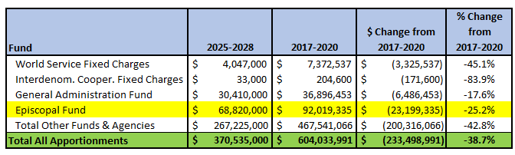
Denomination Circumstances
Jurisdictional Apportionments
z
ENG
Budget Comparison of 2017-2020 Quadrennium to 2025-2028 Quadrennium
FRA
Comparaison budgétaire du quadriennal 2017-2020 au quadriennal 2025-2028
POR
Comparação do Orçamento entre o Quadriénio de 2017-2020 e o Quadriénio de 2025-2028
SWA
Ulinganisho wa Bajeti ya 2017-2020 Quadrennium hadi 2025-2028 Quadrennium
Notes:
Total Apportionments for 2025-2028 at $371 million, a $233 million reduction (38.7%) from 2017-2020. Episcopal Fund for 2025-2028 at $69 million, a $23 million reduction (25.2%) from 2017-2020.

Slide 108
Apportionments Formula 2025-2028
Central Conferences
ENG
FRA
R = (J * M) * E
R = Répartition (contribution connexionnelle)
J = Contribution connexionnelle des juridictions (USA) par membre professant pour chacun des fonds d’administration général est épiscopale.
M = Nombre de membres professant à la Conférence annuelle de la Conférence centrale, tel qu’indiqué dans les statistiques annuelles envoyées à GCFA.
E = Facteur d’ajustement économique (PIB - Produit intérieur brut) par habitant de chaque pays ou conférence annuelle par rapport aux États-Unis) exprimé en pourcentage.
A = (J * M) * I
A = Apportionments
J = Jurisdictional Apportionments per Professing Member for each of the Episcopal and General Administration Funds.
M = Number of Professing Members in the Central Conference Annual Conference as reported in the annual statistics sent to GCFA.
i = Economic Adjustment Factor (each country’s or annual conference’s GDP (Gross Domestic Product) per capita in relation to the U.S. expressed as percentage.
POR
SWA
A = (J * M) * I
A = Contribuições
J = Contribuições Jurisdicionais por Membro Professo para cada um dos Fundos Episcopais e de Administração Geral.
M = Número de Membros Professos na Conferência Anual da Conferência Central, conforme mencionado nos dados estatísticos anuais enviados ao CGFA.
I = Factor de Ajuste Económico (PIB - Produto Interno Bruto de cada país ou conferência anual) per capita em relação aos EUA expresso como percentagem).
A = (J * M) * I
A = Mgawanyo
J = Mgao wa Kisheria kwa Mwanachama Mkuu kwa kila Mfuko wa Maaskofu na Utawala Mkuu.
M = Idadi ya Wanachama Wanachama katika Kongamano Kuu la Mwaka la Mkutano Mkuu kama ilivyoripotiwa katika takwimu za kila mwaka zinazotumwa kwa GCFA.
i = Sababu ya Marekebisho ya Kiuchumi (Pato la Taifa la kila nchi au mkutano wa kila mwaka (Pato la Taifa) kwa kila mtu kuhusiana na Marekani iliyoonyeshwa kama asilimia.

Slide 109
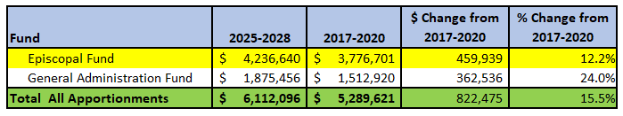
Denomination Circumstances
Central Conference Apportionments
z
ENG
Budget Comparison of 2017-2020 Quadrennium to 2025-2028 Quadrennium
FRA
Comparaison budgétaire du quadriennal 2017-2020 au quadriennal 2025-2028
POR
Comparação do Orçamento entre o Quadriénio de 2017-2020 e o Quadriénio de 2025-2028
SWA
Ulinganisho wa Bajeti ya 2017-2020 Quadrennium hadi 2025-2028 Quadrennium
Notes:
Central Conference Church Apportionments Comparison between Quadrenniums. Total Apportionments for 2025-2028 at $6 million, an $822 thousand increase, 15.5% from 2017-2020.
Episcopal Fund for 2025-2028 at $4 million, a $460 thousand increase, 12.2% from 2017-2020.

Slide 110
Episcopal Fund Financial
Status and Projections

Slide 111
Episcopal Areas Currently Approved by General Conference
ENG
Current approved number of Episcopal Areas
FRA
Nombre de région épiscopales actuellement approuvé
POR
Número de áreas episcopais actualmente aprovadas
SWA
Idadi ya sasa iliyoidhinishwa ya Maeneo ya Maaskofu
Notes:
Episcopal Areas Currently Approved by the General Conference

Slide 112
Episcopal Areas Currently Approved by General Conference
ENG
  Jurisdictions – 46
  By formula in 2024 this number could be lower
    North Central, Northeastern, and South Central Jurisdictions already calculate to lose one Episcopal Area
    Number of areas by calculation could decrease further with disaffiliation
FRA
  Jurisdictions – 46
  Selon la formule en 2024, ce nombre pourrait être inférieur
    Les juridictions du Centre-Nord, du Nord-Est et du Centre-Sud calculent déjà la perte d’une région épiscopale
    Le nombre de régions selon le calcul pourrait diminuer davantage avec les désaffiliations
  Jurisdições – 46
  Pela fórmula, em 2024, este número poderá ser inferior
    As jurisdições Centro-Norte, Nordeste e Centro-Sul já calculam perder uma Área Episcopal
    O número de áreas por cálculo poderá diminuir ainda mais com a desfiliação
POR
  Mamlaka – 46
  Kwa fomula mnamo 2024 nambari hii inaweza kuwa chini
    Mamlaka ya Kaskazini ya Kati, Kaskazini-mashariki, na Kusini mwa Kati tayari yanakokotoa kupoteza Eneo moja la Maaskofu
    Idadi ya maeneo kwa kukokotoa inaweza kupungua zaidi kwa kutoshirikishwa
SWA
Notes:
Jurisdictions – there are 46 Jurisdictions approved by the General Conference. By formula, the number could be lower in 2024 and could decrease further with disaffiliation. By formula, the North Central, Northeastern, and South Central Jurisdictions calculate to lose one Episcopal Area.

Slide 113
Episcopal Areas Currently Approved by General Conference
  Central Conferences
  Current approved Episcopal Areas = 25
  20 currently filled
  5 new areas in Africa approved by 2016 General Conference
ENG
FRA
  Conférences centrales
  Régions épiscopales actuellement approuvées = 25
  20 actuellement pourvus
  5 nouvelles régions en Afrique approuvées par la Conférence générale de 2016
POR
  Conferências Centrais
  Áreas episcopais actualmente aprovadas = 25
  20 actualmente preenchidas
  5 áreas novas em África aprovadas pela Conferência Geral de 2016
SWA
  Mikutano ya Kati
  Maeneo ya Maaskofu yaliyoidhinishwa kwa sasa = 25
  20 zilizojazwa kwa sasa
  Maeneo 5 mapya barani Afrika yaliyoidhinishwa na Mkutano Mkuu wa 2016
Notes:
Central Conferences are approved for 25 Episcopal Areas. 20 Episcopal areas are currently filled and 5 new areas in Africa were approved by the 2016 General Conference.

Slide 114
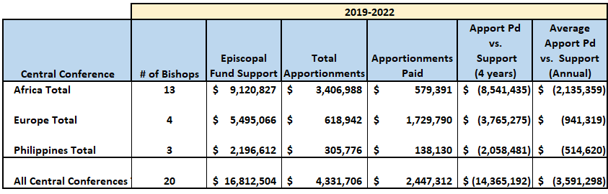
2019-2022 Central Conference Episcopal Costs,
Apportionments and Apportionments Paid
z
ENG
Costs for 20 Active Bishops
FRA
Coûts pour 20 évêques actifs
POR
Custos para 20 Bispos activos
SWA
Gharama kwa Maaskofu 20 Walio hai
Notes:
Episcopal Costs include Salaries, Benefits, Office and Housing Allowances, Travel, Continuing Education, Renewal Leave and Equipment Purchases.
Africa Central Conference Total
The costs for 13 Bishops are $9 million. The Apportionments paid from 2019 to 2022 is $579,000, resulting in a Net Deficit of $8.5 million for 4 years.
The average Net Deficit for each year is $2.1 million.
Europe Central Conference Total
The costs for 4 Bishops are $5.5 million. The Apportionments paid from 2019 to 2022 is $1.7 million, resulting in a Net Deficit of $3.8 million for 4 years.
The average Net Deficit for each year is $941,000.
The Philippines Central Conference Total
The costs for 3 Bishops are $2 million. The Apportionments paid from 2019 to 2022 is $138,000, resulting in a Net Deficit of $2 million for 4 years.
The average Net Deficit for each year is $515,000.

Slide 115
2024 Retirements & Number of Active Bishops Before Elections
z
ENG
FRA
POR
SWA
Notes:
2024 Retirements and Number of Active Bishops before Elections
Jurisdictions – there are 5 mandatory retirements in 2024
Central Conferences – there are 5 mandatory retirements plus 3 Bishops meeting their term limits in 2024, total of 8 retirements in 2024.
The total potential elections in 2024 are 12 for Jurisdictional Conferences and 13 for the Central Conferences.

Slide 116
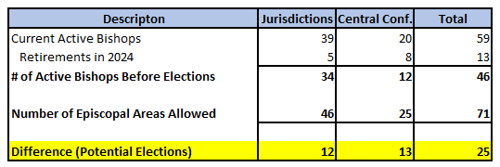
2024 Retirements & Number of Active Bishops Before Elections
z
ENG
FRA
POR
SWA
Notes:
The total potential elections in 2024 are 12 for Jurisdictional Conferences and 13 for the Central Conferences.

Slide 117
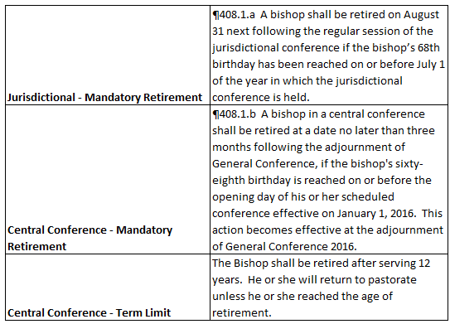
2024 Retirements & Number of Active Bishops Before Elections
z
ENG
FRA
POR
SWA

Slide 118
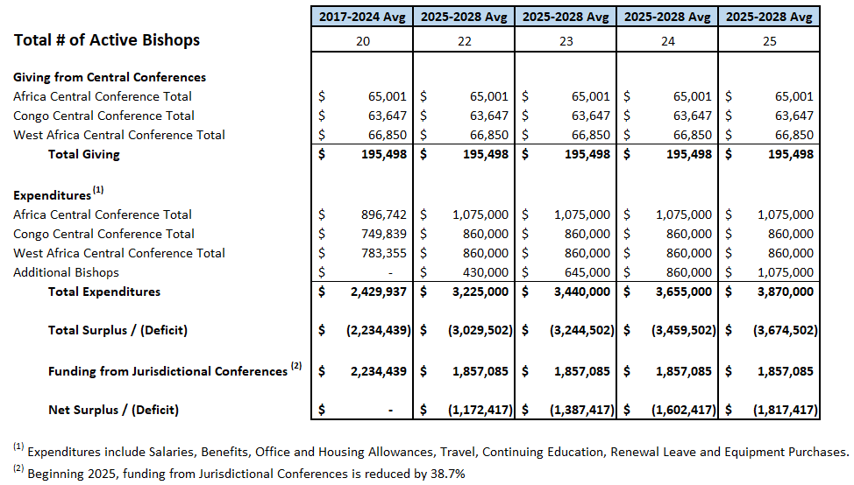
Episcopal Fund – Baseline Giving and Spending Projections
z
ENG
FRA
POR
SWA
Notes:
Episcopal Fund Giving and Spending Projections for the African Central Conferences
Projected average Giving per year, $195,498 remains the same for all scenarios of active Bishops.
Projected average spending increases proportionately to the number of active Bishops, resulting in higher Net Deficit as the number of active Bishops increase.
Net Deficit for the 2017-2024 Quadrennium is projected to be fully funded by the Jurisdictional Conferences.
Beginning 2025, the average funding per year from Jurisdictional Conferences is reduced by 38.7%, resulting in higher annual Net Deficit averages.

Slide 119
Questions?

Slide 120
Connectional
Relations
Notes:
Good afternoon - I’m Kellie Schmeal and I’m the Relationship Director in the Connectional Relations Department at GCFA. I will be talking to you about our UMC Support Brand and our ministry. I’m joined by Ndzulo Tueche, our Shared Services Manager for the Central Conferences.

Slide 121
UMC Support: GCFA’s service brand
ENG
Our Ministry is to support your Ministry!
FRA
Notre ministère consiste à soutenir votre ministère!
POR
O nosso Ministério destina-se a apoiar o seu Ministério!
SWA
Huduma yetu ni kusaidia huduma yenu!
Notes:
UMC Support is GCFA’s Service Brand where our Ministry is to Support your Ministry. We like to say, when you don’t know where to go with a question, we are a good place to start

Slide 122
UMC Support: GCFA’s service brand
ENG
UMC Support is our ministry services brand dedicated to supporting Methodist entities
FRA
UMC Support est notre marque de services du ministère dédiée au soutien des entités méthodistes
POR
Apoio à IMU é a marca dos serviços do nosso ministério dedicados a apoiar as entidades metodistas
SWA
Usaidizi wa UMC ni chapa yetu ya huduma za huduma iliyojitolea kusaidia vyombo vya Methodist
Notes:
UMC Support is our ministry brand dedicated to supporting Methodist entities.

Slide 123
UMC Support: GCFA’s service brand
ENG
We provide United Methodist ministries with cost saving solutions and resources
FRA
Nous fournissons aux ministères Méthodistes Unis des solutions et des ressources économiques
POR
Fornecemos aos ministérios metodistas unidos soluções e recursos para a redução de custos
SWA
Tunatoa huduma za United Methodist masuluhisho na nyenzo za kuokoa gharama
Notes:
We provide United Methodist ministries cost saving solutions and resources

Slide 124
UMC Support: GCFA’s service brand
ENG
Through cost-saving solutions, the UMC can focus those savings on their ministries
FRA
Grâce à des solutions économiques, l’EMU peut concentrer ces économies sur ses ministères.
POR
Através de soluções de redução de custos, a IMU pode concentrar essas economias nos seus ministérios
SWA
Kupitia masuluhisho ya kuokoa gharama, UMC inaweza kuelekeza akiba hizo kwenye wizara zao
Notes:
We provide United Methodist ministries cost saving solutions and resources

Slide 125
UMC Support: GCFA’s service brand
ENG
We help our connection solve problems as they manage their churches, programs, and ministries
FRA
Nous aidons notre connexion à résoudre les problèmes alors qu’ils gèrent leurs églises, leurs programmes et leurs ministères.
POR
Ajudamos a nossa conexão a resolver problemas na gestão das suas igrejas, programas e ministérios
SWA
Tunasaidia muunganisho wetu kutatua matatizo wanaposimamia makanisa, programu, na huduma zao.
Notes:
Through these solutions, you can focus those savings on time and resources back into your ministries of making disciples of Christ

Slide 126
UMC Support: GCFA’s service brand
ENG
We are here to help!
FRA
Nous sommes là pour vous aider!
POR
Estamos aqui para ajudar!
SWA
Tuko hapa kusaidia!
Notes:
I’m now going to turn my time over to Ndzulo Tueche, Shared Services Manager for the Central Conferences to talk more about our services and how he supports our Central Conferences

Slide 127
UMC Support Services
ENG
FRA
UMC Support offers more than 30 services to United Methodist entities, including:
​Communications and Marketing​
Human Resources​
Technology and Audio/Visual Services​
Travel and Meeting Planning​
UMC Support offre plus de 30 services aux entités Méthodistes Unies, y compris:
Communications et marketing
Ressources humaines
Technologie et services audiovisuels
Planification de déplacements et des réunions
POR
SWA
O Apoio à IMU oferece mais de 30 serviços e entidades metodistas, incluindo:
​Comunicação e Marketing​
Recursos Humanos​
Tecnologia e Serviços Audiovisuais​
Planeamento de deslocações e reuniões
Usaidizi wa UMC unatoa huduma Zaidi ya 30 kwa vyombo vya United Methodist, ikijumuisha:
Mawasiliano na Masoko
Rasilimali Watu
Teknolojia na Huduma za Sauti/Visual
Usafiri na Mipango ya Mikutano
Notes:
Thank you, Kellie.
Before unfolding the remaining part of this presentation on UMC Support Services, dear bishops, and annual conference leaders, please don’t hesitate to ask questions in the chat feature of your Zoom application.
Since 2015 and 2016, GCFA has been providing shared services across the denomination as one of many possible avenues to increase the financial resources necessary to fund the exciting process of making disciples of Jesus Christ.

Slide 128
UMC Support Services
ENG
Services for Annual Conferences, Local Churches, Camps & Retreats, Ethnic Caucuses, and more! ​​
FRA
Services pour les conférences annuelles, les églises locales, les camps et les retraites, les caucus ethniques et plus encore!
POR
Serviços para Conferências Anuais, Igrejas Locais, Acampamentos e Retiros,
Convenções Étnicas e muito mais!​​
SWA
Huduma za Mikutano ya Kila Mwaka, Makanisa ya Mitaa, Kambi na Mafungo, Mikutano ya Kikabila na zaidi!
Notes:
We have identified more than 30 such services that we have grouped into four major categories namely: Communications and Marketing services; Human Resources services; Technology and audio/visual services; and Travel and meeting planning services. (Next slide)

Slide 129
UMC Support Services
ENG
FRA
Communication and Marketing Services:
Graphic Design
Website Design
Videos
Logo design​
Services de communication et de marketing:
Conception graphique
Conception de site Web
Vidéos
Conception de logo
POR
SWA
Serviços de Comunicação e Marketing:
Design gráfico
Design de sites
Videos
Design de logótipos​
Mawasiliano na Huduma za Masoko ;
Ubunifu wa Picha,
Kubuni Tovuti,
Video,
Ubunifu wa Nembo
Notes:
Whether you are an annual conference, a local church, a district, a bible camp, a retreat center, or an ethnic caucus… As long as you are a United Methodist-related organization, our services are here to help take your ministry to the next level, with God’s help. (Next slide) On the next few slides, you will see the major categories of our services and in the points, the list of subcategories of services that we offer.

Slide 130
UMC Support Services
ENG
FRA
Human Resources:
HR Recruitment
HR Best Practices
Policy Review​
Ressources humaines:
recrutement RH,
Bonnes pratiques RH examen des
politiques/manuels de procédures
POR
SWA
Recursos Humanos:
Recrutamento de RH Melhores Práticas
Revisão de políticas​
Rasilimali Watu:
Uajiri wa Waajiri,
Mbinu Bora za Utumishi,
Mapitio ya Sera

Slide 131
UMC Support Services
ENG
Technology Services:
Audio Visual Services (Consultations, Equipment, etc.) Computer/Network Assessments
Back Up/Recovery
Email and Server Hosting
Technology Security
BackUp and Recovery Services
Managed Networks, KnowBe4 Security Training Great Plains Accounting and Business Management Software
Internet Phone Service and Hardware​​​
FRA
Services technologiques:
Services audiovisuels (consultations, équipement, etc.)
Ordinateur/Réseau Évaluations
service d’assistance géré, sauvegarde/récupération
hébergement de courriels et de serveurs
sécurité technologique
services de sauvegarde et de récupération
réseaux gérés, formation à la sécurité KnowBe4
logiciel de comptabilité et de gestion d’entreprise Great Plains
service téléphonique Internet et matériel
POR
Serviços de Tecnologia:
Serviços audiovisuais (consultas, equipamento, etc.)
Avaliações de informática e de redes
Cópias de segurança ou backup e recuperação
Alojamento de e-mail e servidores
Segurança tecnológica
Serviços de cópias de segurança e recuperação
Redes geridas, formação em segurança KnowBe4
Software de contabilidade e gestão de negócios Great Plains
Serviço de telefone pela Internet e Hardware​​​
SWA
Huduma za Kiteknolojia: Huduma za Kutazama kwa Sauti (Mashauriano, Vifaa, n.k.)
Tathmini za Kompyuta/Mtandao, Dawati la Usaidizi Linalosimamiwa, Hifadhi nakala/Urejeshaji,
Upangishaji wa Barua pepe na Seva, Usalama wa Teknolojia, Huduma za Hifadhi Nakala na Urejeshaji, Mitandao Inayosimamiwa, Mafunzo ya Usalama ya KnowBe4,
Programu ya Uhasibu na Usimamizi wa Biashara ya Great Plains, Huduma ya Simu ya Mtandao na Maunzi

Slide 132
UMC Support Services
ENG
FRA
Travel and Meeting Planning:
Virtual and Hybrid
Comprehensive Meeting
Planning and Online
Meeting Registration​​
Planification des déplacements et des réunions:
planification complète des réunions virtuelles et hybrides et inscription aux réunions en ligne
POR
SWA
Planeamento de viagens e reuniões:
Virtuais e híbridas
Reuniões abrangentes
Planeamento e online
Registo para reuniões​​
Upangaji wa Kusafiri na Mikutano:
Upangaji wa Mikutano wa Uwazi na
Mseto na Usajili wa Mikutano Mtandaoni.
Notes:
We will send you a detailed list of services we offer. In fact, you can find them on our website www.gcfa.org or www.umcsupport.org. While there, make sure you sign up to receive our monthly e-newsletter titled “The Collaborator.” (Next slide)

Slide 133
Additional Ways We Serve You
ENG
Central Conference bi-annual newsletter (starting in August 2023) ​
FRA
Bulletin semestriel de la Conférence centrale (à partir d’août 2023)
POR
Boletim semestral da Conferência Central (a partir de Agosto de 2023)
SWA
​Jarida la Mkutano Mkuu wa mara mbili wa mwaka (kuanzia Mwezi wa Nane 2023)
Notes:
In addition to the shared services we offer, there are 4 additional ways GCFA is available to serve you. These are:
The Central Conference bi-annual newsletter. Starting this month, we will be releasing this newsletter to provide you with resources you can use to fulfill your respective ministries. A few days after this meeting, we will send you that newsletter. Believe me, you don’t want to miss that email. In this regard, feel free to contact us if you wish to contribute to this newsletter through a testimony, a story of how your ministry changed after implementing sound and proven financial practices. Also, feel free to contact us if you want to sponsor this work. (Next slide)

Slide 134
Additional Ways We Serve You
ENG
Free and/or discounted training and webinars throughout the year
FRA
Formation et webinaires gratuits et/ou à prix réduit tout au long de l’année
POR
Formação e webinars gratuitos e/ou com desconto durante todo o ano
SWA
Mafunzo ya bila malipo na/au yaliyopunguzwa bei na mifumo ya mtandao kwa mwaka mzima
Notes:
Training and webinars make up the second way we serve you. If you go to our YouTube channel and Facebook page, you’ll find webinars to update your knowledge base and perhaps also your skillsets. In fact, we are currently working on a church business development training program we believe can positively transform the way we do church. (Next slide)

Slide 135
Additional Ways We Serve You
ENG
Assist as possible to connect you with GCFA and other UMC-related resources​
FRA
Aider autant que possible à vous mettre en contact avec GCFA et d’autres ressources liées à l’EMU
POR
Ajudar tanto quanto possível a conectá-lo com o GCFA e com outros recursos relacionados com a IMU
SWA
Saidia iwezekanavyo kukuunganisha na GCFA na nyenzo zingine zinazohusiana na UMC
Notes:
The third way GCFA is here to serve you is by connecting you to the right resources within the Agency and across the UMC. We frequently receive questions meant for other agencies. We don’t just answer “sorry we don’t know”. We research and redirect to the appropriate sister agency or the right department within GCFA, to ensure that your ministry has access to what it needs. (Next slide)

Slide 136
Additional Ways We Serve You
ENG
Designated Staff based in Cote d’Ivoire
FRA
Personnel désigné basé en Côte d’Ivoire
POR
Pessoal nomeado e com sede na Costa do Marfim
SWA
Wafanyakazi walioteuliwa wanaoishi Cote d’Ivoire
Notes:
The fourth way GCFA serves you is through our presence on the African continent. Working from Abidjan is meant to make it easier for you to communicate back and forth with GCFA. For any questions you have in relation to GCFA and its services, feel free to contact me. My WhatsApp numbers are +1.615.400.1050 and +225.070.724.5180
I am so grateful for the opportunity to serve you, and by the grace of God, I am not alone. (Next slide)

Slide 137
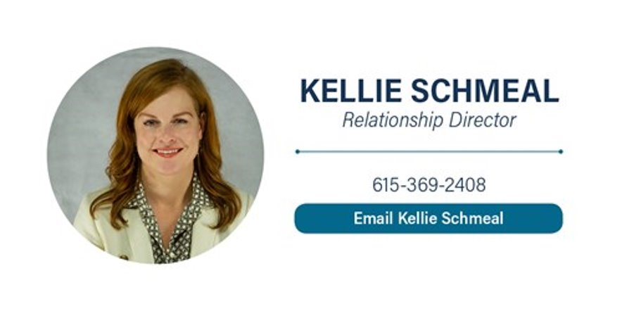


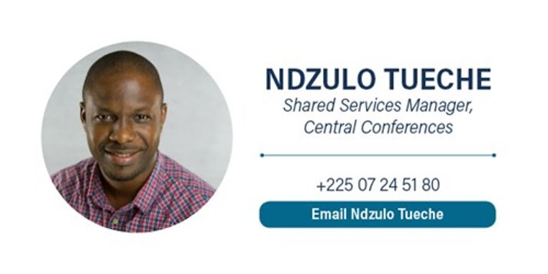
We’re Here To Help
Notes:
Kellie Schemeal, Jacqueline Givens, Tammie Ruffle and I make up the Connectional Relations team, where our ministry is to support your ministry as we journey to make disciples of Jesus Christ.

Slide 138
Questions?

Slide 139
OBRIGADO!
THANK YOU!
CONTACT
1908 Grand Avenue
Nashville, TN 37212
+225 07 24 51 80
NTueche@GCFA.org
www.gcfa.org
Notes:
Thank you very much, Merci beaucoup, Muinto Obrigado, Asante Sana, Matondo Mingi!

