Slide 1
Travel and Meeting Planning
Jodi Chadwell, CFMP
Chief Relationship Officer

Slide 2
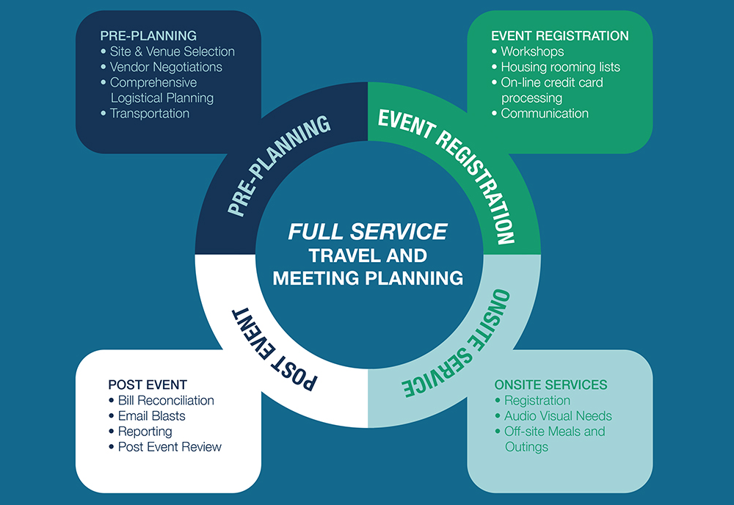
Full Service Meeting Planning

Slide 3
Logistical Support
Meeting Room Set-Up
Audio-Visual Arrangements
Staging and Décor Arrangements
Food and Beverage
Destination Management
Hotel room block management
Rooming list and change submissions
Signage
Coordinate Ground Transportation
Registration site management
Run Pre-Convention and Post-Convention Meetings
Liaison with hotel, convention and other vendors
Handle onsite needs and changes
Audit the Master Bill
Assist in travel changes in conjunction with Adtrav travel agency
On Site Emergency Assistance
  Connecting to local emergency services, doctors, or hospitals

Slide 4
Hybrid & Virtual Meeting Planning
Creatively reviewing agenda for attendee experience
Personalized event website and online registration
Attendee communication and coordination
Interpreter coordination
Individualized, integrative design solutions
Speaker support to include coaching, comprehensive communication pre-meeting and during the meeting
Setting virtual breakouts rooms to promote discussion in smaller groups
AV Vendor coordination
Management of break times to encourage networking and social time
Comprehensive event production planning and scheduling
Legal review of contracts when applicable

Slide 5
1 Music Circle N Nashville, TN 37203
615-369-2366
jchadwell@gcfa.org
www.gcfa.org

