Slide 1
GCFA Resources for Your Annual Conference
Melissa Jackson, Communications & Marketing Services Manager

Slide 2
GCFA Resources For Your Conference!
Feel Free to Republish Our Content!
The Collaborator - Local Church Audience
21,000 subscribers
First Full Week of the Month
http://www.gcfa.org/subscribe
Ministry Minute – Small Subscriber List of Administrative Church Leaders
Features important deadlines & notices to The Connection
Third Full Week of the Month
Audience: Administrative Decision Makers – including you!
Includes updates from Episcopal, Data, Legal, and Finance Departments

Slide 3
Webinars for Your Members
Check Out Our YouTube Channel!
UPCOMING WEBINARS
Understanding Clergy Discretionary Funds – May 23
Understanding, Preventing, & Protecting Against Cyber Crime Part I – July
Understanding, Preventing, & Protecting Against Cyber Crime Part II – August
Office 365 – Make Your Work Easier & More Secure! – September
PREVIOUS WEBINARS
Understanding Unrelated Business Income Tax (March 28) – soon to be published.
Church Tech Talk: Tools to Protect Your Ministry in a Digital Age
Clergy Housing Allowance Q & A with General Counsel Bryan Mills

Slide 4
GCFA Resources For Your Conference!
Content Examples for Churches & Conferences
Human Resources
Onboarding Checklist
Staff Recruiting: Five Steps to Successful Recruiting
Information Technology
IT Case Study
A/V Tips to Maintain Your Equipment
Legal Resources
Understanding Copyrights & Getting the Correct Licenses
Clergy Housing Allowance Explainer & Webinar
Travel & Meeting Planning
Best Practices For Hosting Your Large Event
Communications
Four Essentials When ReBranding
Website Building Worksheet
Financial Resources
Interactive eGiving Training
Clergy Discretionary Fund

Slide 5
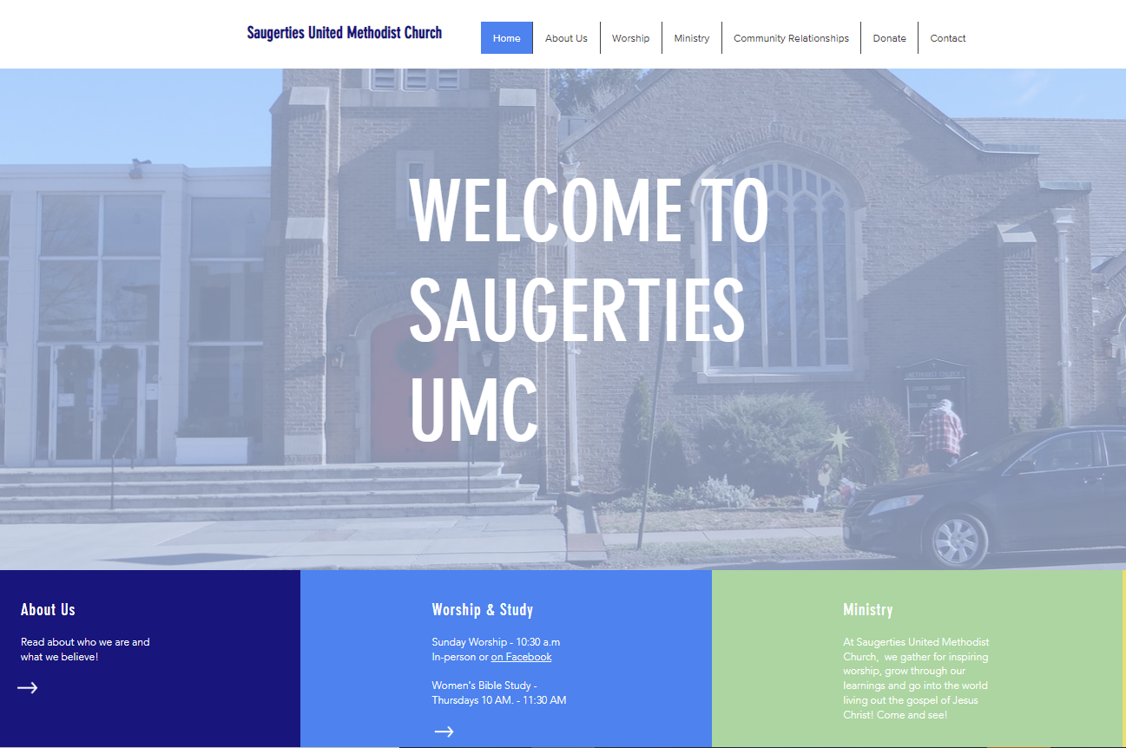
UMC Support Communication Services
Use our Resources … and Our Services!
Website Building Services
Branding
Graphic Design
Communications Audits
Comprehensive Communications Services
Ministry Video Services

Slide 6
1908 Grand Avenue
Nashville,TN 37212
615-403-3514
bbivens@gcfa.org
www.umcsupport.org

