Slide 1
2023 TRUSTEES
The Ministry of Administration
Presented on behalf of
Mississippi Conference Office of the Treasurer Conference Council on Finance & Administration
Conference Board of Trustees
Presented by:
Reverend Mitchell Hedgepeth
Associate Director for Trustee Matters

Slide 2
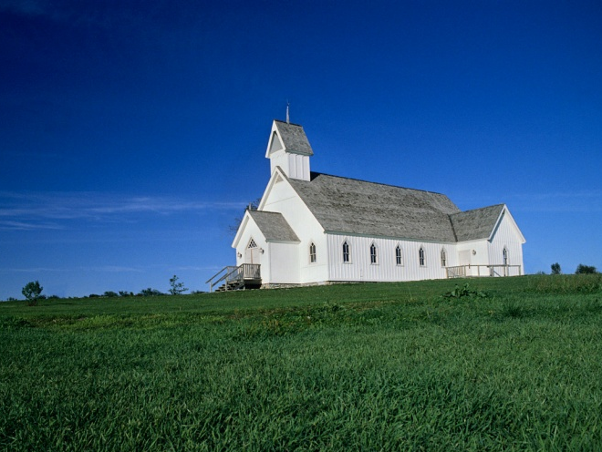
The Trustee’s Job
2016 Discipline 2525-2552
Keeper of God’s House
The agent of physical resources and legal matters
Receive direction and be responsible for the incorporation of the church (David will discuss this next session with Finance)
Oversee, maintain, supervise all local church property cooperating with Pastor
Maintain adequate insurance
Report annually to charge conference
Receive and administer all inherited gifts
Notes:
The Council Says what ministries can take place, the trustees provide the facilities and equipment for effective ministry- example comporary worship-sound lighting, Hearing impaired

Slide 3
The Trustee’s Job
Continued
Ensure updating of property, etc
Work with pastor on use of property-Pastor has full control of pulpit
Submit operating budget request to Finance
Be accessible and accountable to charge conference and church council
Notes:
The Council says what ministries can take place. The trustees provide the facilities and equipment for effective ministry – example: contemporary worship-sound, lighting, hearing impaired, etc.

Slide 4
The Trustee Chair’s Job
(Can not be the Pastor)
Guide the work of the Board of Trustees
Provide advice and direction
Maintain close communication with the pastor
Serve on the church council

Slide 5
To whom do the
Trustees (Relate)
Charge Conference – serves as primary governing body of the church-Legal Arm of the church
Church Council - plans, coordinates, implements church program for ministry
Staff-Parish Relations Committee - responsible for all appointed and hired staff building and equipment needs
Finance Committee - raises, manages, distributes funds

Slide 6
Board of Trustees Members
Shall be of legal age-negotiates and executes contracts
Shall be no fewer than three or more than nine members
At least two-thirds must be professing members of The United Methodist Church of which one third shall be lay women and one third be lay men of the local Church.
Chairperson must be a member of local church
No pastor is a voting member unless elected as a member.

Slide 7
Trustee Election and Term
Three-year term
Board is divided into three classes and a new class is elected each year
Charge conference fills any vacancies that occur in any class
Board elects their own officers at the first meeting each year

Slide 8
Getting Organized (2530)
First meeting must be held within 30 days of the beginning of the year
  Elect chairperson, vice-chairperson, secretary, and other officers as needed; chairperson and vice-chairperson shall not be of the same class (2532)
  Develop a schedule of meetings and tasks to be considered for the entire year and long-range
  Tour the facility and orient new members
Trustees should meet at least quarterly, but required to meet annually

Slide 9
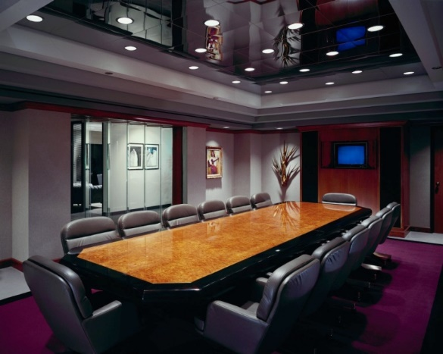
Getting Organized
Continued
A majority of the trustees constitutes a quorum-only group in church that this is required-legal work responsibility
Divide trustees into subgroups assigned to a specific area (e.g. buildings, grounds, bequests, equipment)
Chairperson or pastor calls the meetings (2532)

Slide 10
BOT Powers & Limitations (2533)
Supervision, oversight, and care of all real property and equipment
Property and Casualty Insurance Coverage is in existence and is adequate
Property use with the pastor’s approval
Annual inspection of parsonage with SPRC
Receive and administer all bequest (inheritance) for the local church (Delegate this responsibility-Memorial, Finance, etc)
Incorporation
Accessibility Audit/Inspection

Slide 11
Building Use Policy
(Available in Word on the Web site)
Every group outside of the church must sign one
  You will have to list those meeting in your church on the charge conference forms this year
  You will have to indicate if you have an agreement or not
Certificates of Insurance
  contractors and outside vendors
  church as an additional insured
Usage policy for groups
  internal & external
  groups sign usage agreement
Limits of insurance; certificates updated annually
Segregating groups to specific areas
Opening and closing facilities with groups
Report to Charge Conference (NEW this year)

Slide 12
Property and Casualty Insurance
Must meet standards as directed by GCFA 2533 (2)
Conference BOT established standards-equal to or higher than GCFA - the Conference Plan meets all standards
If NOT in the Conference plan:
  Provide a Declaration Page to Charge Conference to prove existence of the policy
  List the Annual Conference as an additional insured
  Provide Bonding at minimum for Treasurer
  Best option is a position bond

Slide 13
BOT Property Insured Values
BOT must inspect policy to be sure all property is listed
  Pipe organs, pianos, handbells
  Stain Glass
  Art and Historic items
  Vehicles (owned, leased and volunteer)
  All contents
  IT hardware and Cyber coverage
BOT must insure that adequate levels of property coverage exist
  Replacement Cost
  Our TPA A J Gallagher will be doing an intense review of values so that all levels of coverage are adequate
Workers Compensation in conjunction SPRC/Finance

Slide 14
Risk Management
When was the last time you inspected your property?
What should you look for?
Who should you report to?
Who can help us?

Slide 15
Property Risk Management Process
SIX Step Process ---
  Identify The Hazards
  Assess The Hazards
  Mgt. Commitment – to Eliminate the RISK
  Implement Controls – Engineering - Administrative
  Monitor Results (Inspections, Claim History, etc.)
  Repeat the Process

Slide 16
Why We Need Self Inspections?
Leading cause of loss for churches is facility deficiencies
  Poor walking surfaces → slips/trips/falls
  Roof leaks → water damage and mold
  No surge suppression → electrical damage
  No building usage policy → suit from 3rd party who is injured in church building
Facility management - the cornerstone of safety and risk management efforts for religious organizations

Slide 17
What To Consider?
Building Entrance/Travel Paths
Parking Lots
Sidewalks
Playgrounds

Slide 18
What To Consider?
Building Utilities
  Kitchen and Cooking
Fire Protection
Building Security
  Weather / Acts of Nature
  Cemetery

Slide 19
Informal Self Assessment vs. Formal Documented Self Inspections
Informal Assessment – typically no one takes ownership, it’s infrequent, no format to follow, not very helpful when a claim occurs with defense, etc
Formal Documented Self-inspection - identifies physical deficiencies on a regular scheduled basis.
  Completed at least quarterly or more often if necessary
  Documented (form) is used to guide the process
  Date, time, conditions are noted and by whom
  Work orders can be generated from the report
  Communicate the results

Slide 20
Auto Risk Management
Our Driver’s - “BEST ASSET OR WORST LIABILITY”
Driver Selection – why – because 90% of accidents are caused by Human Behavior.
Start with Pre-selected Drivers list
MVR (motor vehicle record) review of all drivers.
MVR “Written” criteria based on frequency and severity of violations. Do you have one?
Age limit (25 to 70)
Church Vehicle vs Personal Vehicles [primary – secondary]
Pre-trip vehicle inspection?
Driver Training - Training and More Training. (DDC) VAN’s – Buses, etc.
Preventative maintenance program for vehicles - Records
Key Control – who, where, when, for what???
Notes:
20

Slide 21

QUESTIONS

Slide 22
Thank You for all you have done in the past, for all you will do in the future and all that you are doing today in the Administry of your local church
On a final note:

Slide 23
Let us help you!
Call us-so we won’t be lonesome like the Maytag repair man.
Web sites
  http://www.mississippi-umc.org
  http://www.gcfa.org/gcfa/legal-manual
Conference Treasurer/CBO Staff
  David Stotts Treasurer & CBO
  Bernice Grant Administry Coordinator
  Laura Rollins Administry Accountant Receipts
  Tamara Easter Young Administry Accountant Disbursements
  Ed Jones Internal Auditor
  Jackie McGough Benefits Coordinator
  Andy Ray Retiree Benefits Liaison
  Mitchell Hedgepeth Associate Director-Trustees Matters
Conference Office Phone Numbers
601-354-0515 or 866-647-7486

Slide 24
