Slide 1
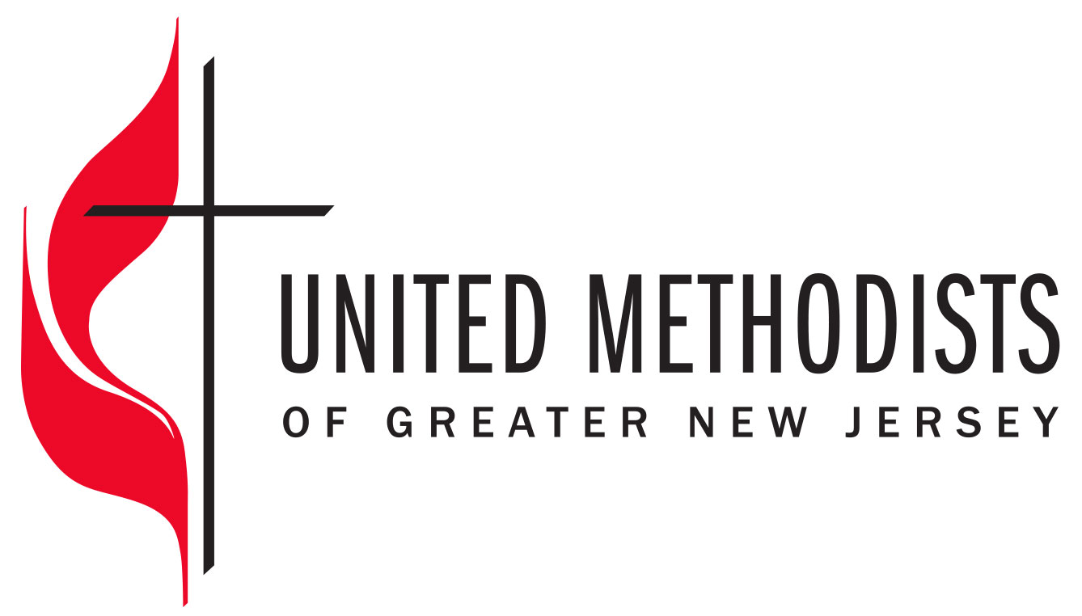
NAACT 2023
Investment Committee & Reserves

Slide 3
Investment Committee
Members:
Sub-Committee of CFA, currently compromised of:
CFA Chair
Two CFA Members
Two non-CFA members with strong investment management background (lay members of local churches)
UM Stewardship Foundation Chair
Conference CFO/Treasurer (myself)
Recently added as “guest members” to hear Wespath presentation and share strategies, representatives from:
Centenary Fund representative
Additional members of the UMF with strong investment management background
Selection of members through CFA
Getting “qualified” members was and will continue to be a struggle
Losing two members due to disaffiliations

Slide 4
Investment Committee
Denomination Parameters:
The Greater New Jersey Annual Conference of the United Methodist Church will carry its responsibility for investing within the policy of the denomination as stated in The Book of Discipline, with special attention to paragraphs:
613.5 - policies governing investments
717 - sustainable & socially responsible investments
1504.14 - fiduciary duties
Fiduciary Responsibility:
Duty of care - To invest with the care that a prudent person would use regarding investment of his/her own funds. Fulfilling this duty includes attention to appropriate risk levels, diversification, and performance of investments.
Duty of loyalty - To manage funds with the interest of the Greater New Jersey Annual Conference of the United Methodist Church paramount and without factoring in personal considerations, in other words, no conflict of interest on the part of staff, officers, or investment committee members

Slide 5
Investment Committee
Duties & Responsibilities:
Remain in compliance with church law according to the current The Book of Discipline of the United Methodist Church and attempt to perpetuate our church values as interpreted in the current The Book of Resolutions of the United Methodist Church.
Develop the Investment Policy of the Greater New Jersey Annual Conference to include the establishment of investment risk and return objectives, asset allocation policy, the selection of investment managers and the design of the investment manager structure, securities guidelines for the investment managers, performance monitoring and reporting procedures and protocols.
Review the investment performance of the Portfolio and the investment managers on at least a semi-annual basis, including compliance with the asset allocation policies of the portfolio.
Report investment performance to CF&A on a semiannual basis.
Rebalance the Portfolio as directed by the Investment Policy Statement.
Monitor and review the overall costs of operating the Portfolio on an annual basis.
Review and recommend the annual spending rate for the Portfolio.
Recommend Investment Policy modifications or enhancements as needed.
Maintain compliance with applicable fiduciary laws and regulations.

Slide 6
Investment Committee
Governance:
All actions and minutes of the Investment Committee are reported to CFA
Investment Committee is authorized to delegate certain responsibilities to professional experts in various fields. These fields include, but are not limited to:
Investment Management Consultant:
establishing investment policy, objectives, and guidelines.
selecting investment managers.
the periodic review of investment managers.
measuring and evaluating investment performance.
make certain investments align with guidelines outline in the Book of Discipline
and other tasks as deemed appropriate.
Investment Manager. The investment manager has discretion within policy guidelines to purchase, sell, or hold the specific securities that will be used to meet the Fund’s investment objectives.
The CFO’s team will perform regular accounting of all assets owned, purchased, or sold, as well as movement of assets within the Fund accounts.

Slide 7
Reserves (GNJ’s Designated Funds)
At the October 2021 Special Charge Conference Session, GNJ approved the “Designated Fund Legislation”
Twelve Funds, each with a specific purpose:
Operating Reserve Fund – each year, CFA will establish a surplus needed to manage cashflow during the year. It shall be set at 10% of the consolidated budget approved by the annual conference.
Harvest Mission Fund – supports leadership and congregational development and mission engagement.
Strategic Disciple Making Fund – funds new faith communities (congregations, second sites, new worship services).
St. John’s Native American Historic Preservation Fund – fund the preservation of the St. John’s building as a historical site and the Native American burial ground and costs to transfer property to the tribe when applicable.
Next Gen Ministries Fund– fund ministries of young people between 12 and 30 that may include camping, Ignite, youth ministries, campus ministries and other ministries to form and shape young people’s commitment to and faith in Jesus Christ.

Slide 8
Reserves (GNJ’s Designated Funds)
Twelve Funds, each with a specific purpose:
Pension and Benefits Operational Fund – fund the administrative work of the Conference Board of Pensions and Health Benefits.
Retiree Health Fund – fund payments for retiree health care and secure retire health care.
Property Operational Fund - funds maintenance and equipment purchases for the GNJ Mission and Resource Center, closed church property and cemeteries owned by the annual conference.
Property Redevelopment Fund – funds redeveloping GNJ congregational property. Our first priority is for congregations in low-income communities to be able to increase income for ministry and mission in low-income communities.
Superintendent Housing Fund – funds the purchase and maintenance of superintendent parsonages or provides a housing allowance for one or more district superintendents.
Episcopal Residence Fund – funds the purchase and maintenance of the bishop’s residence or provides housing allowance.
Episcopal Office Fund – funds discretionary fund and scholarships to the bishop’s clergy convocation.

Slide 9
Reserves (GNJ’s Designated Funds)
Policy & Procedures:
Each fund has a target balance where a 5% draw would cover the estimated costs associated with each fund’s purpose.
Purpose – draw from these funds to cover the costs reduces the burden on Shared Ministry (Apportionments) to cover
The income (draw) is included in the annual operating budget
Building the funds:
Distribution of the Investable Property Proceeds (proceeds above and beyond the operating budgeted amount) to the various funds will follow the plan established by CFA (i.e., CFA sets the % allocation of property proceeds each year)
Once target levels are achieved (“steady state”), legislation calls for ongoing allocation as follows (ETA is 2025):
Harvest Mission Fund – 50%
Strategic Disciple Making Fund – 20%
Retiree Health Care – 15%
Property Redevelopment Fund – 15%

Slide 10
Reserves (GNJ’s Designated Funds)
Policy & Procedures:
Fund Committee:
At least three persons from the CFA investment committee
CFO/Treasurer
One person from each of the following agencies:
Board of Trustees
Board of Pensions and Health Benefits
Connectional Table
Cabinet
The Fund Committee is to report at least twice a year to each of the above agencies the state of each GNJ designated fund including balances and disbursements made toward approved uses (as defined in this policy), progress towards the fund goal amount, and recommend to the Board of Trustees and CFA policy updates as needed

Slide 11
West Ohio Conference

Slide 12
West Ohio Corporate Structure
WOC AC
(1/1/2024)
BOP
UMFWO
District 1
Districts 2…
…District 6
$96 MM
7/31/2023
Local Church Endowments (nascent)

Slide 13
West Ohio’s Foundation
Conference is sole member
Conference provides accounting, reporting & controls
Only recently began functioning as a classic Foundation
Was an apportioned entity until 2020
Conference and all but two districts have investments with the foundation at local church rates (50 bps)
BOP has its investments with the foundation at 30 bps
UMFWO will partially cover overhead in 2024 (occupancy, IT and direct financial administration)
2025 goal is to cover all overhead

Slide 14
Investment Manager Review Process
2022 process; first since 2012- related to strategic repositioning of the UMFWO
Incumbents were Morgan Stanley and Huntington
Board was divided on need for a sole investment manager or an investment consultant
Foundation hired Kidderbrook & Associates to assist with the process and to facilitate a decision
Cost was about $60,000 or 6 basis points
Six months from start to decision with manager implantation to follow

Slide 15
Kidderbrook Process-stage 1-Education
Governance Review
Defining OCIO (Outsourced Chief Investment Officer)
OCIO Marketplace Evolution
Provider Types & Solutions
Fees
Next steps - calendar

Slide 16
Kidderbrook – Stage 2
UMFWO determines its criteria
Based on criteria, Kidderbrook identified 10-15 pre-cleared firms and develops an executive summary of each
UMFWO identifies 5-7 from which to seek RFPs
Kidderbrook summarized RFP responses
UMFWO selected 3 finalists to present
Kidderbrook organizes and facilitates in-person finalist presentations and board decision
Kidderbrook follows up with questions and negotiates fees

Slide 17
Investment Committee/Reserves

Slide 18
Investment Committee Purpose Statement
The Investment Committee of The Florida Annual Conference of The United Methodist Church is committed to establishing and managing funds for the immediate and future needs of the Conference's operations and programs. Moreover, the Investment Committee is dedicated to acting prudently and diligently as a responsible steward for the financial resources of the Conference.

Slide 19
Investment Committee Objective
The objective of the Conference Investment Committee and Policy is to (a) provide reasonable investment returns, (b) invest assets in a manner consistent with preventing significant loss of capital.

Slide 20
Investment Committee Guidelines
Determine an appropriate risk level for the Investment Assets
Seek to ensure prudent diversification of the Investment Assets
Define the responsibilities of the Committee for managing the investment process
Establish strategic asset allocation guidelines for asset classes and investment styles deemed suitable for the Investment Assets

Slide 21
Investment Committee Goals
Provide a reasonable level of total return given the Conference structure and desired rate of return and asset allocation.
Avoid significant underperformance of the desired rate of return, or loss of invested capital.
Minimize the Conference's exposure to fluctuating investment returns.

Slide 22
Investment Philosophy
Focus upon total return (combined return from capital appreciation plus dividend and interest income).
Make reasonable efforts to preserve and appreciate capital, understanding that losses may occur in individual securities.
Make reasonable efforts to control risk and evaluate regularly to ensure the risk assumed is commensurate with the given investment style and objectives.

Slide 23
Investment Philosophy (cont.)
Understand that, in order to achieve its objectives for the Investment Assets, the Portfolios will experience volatility of returns and fluctuations of market value.
Recognize that broad diversification of the Investment Assets among various asset classes should help mitigate the magnitude of a loss in any single year.
Prudently appreciate capital to provide additional funding for the Conference's future operation and support.

Slide 24
Investment Committee Responsibilities
Oversee the management of the Investment Assets.
Adopt, review and revise, as needed, a statement of investment policies and objectives on an annual basis.
Approve the selection, retention or termination of Investment Consultant(s)
Recommend strategic guidelines for the asset allocation of the Investment Assets, taking into account near term cash needs and liquidity.

Slide 25
Investment Committee Membership
Sub-Committee of Board of Trustees.
Six members – two members of Board of Trustees, two Conference staff, two others.
Three Clergy members, three lay members.

