Slide 1



THE UNITED METHODIST CHURCH
BUDGET

Slide 2
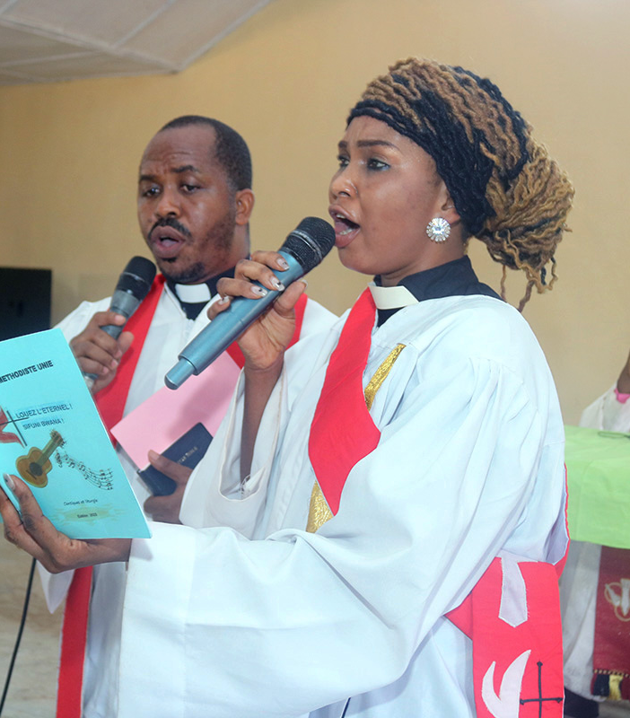
So, What’s In The Budget?
The budget consists of the seven apportioned funds:
Africa University – supports education efforts on the African continent
Black College Fund – supports 11 historically Black church-affiliated schools
Episcopal Fund – supports the episcopal leadership for the general superintendency of the Church
General Administration Fund – supports General Conference, the Judicial Council, Archives and History, and the Church’s finance agency
Interdenominational Cooperation Fund – supports the UMC’s ecumenical work
Ministerial Education Fund – supports United Methodist seminaries and clergy development
World Service Fund – supports the diversity of mission through the work of church agencies and the Connectional Table
WHAT’S IN THE BUDGET
2

Slide 3
Denominational Circumstances
Collections began to decline before the pandemic, and the decline was exacerbated further by the Covid-19 pandemic and social distancing.
The original proposed budget in 2020 was 18% lower than the budget adopted in 2016.
Disaffiliation has also had a significant impact on general church apportionments, as more than 30% of churches in the United States have left.
Operating costs for churches in the United States (building maintenance, utilities, insurance, and pastor salaries) have remained at the same level. Combined with the decrease in collections, a shortfall has occurred for discretionary spending for programs, missions, and apportionments.
Since there is less capacity to give to the general church from a local church level, GCFA is currently recommending a 21.2% reduction in the rate of apportionments.
3

Slide 4
How Much Is The Budget?
$347 Million
The budget currently submitted in the ADCA is $347 million over the next quadrennium.
This represents a 43% reduction from the last budget adopted in 2016.
This is due to a combination of factors: disaffiliation is higher than predicted, along with inflation and other economic factors.
WHAT TO KNOW
This is the budget that will be recommended to General Conference.
The current recommended base rate is 2.595%, compared to the previous base rate of 3.29%.
Because fixed expenses are the same or increasing at the local church level, the decrease in base rate is designed to keep more dollars at the local church level for ministry.
43% Reduction
4

Slide 5
MORE INFORMATION
5.4%
What’s In The Proposed Budget?
4.3%
4.5%
28.6%
8.7%
EDUCATION
EPISCOPAL LEADERSHIP and ECUMENICAL MINISTRIES
GLOBAL MISSIONS
COMMUNICATION
JUSTICE INITIATIVES
DISCIPLESHIP
FINANCE AND ADMINISTRATION
INTRA-CHURCH NEEDS
10%
23.2%
15.4%
WHAT’S IN THE BUDGET?
5

Slide 6
General Administration Fund Allocation Summary
General Administration Fund: Allocations to the General Administration Fund are reduced 27.5%.
  General Conference is budgeted for a 15.4% increase, due to an additional $7 million for a special called General Conference Session in 2026.
  Other reductions include:
    GCFA – almost 60% decrease;
    Archives & History – almost 10% decrease;
    Standing Committee on Central Conference Matters – a 5.6% decrease; and
    Judicial Council – a 43.5% decrease.
See Exhibit A for General Administration Fund Allocations.
6

Slide 7
Connectional Table Allocation Summary
Connectional Table: Allocations to Connectional Table entities are reduced 49%.
The Ministerial Education Fund, Black College Fund, Interpretation Resources, and Africa University are being recommended for a 47% decrease each.
GCFA is also recommending unrestricting funds for the Interdenominational Cooperation Fund, a decrease of 72%. This fund has sufficient reserves, creating capacity to continue in their work.
The Connectional Table, COSROW, GCORR and the Ethnic Plans were prioritized by The Connectional Table in this budget cycle and receive less than 1% decrease.
The Central Conference Theological Education Fund and Contingency Fund are reduced by 50%.
The Young Clergy Initiative is now being phased out.
United Methodist Men is recommended for a 41.8% reduction.
GBCS, GBGM, UMCOM, Discipleship Ministries, and GBHEM – 52.8% reduction.
See Exhibit B for Connectional Table Allocations.
7

Slide 8
Episcopal Fund Considerations
In 2023, the giving rate for the Episcopal Fund was 88.42% for both Jurisdictional & Central Conferences.
GCFA is required to budget for all Episcopal Areas, a total of 71 Bishops, including five additional Bishops in Africa that were approved by the 2016 General Conference.
However, concern lingers over the long-term sustainability of the fund. The Fund will run a deficit in either 2026 or 2027 (depending on the collection rate) if all vacancies are filled.
In the current proposed budget, The Episcopal Fund can support approximately 54 Bishops worldwide through the next quadrennium.
The General Conference decides how many Bishops to elect; GCFA has no authority to decide the number of Bishops.
8

Slide 9
Episcopal Fund Allocations
Episcopal Fund: Allocations to the Episcopal Fund are reduced by just over 15%.
  Allocations to the Episcopal Fund have been increased for the coming quadrennium from the published ADCA through a transitional, one-time line item in the proposed budget in the amount of $15 million.
  This additional $15 million is achieved two ways:
    By increasing the proposed base rate to 2.595%, generating $7.5 million.
    The remaining $7.5 million would be reallocated from general Church agencies to the Episcopal Fund. However, the funding level of the general Church agencies will remain the same, as they are schedule to receive an additional distribution from the Benefit Trust.
See Exhibit A for Episcopal Allocations.
9

Slide 10
Episcopal Fund 4-year average 2025-2028
10

Slide 11
Episcopal Fund Projections 2025-2028
Cost Assumptions:
3% increase on Salaries and Office allowances in 2024. No other changes to Office, Housing or Salary in 2025-2028
Two in-person meetings in 2024, 2026 and 2028. Only 1 in-person meeting in other years.
11

Slide 12
Allocations Details – Exhibit A
12

Slide 13
CT Allocations – Exhibit B
13

Slide 14

Follow GCFA at General Conference!
  GCFA will be continuing our Data-Driven Discernment Campaign during General Conference.
  Visit www.gcfa.org/generalconference for daily updates!
  Follow us!
    Facebook: UMC.GCFA
    YouTube: @UMC_GCFA
    Instagram: @umc_gcfa
    X (Twitter): @UMC_GCFA
14

Slide 15
Questions?
Contact Brandy Bivens – bbivens@gcfa.org
The General Council on Finance and Administration wishes to thank all delegates and members for their commitment to The United Methodist Church and its mission.
QUESTIONS?

Slide 16
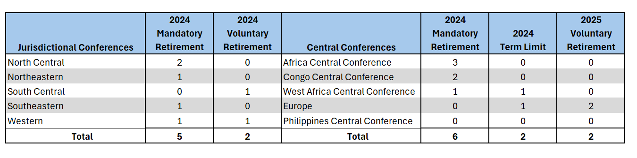
Episcopal Fund
Retirements & Active Bishops Before Elections
16

Slide 17
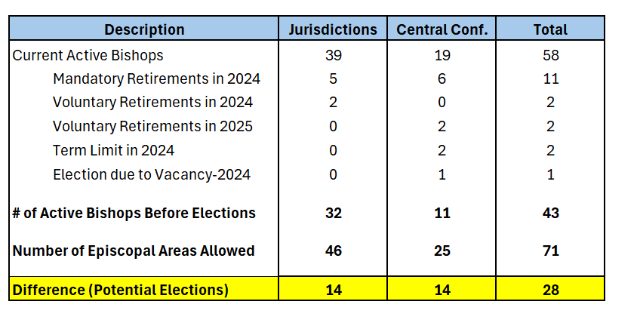
Episcopal Fund
17

